Slide 1
PHY 711 Classical Mechanics and Mathematical Methods
9-9:50 AM MWF Olin 107
Plan for Lecture 19:
Welcome back from fall break
Comments on mid-term exam
Comments on “computational projects”
Mechanics of continuous media (Chapters 4 & 7)

Slide 2
Three events this week --
+ pizza

Slide 3
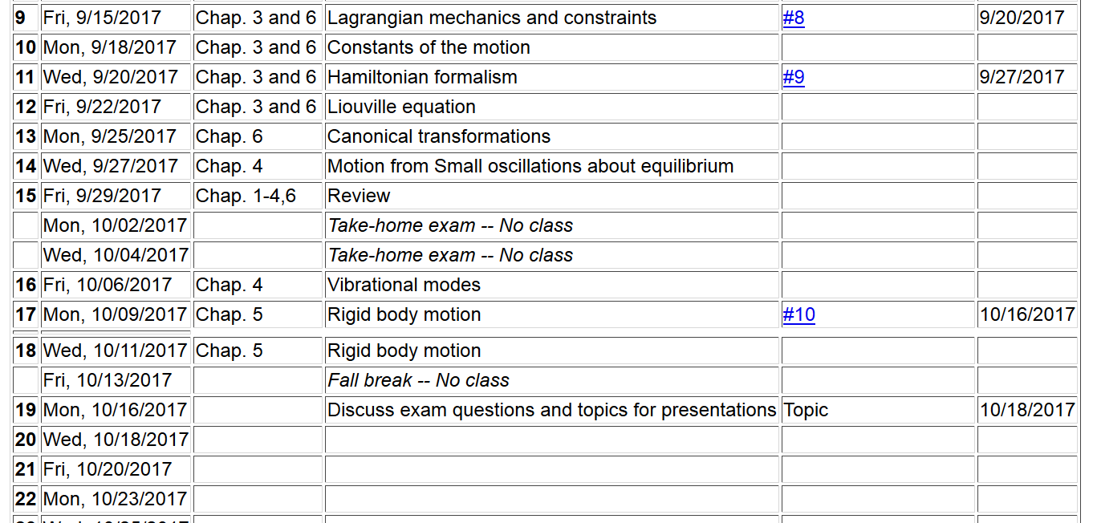

Slide 4
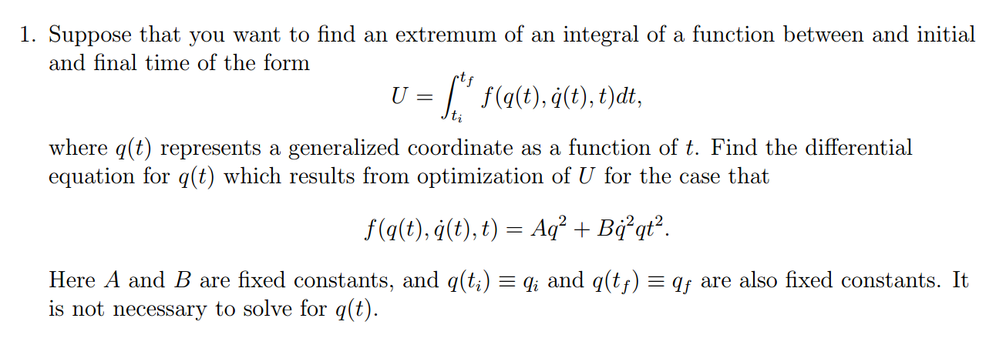

Slide 5
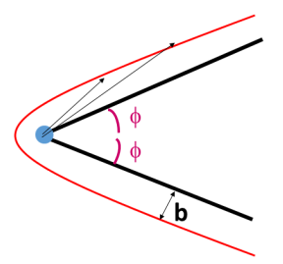
2.
θ

Slide 7
Relationship between center of mass and laboratory frames of reference – for elastic scattering
V_{CM}
V₁
v₁
ψ
θ

Slide 8
Differential cross sections in different reference frames – continued:

Slide 10
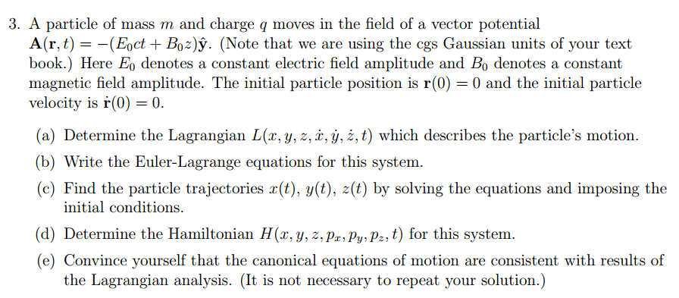

Slide 13
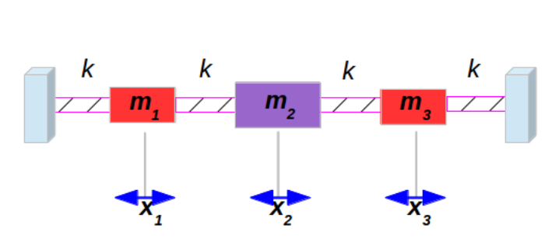
4.

Slide 15
Picking topic for “project”
Prepare ~ 10 minute presentation to teach us (and yourself) something related to classical mechanics
Similar effort to take-home exam
May combine projects for PHY 711 and 741

