Slide 1
PHY 711 Classical Mechanics and Mathematical Methods
9-9:50 AM MWF Olin 107
Plan for Lecture 22:
Read Chapter 7 & Appendices A-D
Generalization of the one dimensional wave equation ➔ various mathematical problems and techniques including:
Sturm-Liouville equations
Orthogonal function expansions
Green’s functions methods

Slide 2
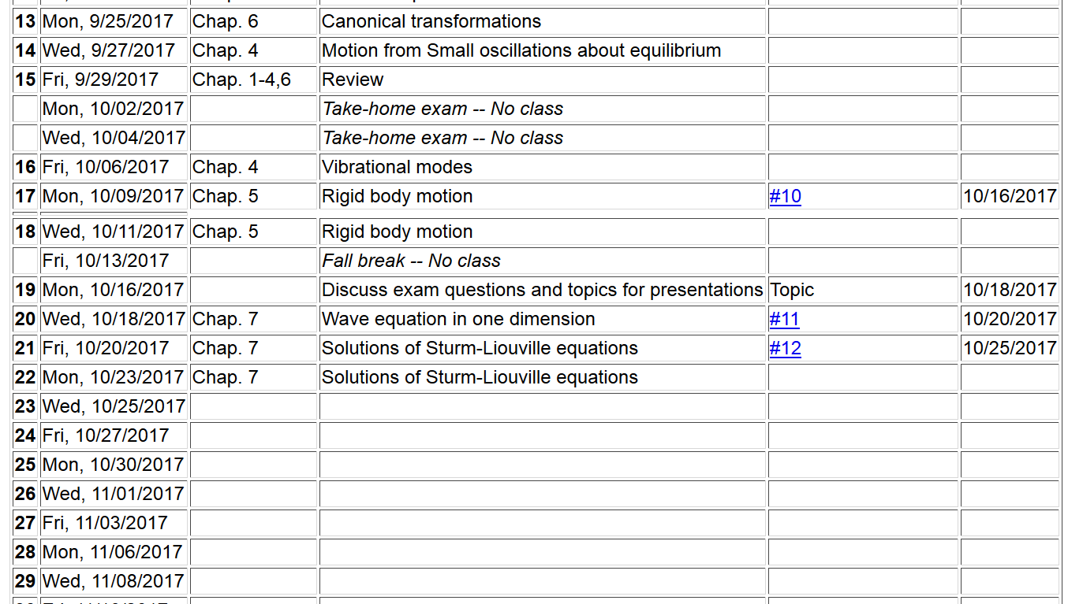

Slide 3
Eigenvalues and eigenfunctions of Sturm-Liouville equations

Slide 4
Variation approximation to lowest eigenvalue
In general, there are several techniques to determine the eigenvalues λ_{n} and eigenfunctions f_{n}(x). When it is not possible to find the ``exact'' functions, there are several powerful approximation techniques. For example, the lowest eigenvalue can be approximated by minimizing the function
where is a variable function which satisfies the
correct boundary values. The ``proof'' of this inequality is
based on the notion that can in principle be expanded
in terms of the (unknown) exact eigenfunctions f_{n}(x):
where the coefficients C_{n} can be
assumed to be real.

Slide 5
Estimation of the lowest eigenvalue – continued:
From the eigenfunction equation, we know that
It follows that:

Slide 6
Rayleigh-Ritz method of estimating the lowest eigenvalue

Slide 7
Rayleigh-Ritz method of estimating the lowest eigenvalue

Slide 8
Comment on “completeness” of set of eigenfunctions
It can be shown that for any reasonable function h(x), defined within the interval a < x <b, we can expand that function as a linear combination of the eigenfunctions f_{n}(x)
These ideas lead to the notion that the set of eigenfunctions f_{n}(x) form a ``complete'' set in the sense of ``spanning'' the space of all functions in the interval
a < x <b, as summarized by the statement:

Slide 9
Green’s function solution methods

Slide 10
Green’s function solution methods
Recall:

Slide 11
Solution to inhomogeneous problem by using Green’s functions
Solution to homogeneous problem

Slide 12
Example Sturm-Liouville problem:

Slide 16
(after some algebra)

Slide 17
General method of constructing Green’s functions using homogeneous solution

