Slide 1
PHY 711 Classical Mechanics and Mathematical Methods
9-9:50 AM MWF Olin 107
Plan for Lecture 24:
Read Chapter 7 & Appendices A-D
Generalization of the one dimensional wave equation ➔ various mathematical problems and techniques including:
Complex variables
Contour integrals

Slide 2
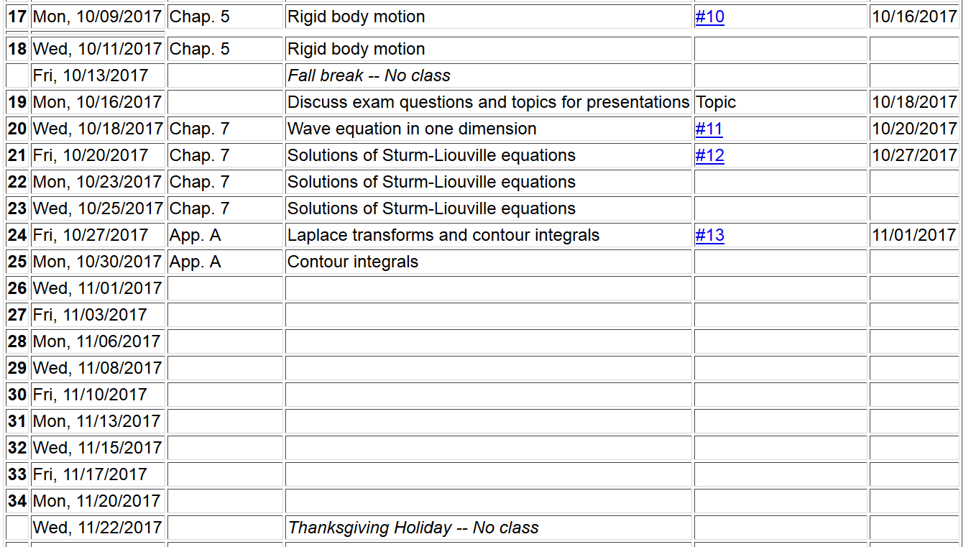

Slide 3
Counter-clockwise

Slide 6
Example:
Im(z)
Re(z)

Slide 7
Another example:
Im(z)
ia
Re(z)

Slide 9
Cauchy integral theorem for analytic function f(z):

Slide 10
Example
Im(z)
Re(z)

Slide 11
Example -- continued
Im(z)
Re(z)

Slide 12
Example -- continued
Im(z’)
x
Re(z’)

Slide 13
Example -- continued
Kramers-Kronig relationships

Slide 14
Comment on evaluating principal parts integrals
y’
x’

Slide 15
b(x’)
-2L
-L
L
2L
x’

Slide 16
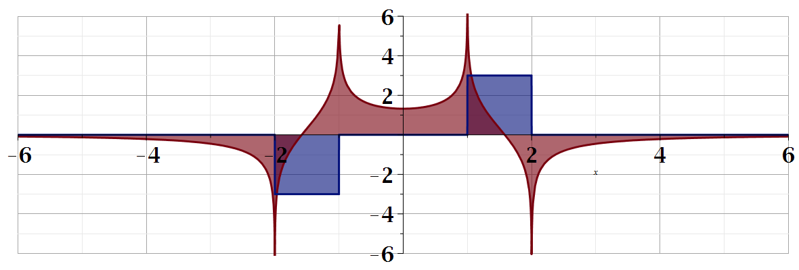
For our example:
b(x)
a(x)

