Slide 1
PHY 711 Classical Mechanics and Mathematical Methods
9-9:50 AM MWF Olin 107
Plan for Lecture 29: Chap. 9 of F&W
Wave equation for sound in linear approximation
Wave equations for sound
Speed of sound
Standing wave solutions

Slide 3
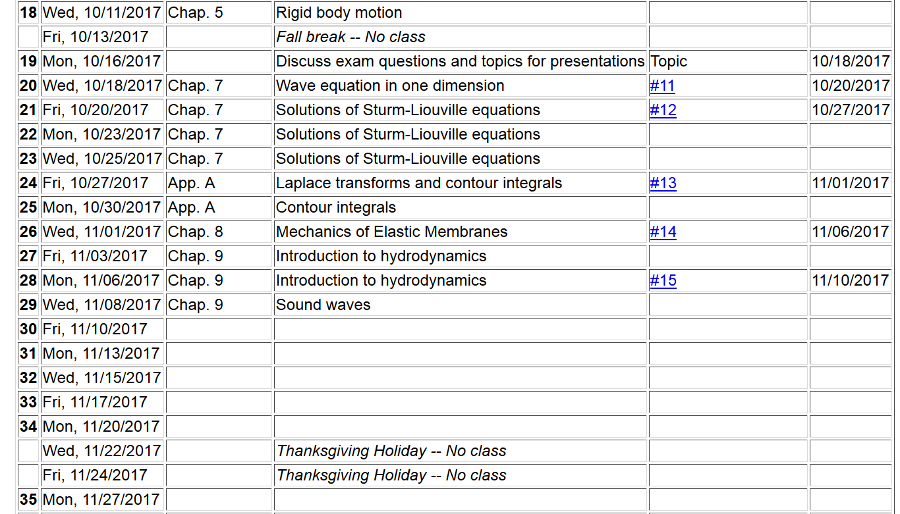

Slide 4
Application of fluid equations to the case of air in equilibrium plus small perturbation

Slide 8
Analysis of wave velocity in an ideal gas:
adiabatic conditions

Slide 14
Time harmonic standing waves in a pipe
a
L

Slide 18
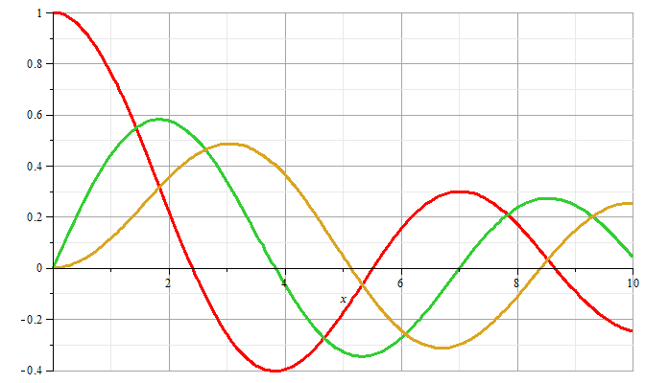
m=0
m=1
m=2

Slide 19
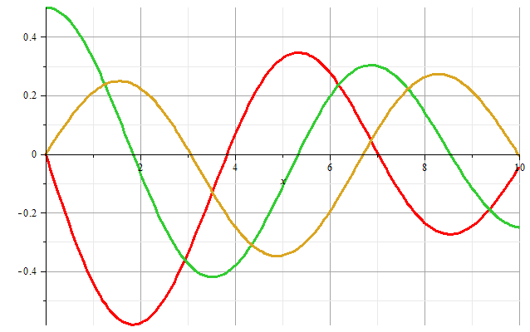
m=1
m=2
m=0
Zeros of derivatives: m=0: 0.00000, 3.83171, 7.01559
m=1: 1.84118, 5.33144, 8.53632
m=2: 3.05424, 6.70613, 9.96947

Slide 20
Boundary condition for z=0, z=L:

Slide 21
Example

Slide 22
Alternate boundary condition for z=0, z=L:

Slide 23
Other solutions to wave equation:

