Slide 1
PHY 741 Quantum Mechanics
12-12:50 PM MWF Olin 103
Plan for Lecture 1:
Welcome & overview
Class structure & announcements
Overview of Mathematical Tools (Chapter 1 of our textbook)
Notation
Vector spaces

Slide 2
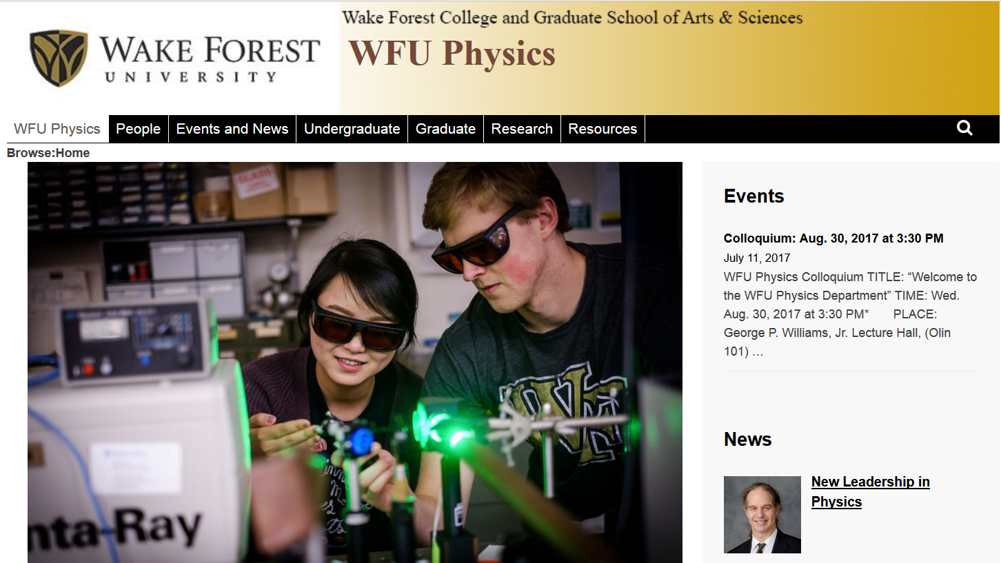
Comment about Physics Colloquia
http://www.physics.wfu.edu

Slide 3
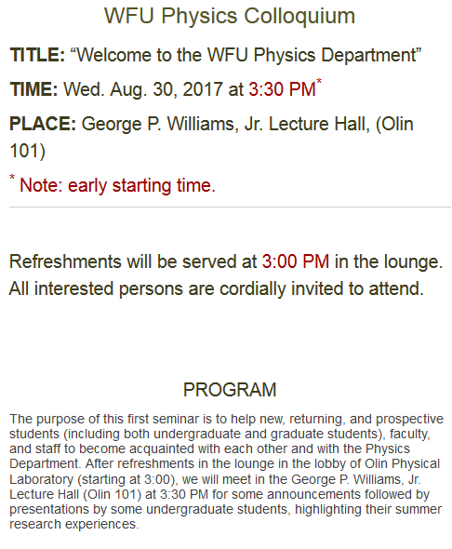

Slide 4
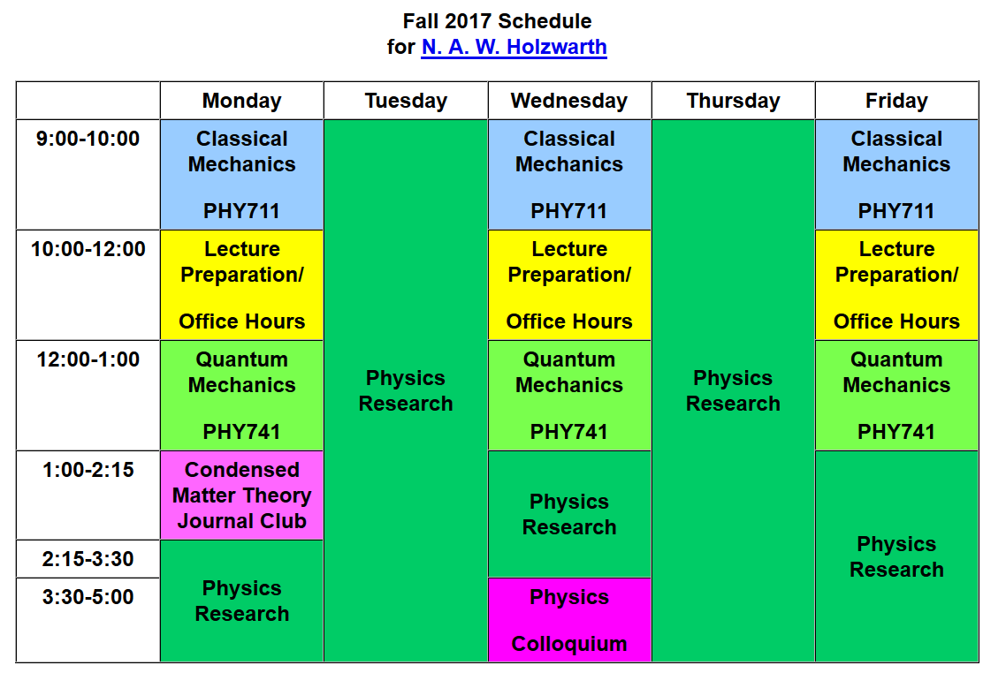
email: natalie@wfu.edu office: Olin 300

Slide 5
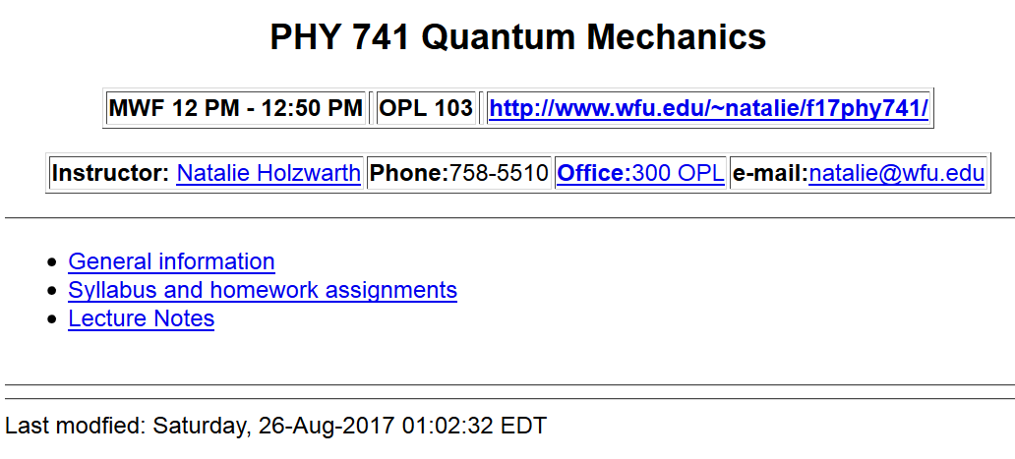
Course webpage: http://www.wfu.edu/~natalie/f17phy741

Slide 6
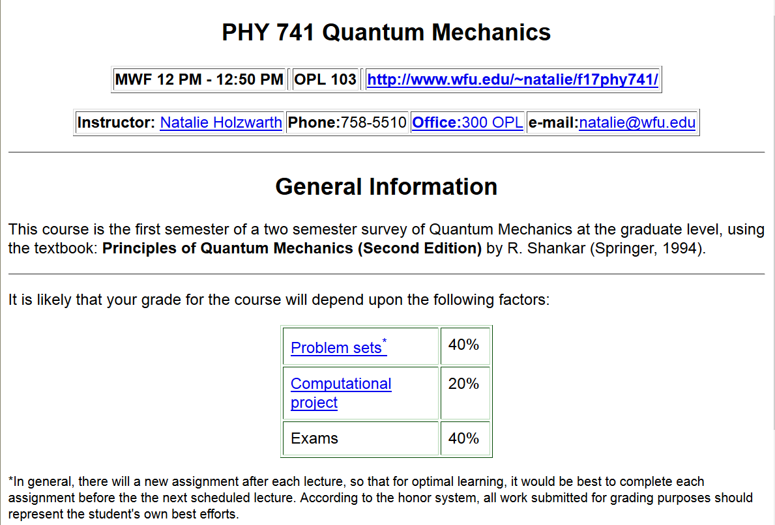
Course webpage:
http://www.wfu.edu/~natalie/f17phy741/info

Slide 7
Course webpage:
http://www.wfu.edu/~natalie/f17phy741/info

Slide 8
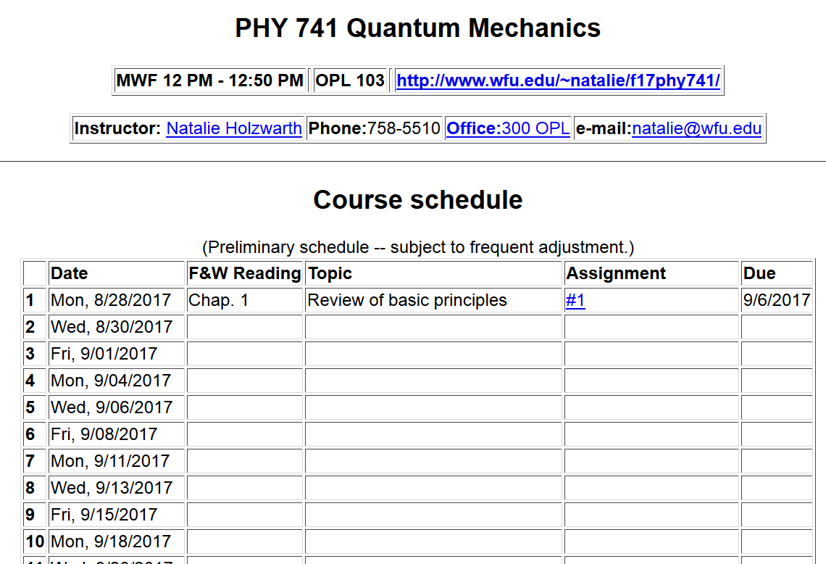
Course webpage: http://www.wfu.edu/~natalie/f17phy741/homework

Slide 10
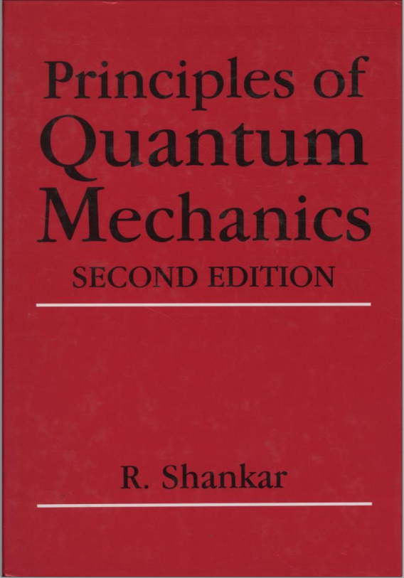
Textbook:
Topics
Mathematical introduction
Review of classical mechanics and emergence of quantum effects
Simple one-dimensional systems in the quantum and classical treatments
The harmonic oscillator
Feynman’s path integrals
Multi-dimensional systems
Angular momentum
The hydrogen atom
Spin
Approximation methods
Time-dependence

Slide 11
Textbook:
Topics -- continued
Time-dependent perturbation theory
Scattering theory
The Dirac equation
More about path integrals

Slide 12
Read Chapter 1 -- (1.1-1.4)
Mathematical tools useful for studying quantum mechanics
Notion of generalized linear vector space
Physics vectors in 3-dimensional space
V
v₁
v₂

Slide 13
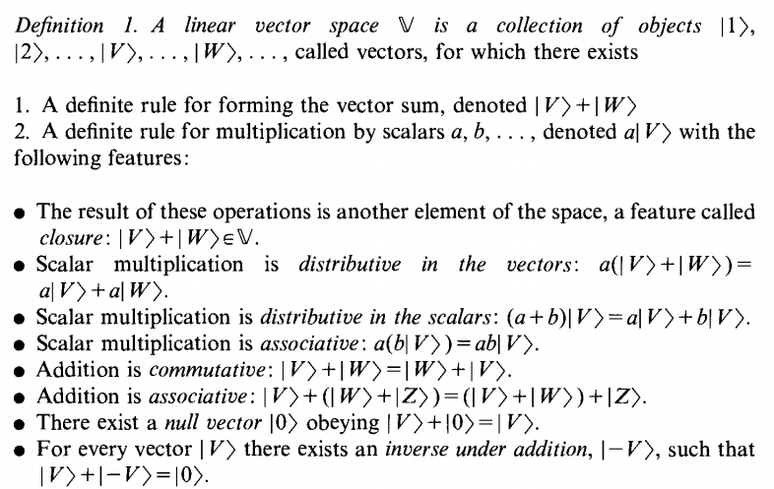
Abstract linear vector space

Slide 15
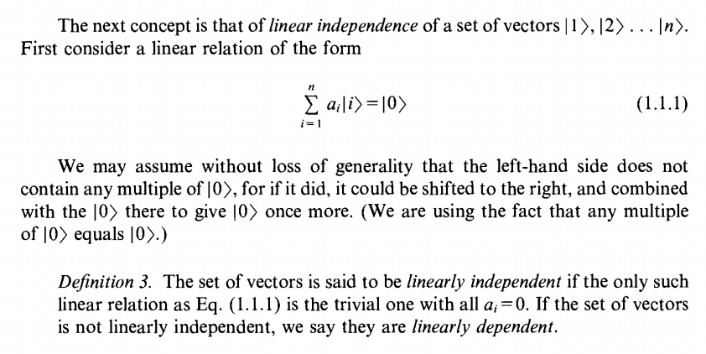
Notion of linear independence

Slide 16
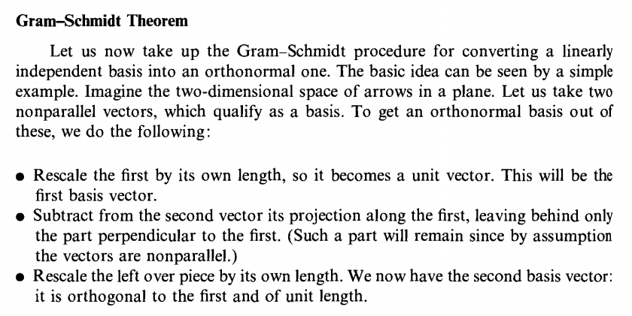
Note that linear independence does not necessarily imply that the vectors are orthogonal.

Slide 17
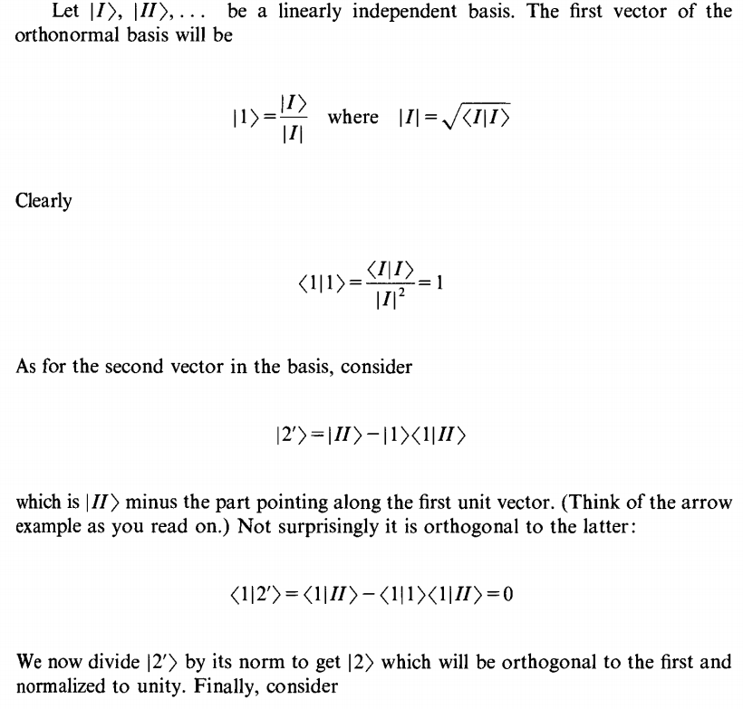

Slide 18
Note that, the orthonormal basis set is not unique

Slide 19
Other methods of finding orthonormal basis from linearly independent vectors.

Slide 20
Other methods of finding orthonormal basis from linearly independent vectors -- continued
It can be shown that:
O is a Hermitian, positive definite matrix
Its eigenvectors can be put into orthonormal form

Slide 21
Other methods of finding orthonormal basis from linearly independent vectors -- continued

