Slide 1
PHY 741 Quantum Mechanics
12-12:50 PM MWF Olin 103
Plan for Lecture 14:
Reading in Shankar: Read Chapter 12
Quantum mechanics of angular momentum
Review of commutation relations
Eigenvalues and eigenvectors of angular momentum
Generalization to spin angular momentum
Finite rotations

Slide 2
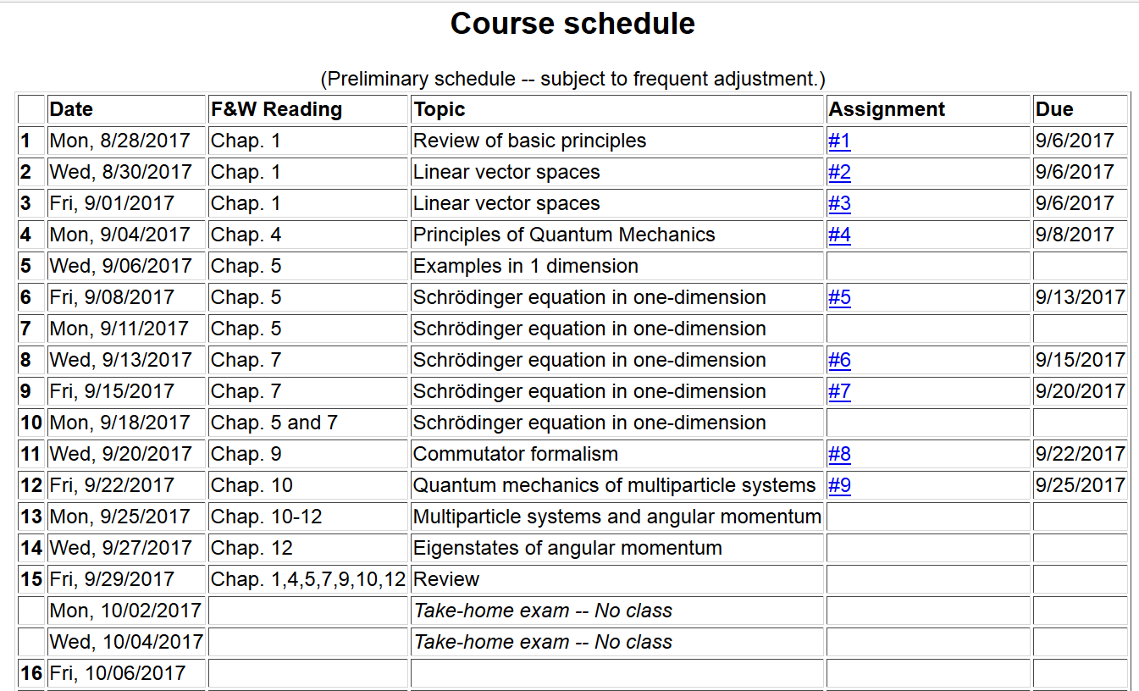

Slide 3
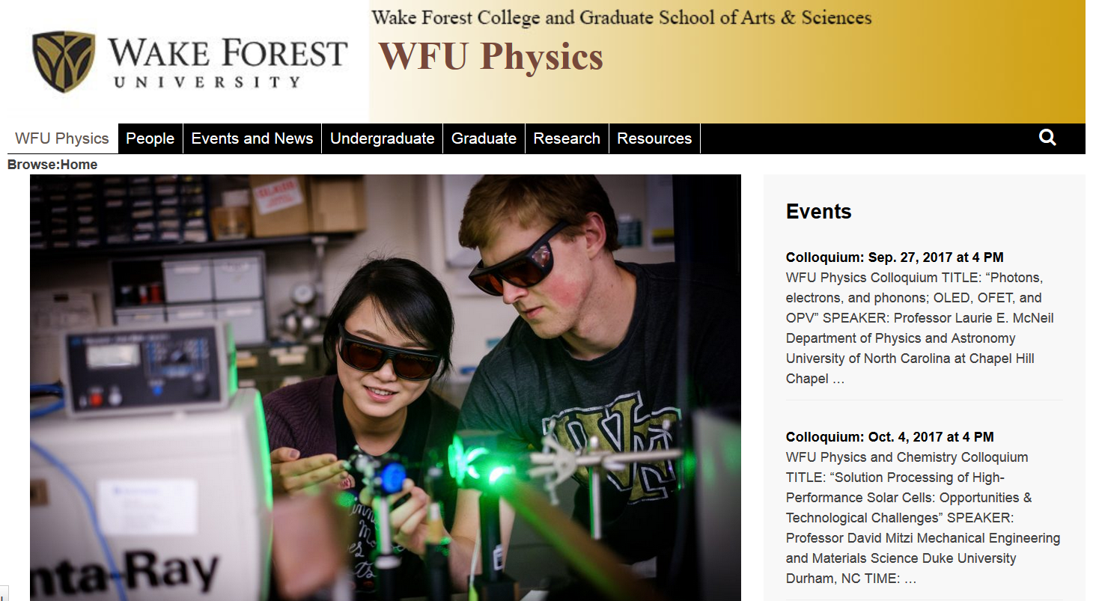

Slide 4
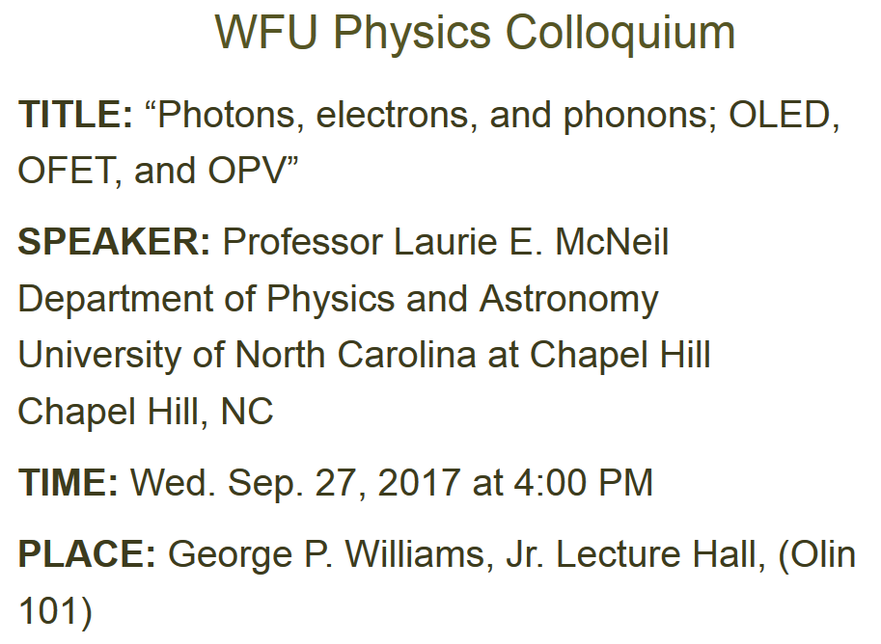

Slide 5
Review of commutation relations for angular momentum

Slide 7
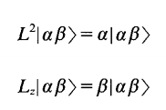
Since L² and L_{z} commute, it is possible to simultaneous eigenvectors
Let:
Note that:
and

Slide 8
Eigenvalues and eigenvectors of L² and L_{z} -- continued

Slide 9
Eigenvalues and eigenvectors of L² and L_{z} -- continued

Slide 10
Eigenvalues and eigenvectors of L² and L_{z} -- continued

Slide 11
Eigenvalues and eigenvectors of J² and J_{z} -- continued

Slide 12
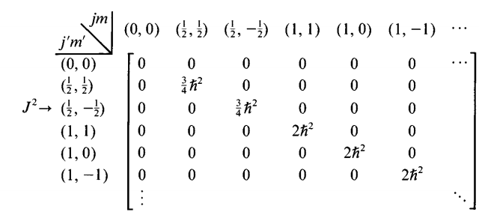
Matrix representations of angular momentum operators:

Slide 13
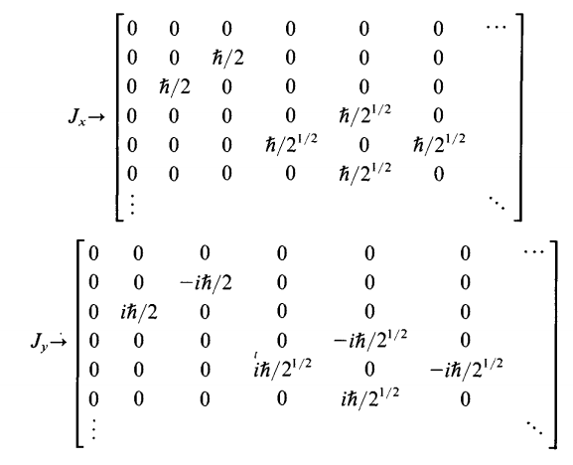
Matrix representations of angular momentum operators:
(block diagonal form)

Slide 14
Note that each j block is typically considered separately

Slide 15
For integer values of j, it is also possible to find special representations of the operators L² and L_{z}

Slide 16
Some spherical harmonic functions:

Slide 17
Relationship of angular momentum to rotations

Slide 18
Rotation transformations
Rotation about the z-axis
Rotation about the y-axis for j=1/2
Rotation about the y-axis for j=1

