Slide 1
PHY 741 Quantum Mechanics
12-12:50 PM MWF Olin 103
Plan for Lecture 15:
Review Chapters 1,3-7,9-12
Some relevant mathematical formalism
Quantum mechanical concepts
One-dimensional quantum systems
Commutators and uncertainty principle
Multiparticle systems
Eigenvalues and eigenvectors of angular momentum

Slide 2
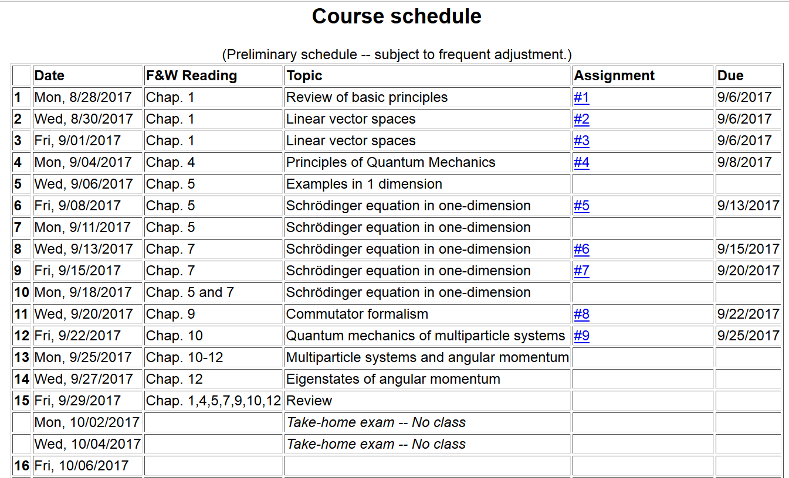
Next class on Oct. 6th

Slide 3
Operators and matrices, especially Hermitian and Unitary

Slide 5
Functions of Operators

Slide 7
Quantum mechanical particles in one dimension

Slide 8
Energy eigenstates of the Schrödingder equation
Example: Particle of mass m confined within an infinite square well:
V(x)
x
-a
a

Slide 9
Summary: Energy eigenvalue spectrum for a particle of mass m confined within an infinite square well of width 2a:
n=1
n=2
n=3
n=4
N(E)

Slide 10
Example: Particle of mass m confined within an finite square well:
V(x)
V₀
V₀
x
-a
a

Slide 11
Solution of transcendental equations:

Slide 12
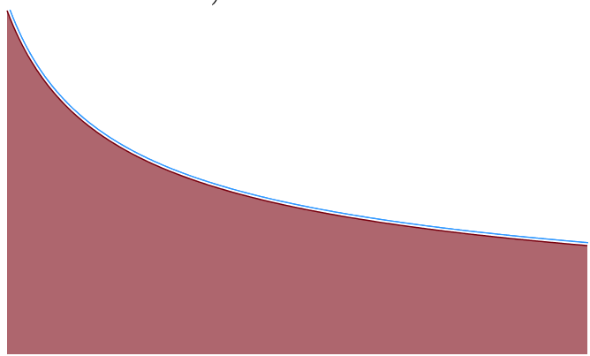
Summary: Energy eigenvalue spectrum for a particle of mass m confined within an finite square well of height V₀ and width 2a:
N(E)
1
Discrete eigenvalues
Continuum eigenvalues

Slide 13
Another example of a one-dimensional system
Consider an electron moving in a one-dimensional model potential (Kronig and Penney, Proc. Roy. Soc. (London) 130, 499 (1931)
a
V₀

Slide 14
Consider a single potential well
Spectrum
E

Slide 15
Consider a periodic potential well system
Spectrum
E
a
V₀

Slide 16
Some details of solution --
Forbidden states
v
f
v
Forbidden states

Slide 17
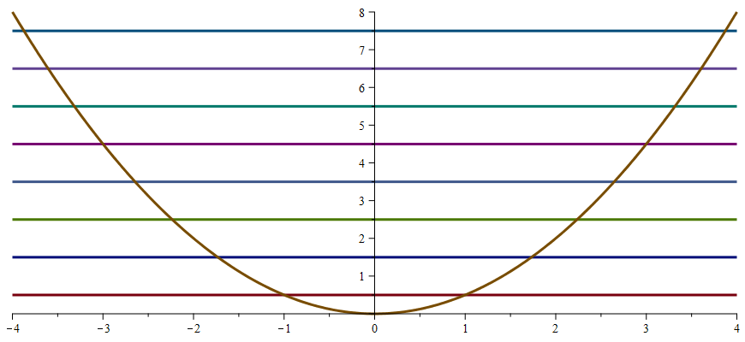
Harmonic oscillator eigenstates
V(x)=1/2 k x²
x
Comes from analysis of systems near equilibrium:

Slide 18
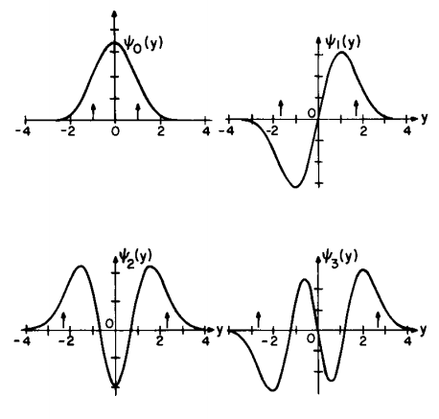
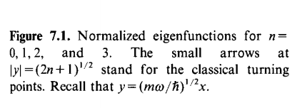
Complete solution including normalization

Slide 19
Energy eigenstates of the Schrödinger equation for one-dimensional systems
V(x)
E
Energy
x
a

Slide 20
One dimensional Schrödinger equation for charged particle in an electrostatic field – continued:
V(x)
E
Energy
x
a

Slide 21
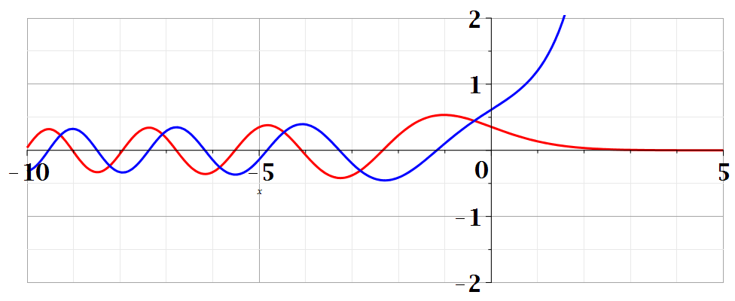
Airy functions
Bi(z)
Ai(z)

Slide 22
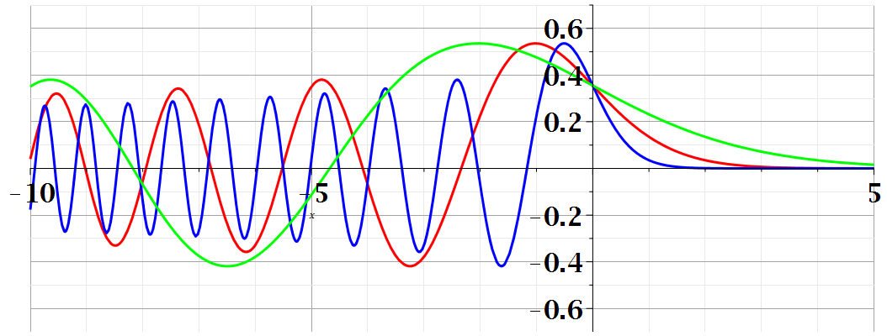
Summary of results

Slide 23
Consider a particle of mass m in the presence of an infinite potential step -- continued:
V(x)
V₀
x
0

Slide 24
Notion of current density for continuum wavefunctions

Slide 25
Commutation relations

Slide 26
Commutator formalism in quantum mechanics

Slide 27
Multi particle systems

Slide 28
Quantum mechanical treatment of multiparticle systems

Slide 29
Quantum mechanical treatment of multiparticle systems –
non-interacting particles
The treatment given on previous slides, assumes that the particles are distinguishable.
A more sophisticated treatment is needed for indistinguishable particles.

Slide 30
Quantum mechanical treatment of multiparticle systems –
non-interacting Fermi particles

Slide 31
Eigenvalues and eigenvectors of angular momentum

Slide 32
Review of commutation relations for angular momentum

Slide 33
Eigenvalues and eigenvectors of J² and J_{z} -- continued

Slide 35
For integer values of j, it is also possible to find spacial representations of the operators L² and L_{z}

Slide 36
Some spherical harmonic functions:

