Slide 1
PHY 741 Quantum Mechanics
12-12:50 PM MWF Olin 103
Plan for Lecture 18:
Shankar, Chapter 13
Approximate eigenstates of multielectron atoms
Hartree-Fock approximation
Density functional approximation

Slide 2
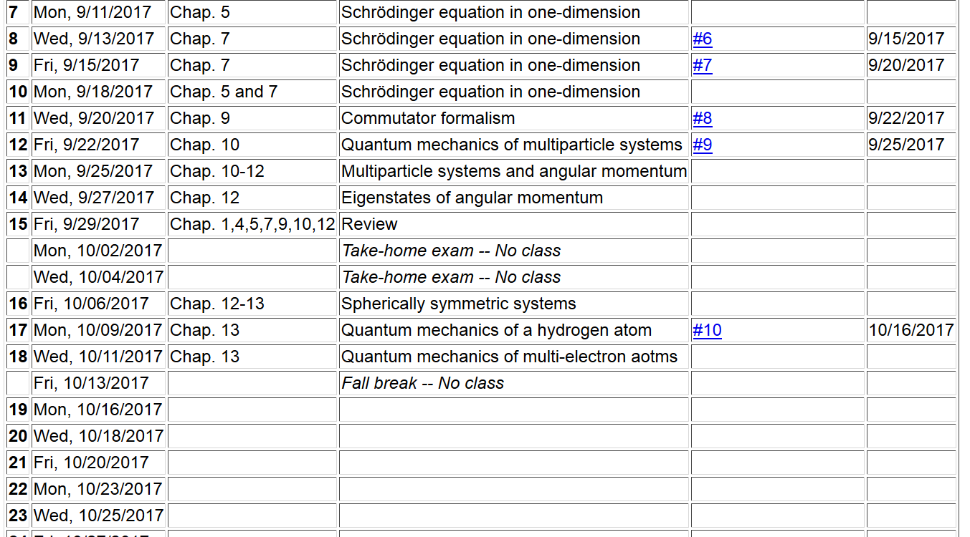

Slide 3
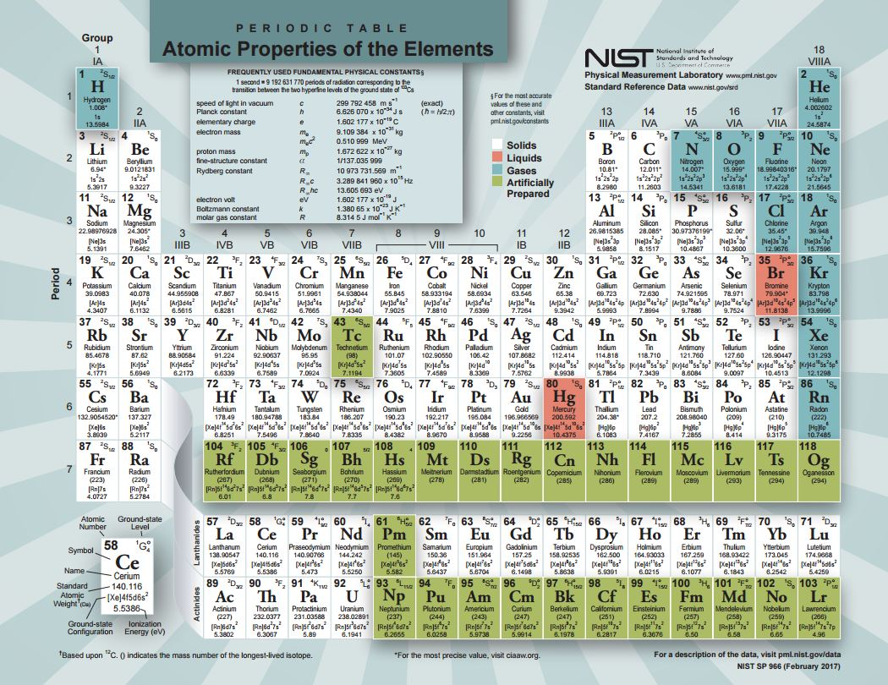

Slide 4
For Hydrogen atom:

Slide 5
Hydrogen atom eigenvalues --
Example of normalized radial functions R_{nl}(r):

Slide 8
Electronic coordinates
Atomic coordinates
Systemmatic approach for studying the
quantum theory of materials
Born-Oppenheimer approximation
Born & Huang, Dynamical Theory of Crystal Lattices, Oxford (1954)

Slide 9
Quantum Theory of materials -- continued
(Often treated classically)
Effective nuclear interaction provided by electrons

Slide 10
Consider electronic Hamiltonian
Electron-electron interaction term prevents exactly separable electron wavefunction

Slide 11
electron spin

Slide 12
Hartree approximation to electronic wavefunction

Slide 13
Variational equation for Hartree approximation -- continued
Note: In principle, the self interaction term should be omitted from V_{ee}(r), but often it is included.

Slide 14
Hartree approximation -- continued
In practice, the equations must be solved self-consistently

Slide 15
Hartree approximation -- continued

Slide 16
Comment about electron-electron interaction in the Hartree approximation

Slide 17
Hartree-Fock approximation to electronic wavefunction

Slide 18
Hartree-Fock approximation to electronic wavefunction
-- continued

Slide 19
Variational equation for Hartree-Fock approximation -- continued
Note that in the Hartree-Fock formalism, there is no spurious electron self-interaction.

Slide 20
Hartree-Fock approximation – continued
As for the Hartree formulation, the Hartree-Fock equations
must be solved iteratively. At convergence, the Hartree-Fock electronic energy can be calculated from the one-electron orbitals and the charge density

Slide 22
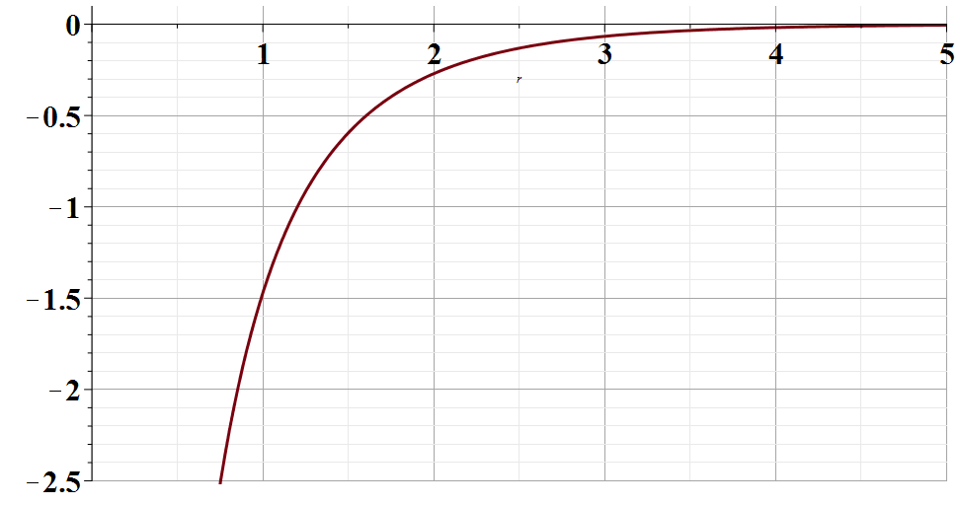
Shell structure of atoms based on Hartree and Hartree-Fock treatments
r

Slide 23
Equation for radial functions

