Slide 1
PHY 741 Quantum Mechanics
12-12:50 AM MWF Olin 103
Plan for Lecture 20:
Preparation for studying multi-electron atoms; notions of spin and “addition” of angular momenta – Chap. 14-15
Internal spin
Spin interactions

Slide 2
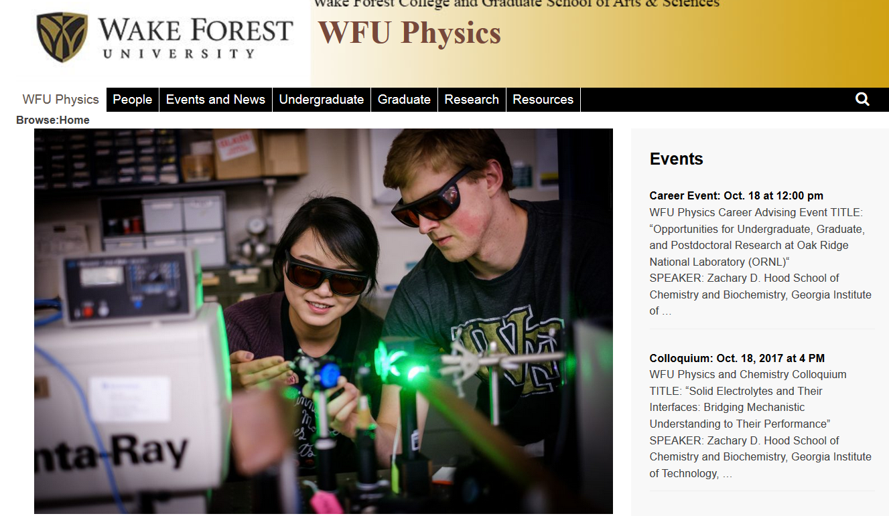

Slide 3
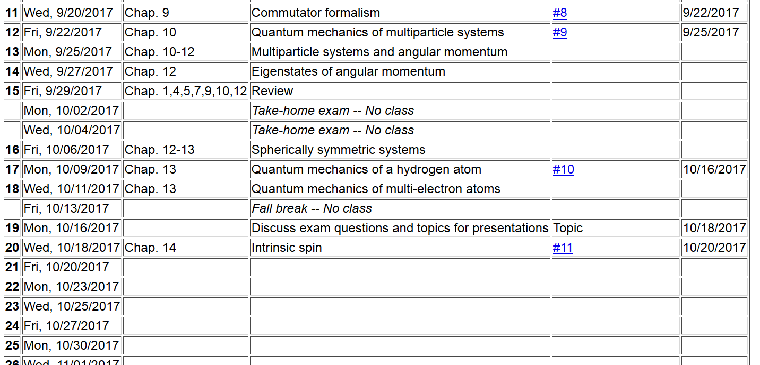

Slide 4
Recall that, we analyzed the general eignstates of angular momentum, especially finding eigenvalues and eigenvectors of J² and J_{z}
➔j=integer or
half integer

Slide 5
Particles can have intrinsic spin angular momentum, related to their magnetic dipole moments

Slide 6
Spin ½ systems –

Slide 7
Rotation of angular momentum

Slide 8
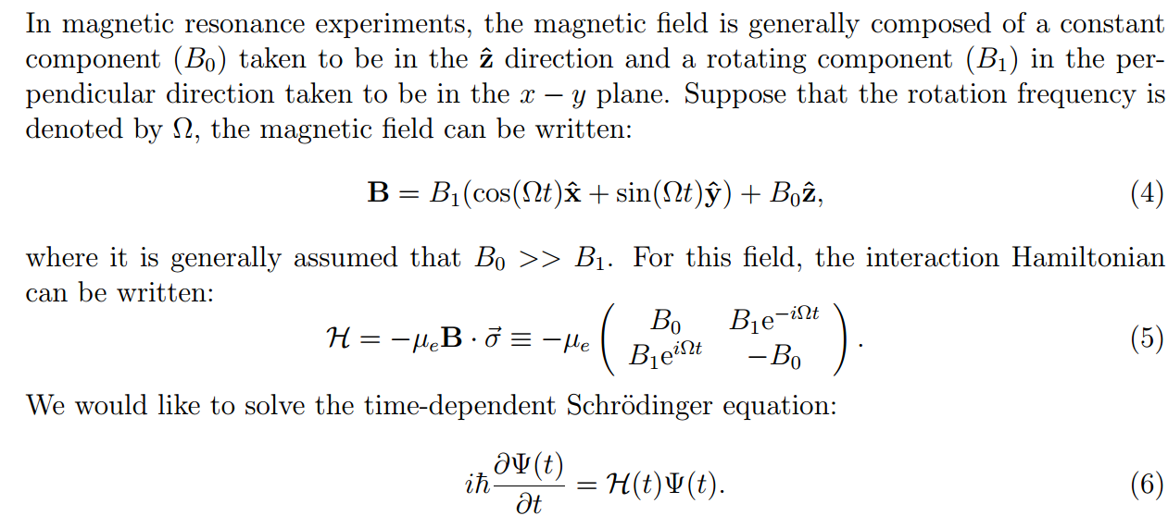
Response of magnetic moment to an applied magnetic field

Slide 11
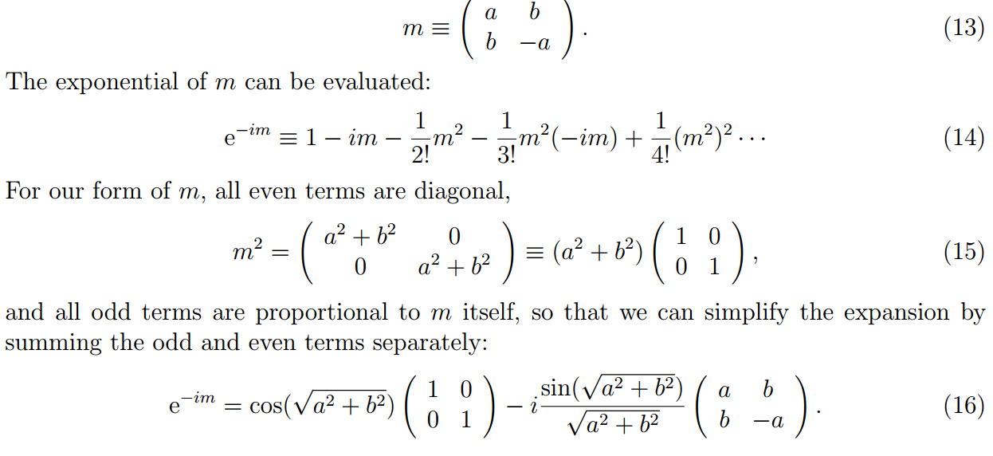
From this result, we obtain the full solution
Some details:

Slide 12
In our case --

Slide 14
Physical effects of intrinsic spin and orbital angular momentum:
Because both are associated with magnetic fields, there is an interaction energy of the form
Hyperfine interaction between nuclear spin and electronic spin and angular momentum:

Slide 15
In the absence of external magnetic fields, the internal magnetic dipoles cause spin interactions within each system, however, the total angular momentum of the system should be conserved.
Finding the total angular momentum – “addition” of angular momentum.

Slide 16
“Addition” of angular momentum

