Slide 1
PHY 741 Quantum Mechanics
12-12:50 AM MWF Olin 103
Plan for Lecture 23:
“Addition” of angular momenta – Chap. 15
States of multi-electron atoms
Atomic term analysis
Rotation of angular momentum eigenstates
Quantum states of a diatomic molecule

Slide 2
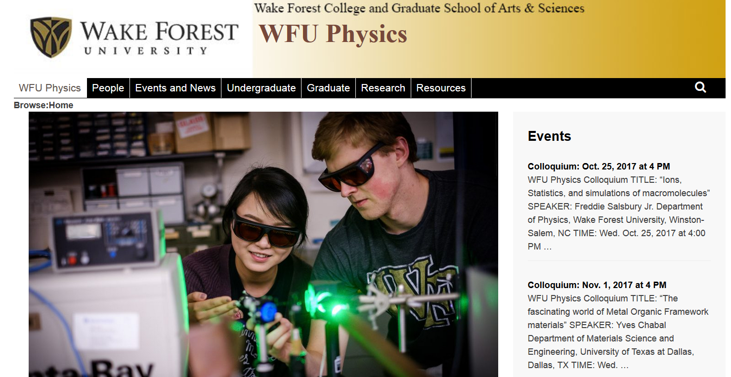

Slide 3
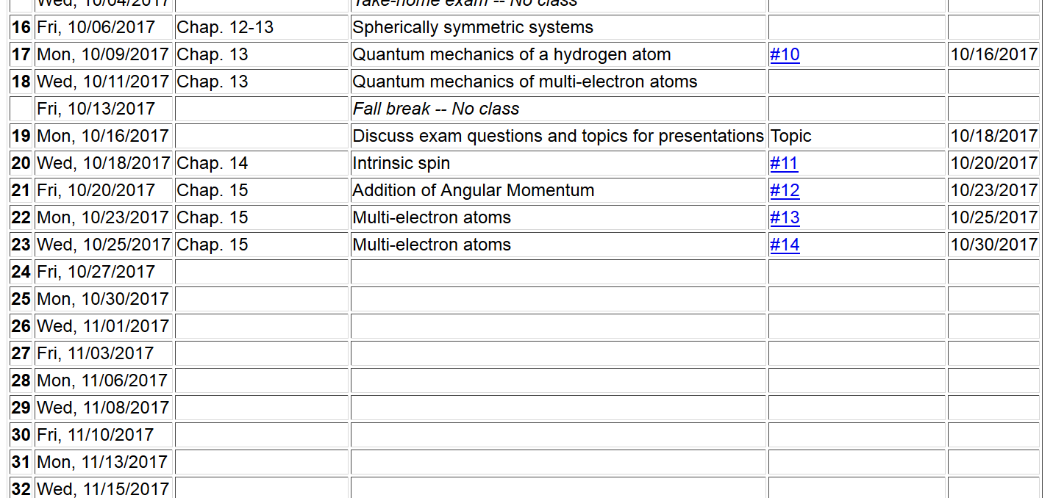

Slide 4
Summary of results for analysis of atomic term energies
single electron terms
electron-electron interaction

Slide 5
In this case, the Hamiltonian does not depend on spin, and the Hamiltonian commutes with total orbital angular momentum

Slide 7
Gaunt Coefficients

Slide 8
Rotation of eigenstate of angular momentum

Slide 10
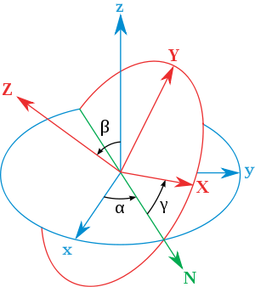
Euler angles --
initial
final
x
y
y
x

Slide 12
Rotation matrix for J=1/2:

Slide 13
Quantum states of H₂⁺
e
r_{B}
r_{A}
R_{AB}

