Slide 1
PHY 741 Quantum Mechanics
12-12:50 AM MWF Olin 103
Plan for Lecture 24:
Quantum states of a diatomic molecule
H₂⁺ with stationary nuclei
H₂⁺ within Born-Oppenheimer approximation
Ref: Linus Pauling and E. Bright Wilson, “Introduction to Quantum Mechanics”, McGraw Hill, 1935,
Max Born and Kun Huang, “Dynamical Theory of Crystal Lattices”, Oxford, 1954

Slide 2
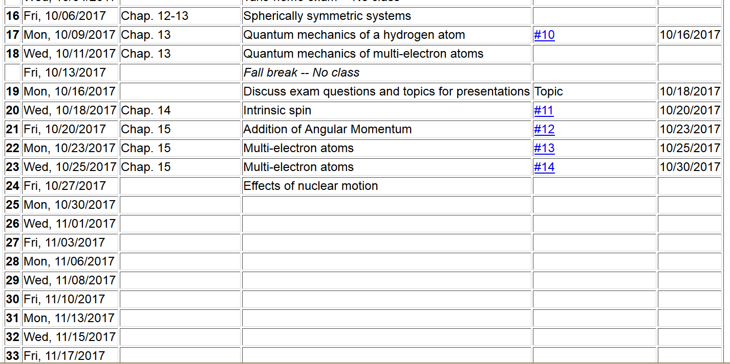

Slide 3
Quantum states of H₂⁺
e
r_{B}
r_{A}
R_{AB}

Slide 4
e
r_{B}
r_{A}
R_{AB}

Slide 5
r_{B}
r_{A}
R_{AB}

Slide 7
Evaluation of matrix elements:

Slide 8
Evaluation of matrix elements -- continued:

Slide 10
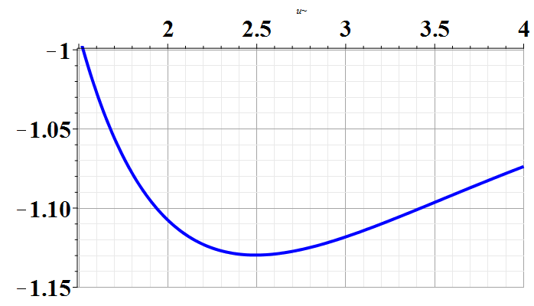
D
U₀(Ry)
Experimental bond length according to NIST:
~ 2 Bohr

Slide 11
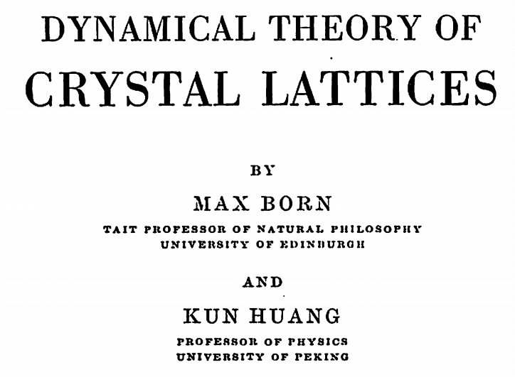
A more complete treatment, takes into account the effects of nuclear motions --

Slide 12
Born-Oppenheimer approximation
M. Born and R. Oppenheimer, Ann. d. Phys. 84, 457 (1927)
Total Hamiltonian
Electron kinetic energy
Nuclear kinetic energy
Electron-nuclear coupling
Fixed nuclear postitions

Slide 13
Eigenstates of electronic Hamiltonian at fixed X:
Full eigenstates:
Solving for the nuclear functions:
Often neglected

Slide 14
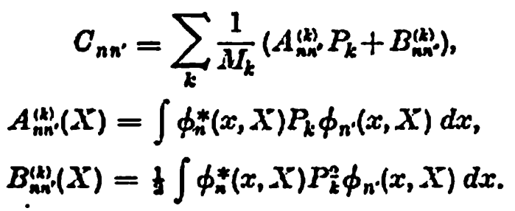
Nuclear kinetic energy

Slide 15
Treatment of nuclear motion
e
r_{B}
r_{A}
R_{AB}

Slide 17
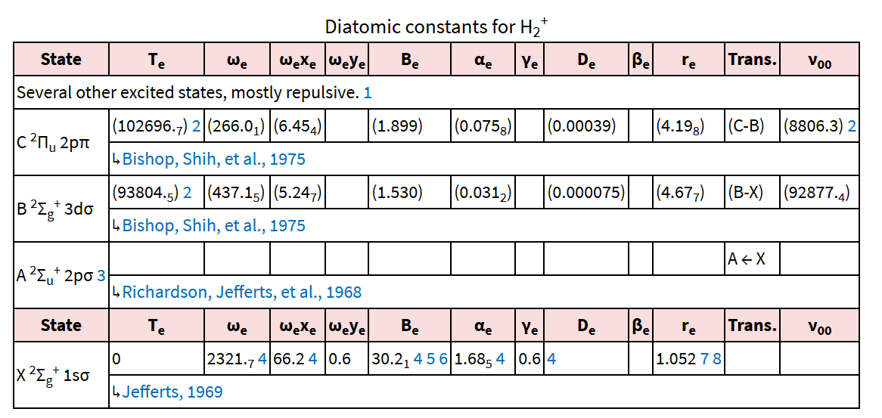
NIST data for H₂⁺

Slide 19
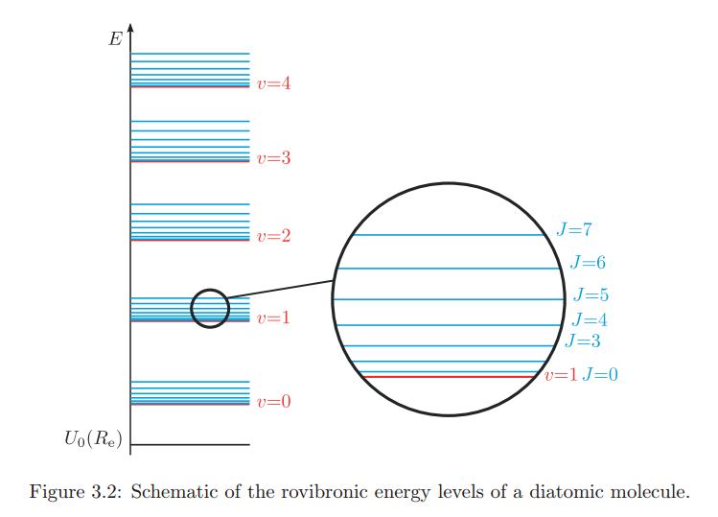
From: https://www.google.com/url?sa=t&rct=j&q=&esrc=s&source=web&cd=6&ved=0ahUKEwjc7cmpipHXAhVH6SYKHTKqCbkQFghEMAU&url=https%3A%2F%2Fwww.ethz.ch%2Fcontent%2Fdam%2Fethz%2Fspecial-interest%2Fchab%2Fphysical-chemistry%2Fultrafast-spectroscopy-dam%2Fdocuments%2Flectures%2FspectroscopyFS13%2FscriptFS13%2FPCV_Ch3.pdf&usg=AOvVaw3UBFJLJvEzpZNAyr-NHGxI

