Slide 1
PHY 741 Quantum Mechanics
12-12:50 AM MWF Olin 103
Plan for Lecture 25:
Chap. 17 in Shankar: Time-Independent Perturbation Theory
Case of non-degenerate spectrum
Treatment of degenerate spectrum

Slide 2
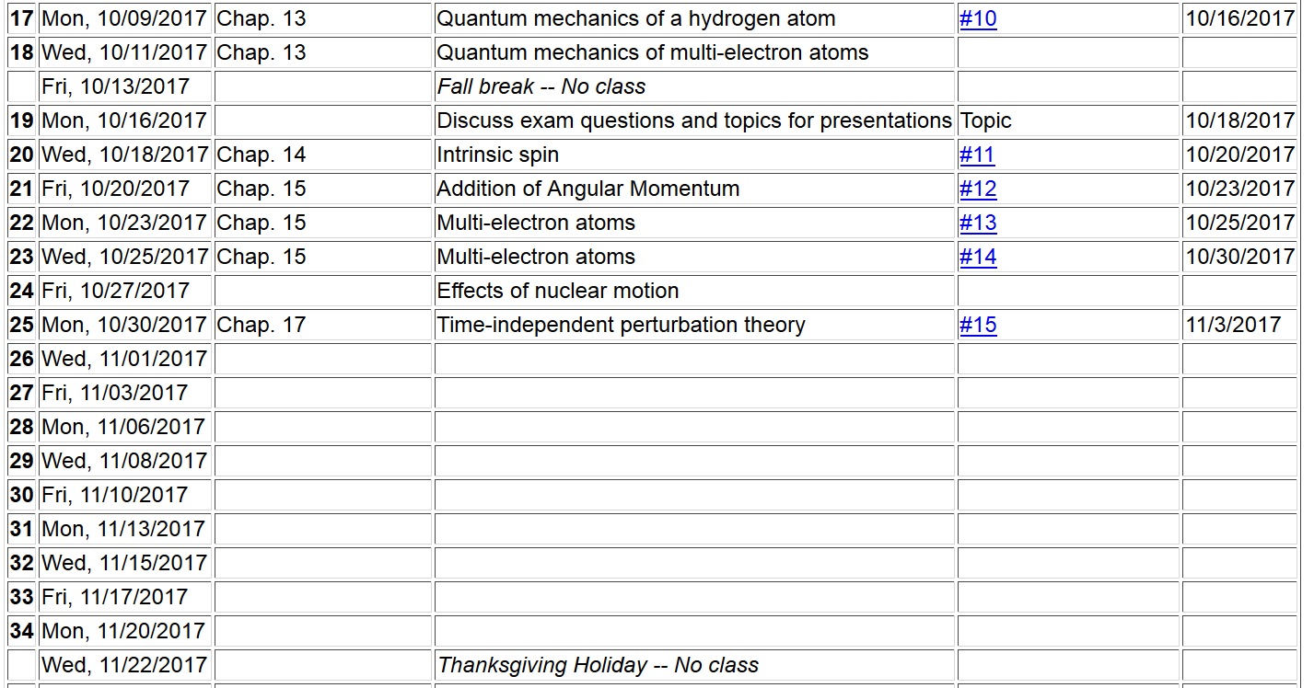

Slide 3
Methods for finding approximate solutions to the time-independent Schrödinger equation
Bound states Continuum states
Variational methods Scattering theory
Perturbation theory

Slide 5
First order corrections

Slide 6
First order corrections -- continued

Slide 7
Second order corrections
Due to normalization

Slide 8
Example – Harmonic oscillator

Slide 9
Example: He atom

Slide 10
What happens when the spectrum of H⁰ has degeneracy?

Slide 11
problem when E⁰_{n}=E⁰_{m}
solution – consider the degenerate states separately

