Slide 1
PHY 741 Quantum Mechanics
12-12:50 AM MWF Olin 103
Plan for Lecture 29:
Chap. 18 in Shankar: Time-dependent perturbation theory
Resonant phenomena
Sudden approximation
Adiabatic approximation

Slide 2
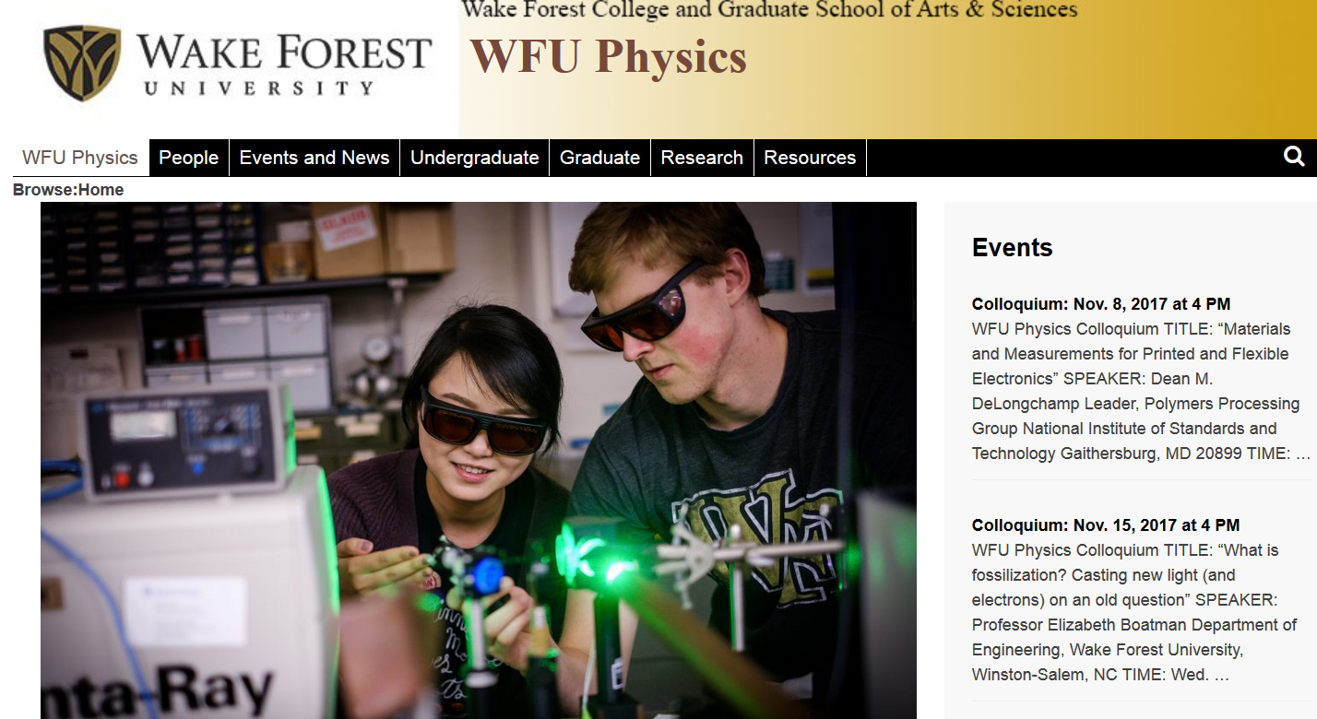

Slide 3
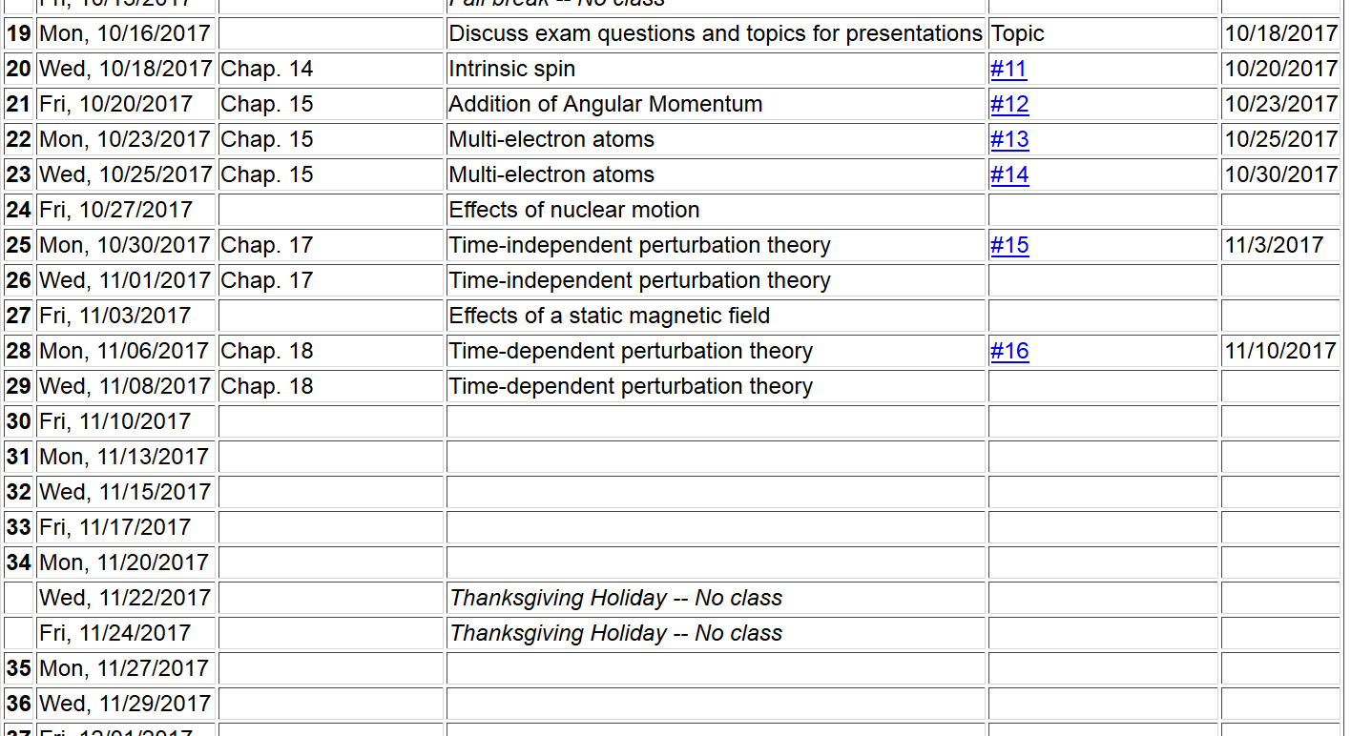

Slide 4
Summary of time-dependent perturbation expansions

Slide 5
Summary of time-dependent perturbation treatment -- continued

Slide 6
Estimating the rate of transitions I → f
Fermi “Golden” rule

Slide 7
Example
H atom in presence of electric field

Slide 9
Summary of results for resonant transitions for H-like ion
1s→2p₀

Slide 10
Digression: Notion of oscillator strength for transition between states l→n:

Slide 11
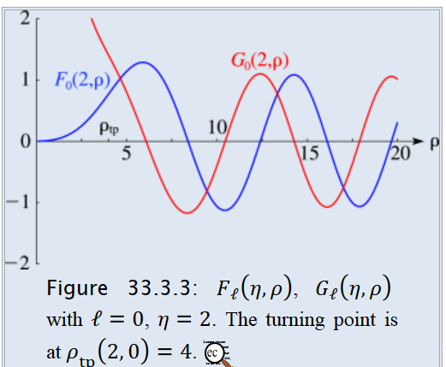
Absorption of radiation in the case of photo emission
From: http://dlmf.nist.gov/33.2

Slide 12
Absorption of radiation in the case of photo emission
approximating final state as a plane wave (Born approximation)
Note: In this case, it is necessary to modify the static electric field in order to account for electrodynamics …

Slide 13
For a H-like ion in a beam of photons with flux S, it is convenient to define a cross section:
(Details: Merzbacher, Quantum Mechanics, third ed. (1998)

Slide 14
Sudden approximation
This method is useful when there is an abrupt change in the Hamiltonian of the system
This can happen when we have a nuclear process occur which is “sudden” for the electronic states. It is also a reasonable approximation for some X-ray core absorption processes.

Slide 15
Sudden approximation -- continued

Slide 16
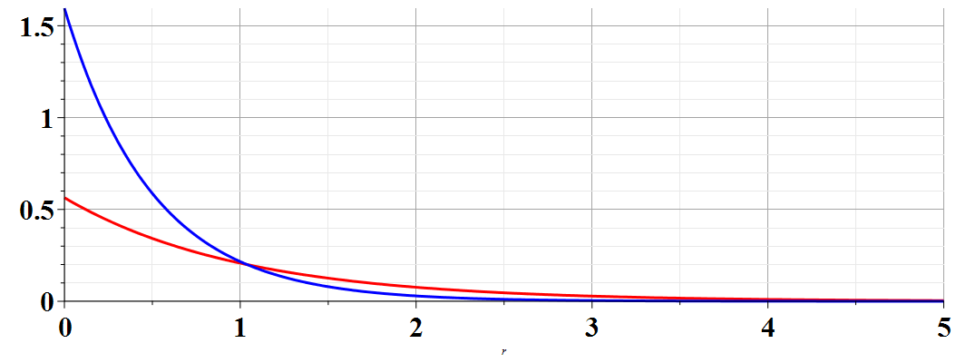
Example of a H-like ion initially with Z^{A}=2,
transforming to one with Z^{B}=1.
A
Z^{A}=2
B
Z^{B}=1

Slide 17
Adiabatic approximation for treating Hamiltonians having a “slow” time-dependence --

Slide 18
If we assume that we can determine the functions

