Slide 1
PHY 712 Quantum Mechanics
12-12:50 PM MWF Olin 103
Plan for Lecture 3:
Reading: Chapter 1 in Shankar
Evaluation of operators and functions of operators
Continuum bases

Slide 2
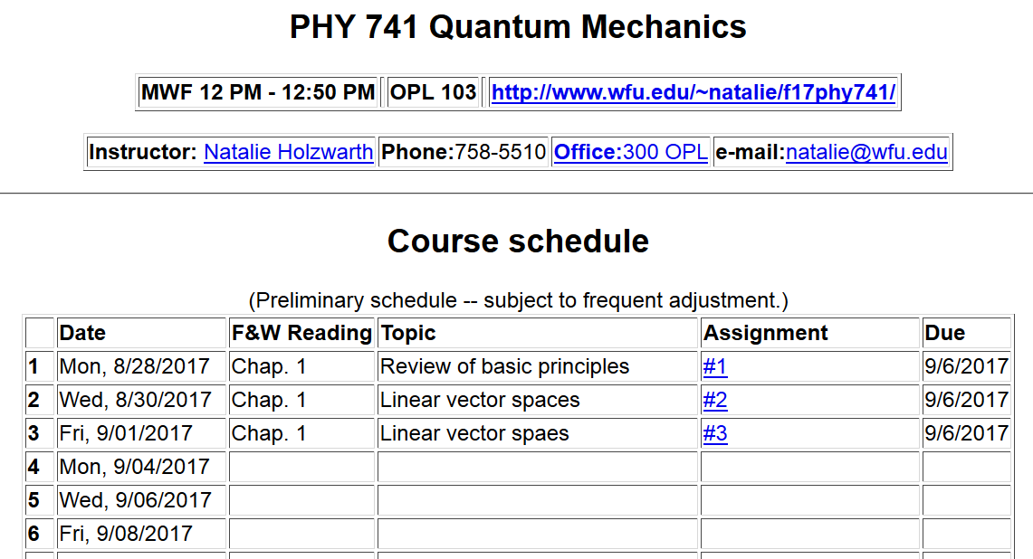
spaces

Slide 3
Correction to Wednesday’s lecture:
Note that SVD can be applied to rectangular matrices
M= =
U
Σ
V^{T}

Slide 5
“Proof” that Hermitial matrices have real eigenvalues

Slide 6
Functions of Operators

Slide 8
Functions of multiple operators

Slide 9
This is a famous result attributed to Baker, Cambell, and
Hausdorff

Slide 10
Examples of finite dimensional vector spaces
Two-dimensional physical space
V
Three-dimensional physical space
V

Slide 11
Notion of a set of vectors which may or may not “span” the vector space.
Notion of “completeness” –
In this example |v₁>, |v₂>, and |v₃>, are not “complete”; they do not span the 3-dimensional vector space.

Slide 12
Examples of finite dimensional vector spaces
Vector spaces constructed with orthonormal functions usually defined in a fixed region of space.

Slide 13
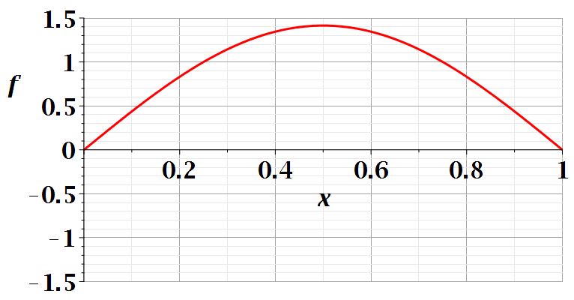
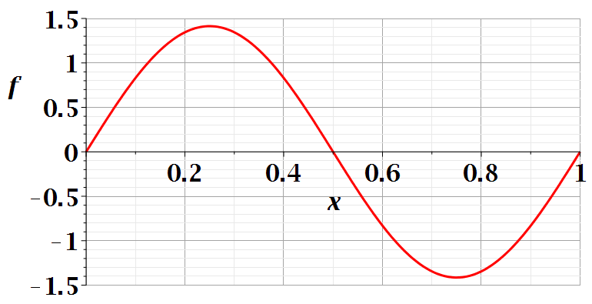
n=1
n=2

Slide 14
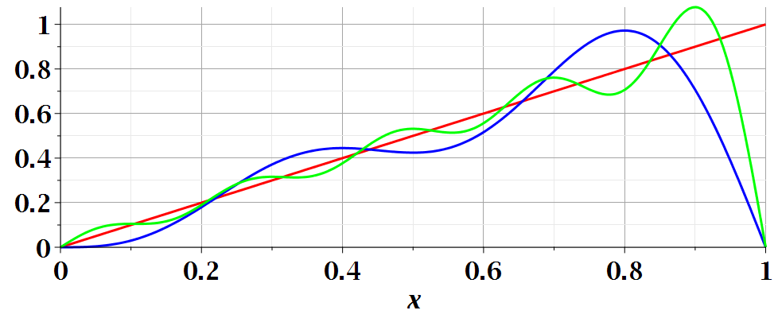
In this case, the vector space becomes “complete” as

Slide 15
Relationship between the finite and continuous systems
Kronecker ⬅➔ Dirac delta functions

Slide 16
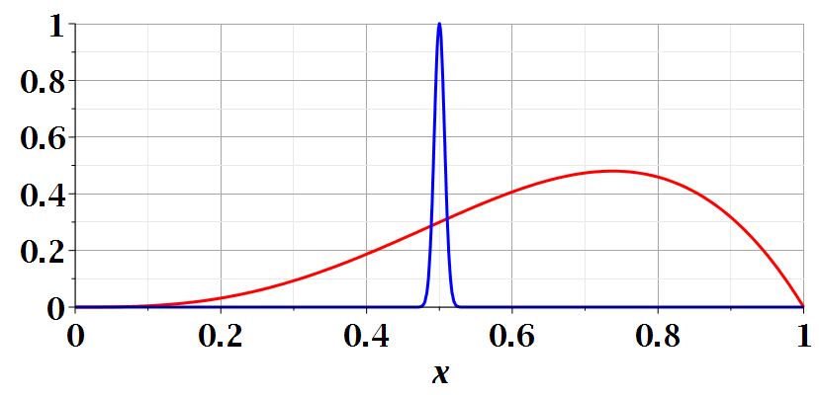
Properties of the Dirac delta function

Slide 17
Properties of the Dirac delta function -- continued

