Slide 1
PHY 741 Quantum Mechanics
12-12:50 AM MWF Olin 103
Plan for Lecture 35:
Chap. 20 in Shankar – Supplemented with J. J. Sakurai -- Dirac equation for hydrogen-like ions and other atoms
Review of results for H-like ions
Generalization to approximate treatment of spherical atoms
Comparison with non-relativistic results

Slide 2
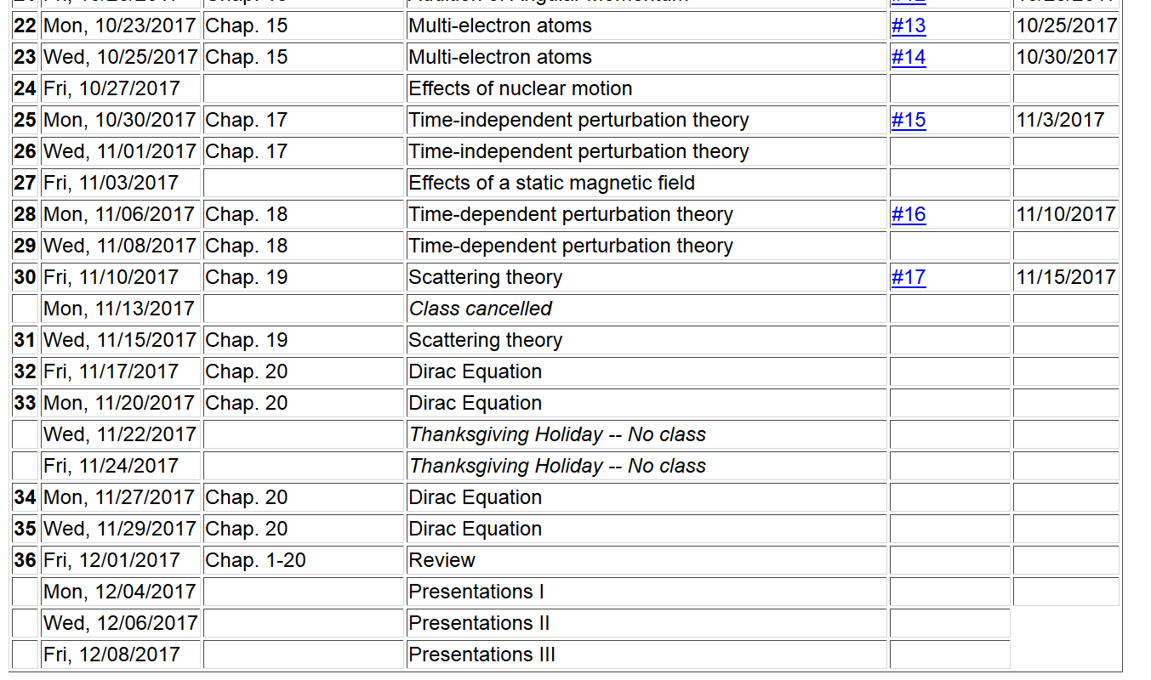

Slide 4
Dirac equation for electron in the field of a H-like ion

Slide 6
Dirac equation for electron in the field of a H-like ion
Comparison with Schroedinger equation --
Schematic diagram:
3d_{5/2}
3s,3p,3d
3p_{3/2},3d_{3/2}
3s_{1/2},3p_{1/2}
2s,2p
2p_{3/2}
2s_{1/2},2p_{1/2}
1s
1s_{1/2}

Slide 7
Some details

Slide 8
More details about ground state of H-like ion from Dirac equation

Slide 9
More general treatment of bound states of Fermi particle within spherical potential V(r)

Slide 10
Practical solution of radial portions of Dirac equation

Slide 11
More general treatment of bound states of Fermi particle within spherical potential V(r) -- continued

Slide 12
More general treatment of bound states of Fermi particle within spherical potential V(r) -- continued

Slide 13
More general treatment of bound states of Fermi particle within spherical potential V(r) -- continued

Slide 15
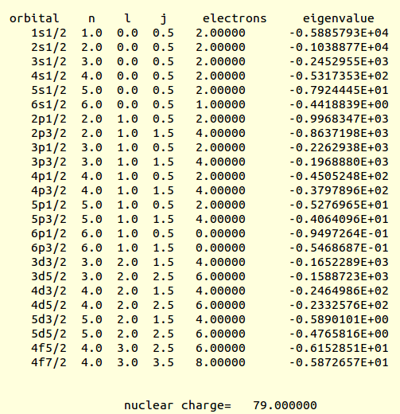
Example results for Au (from an old code)
(Ry units)

Slide 16
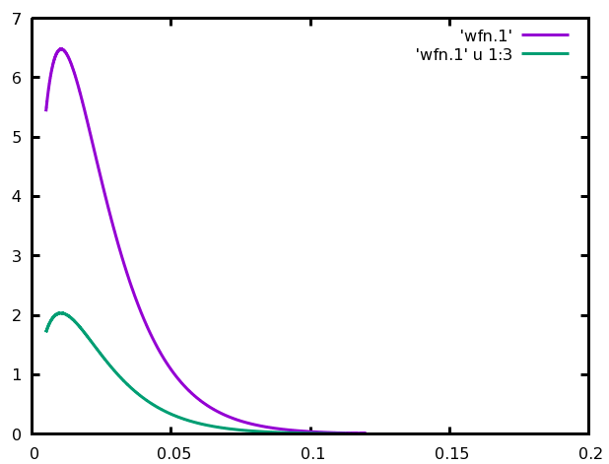
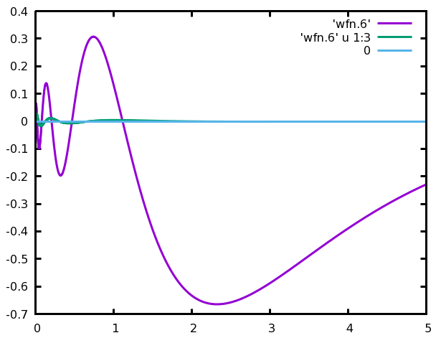
1s_{1/2}
G
For Au
F
6s_{1/2}
F
G

Slide 17
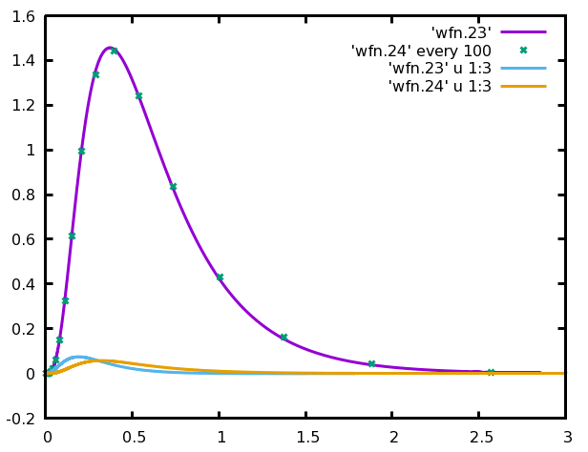
For Au
G_{4f5/2}
G_{4f7/2}
F_{4f5/2}
F_{4f7/2}

Slide 18
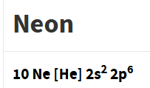
More general treatment of bound states of Fermi particle within spherical potential V(r) – continued
Some sample results within density functional theory
Ref. https://www.nist.gov/pml/data/results
Energy unit is “Hartree
1H= 27.21138602 eV
Non-relativistic
Relativistic
J=1/2
J=1/2
J=1/2
J=3/2
1s | -30.305855 |  | -30.314393
2s | -1.322809 |  | -1.326075
2p | -0.498034 |  | -0.500040 -0.496232

Slide 19
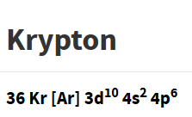
Non-relativistic
Relativistic
1s | -509.982989 |  | -517.456410
2s | -66.285953 |  | -68.209637
2p | -60.017328 |  | -61.753188 -59.789712
3s | -9.315192 |  | -9.639319
3p | -7.086634 |  | -7.347319 -7.057577
3d | -3.074109 |  | -3.032140 -2.984281
4s | -0.820574 |  | -0.851373
4p | -0.346340 |  | -0.361325 -0.33742
J=1/2
J=1/2
J=1/2
J=3/2
J=1/2
J=1/2
J=3/2
J=3/2
J=5/2
J=1/2
J=1/2
J=3/2

Slide 20
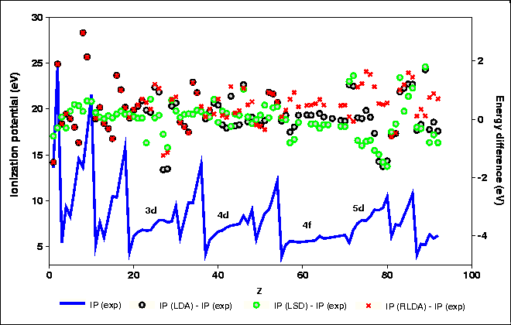
https://www.nist.gov/pml/atomic-reference-data-electronic-structure-calculations-trends-across-periodic-table

