Slide 1
PHY 712 Quantum Mechanics
12-12:50 PM MWF Olin 103
Plan for Lecture 4:
Reading: Skim chapters #2 & #3 and start reading #4 in Shankar
Mathematical formalisms that can represent quantum phenomena
State vector
Physical variables and their representations

Slide 2
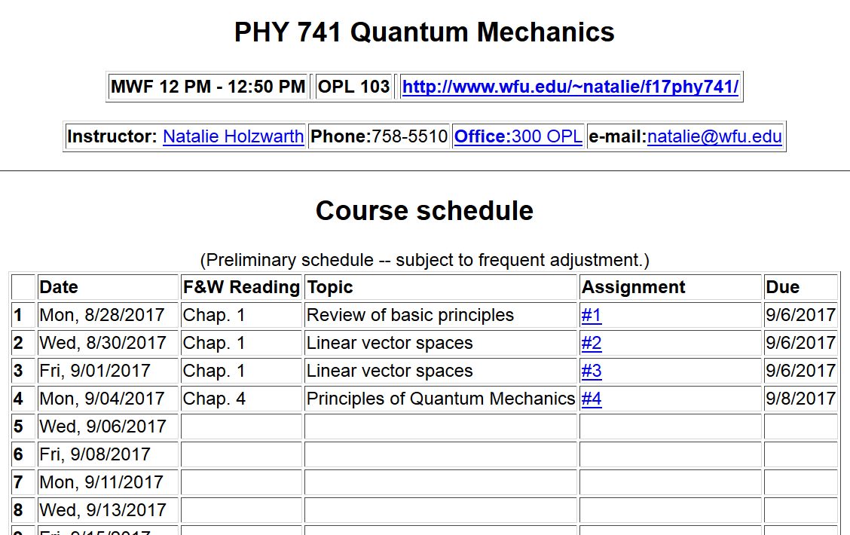

Slide 3
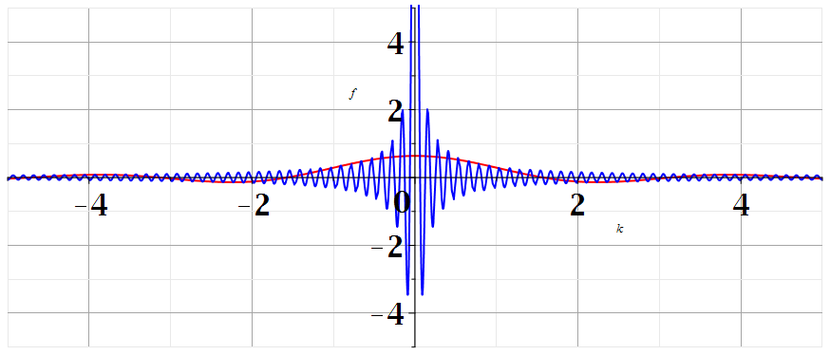
Dirac delta functions
L=50
L=2

Slide 4
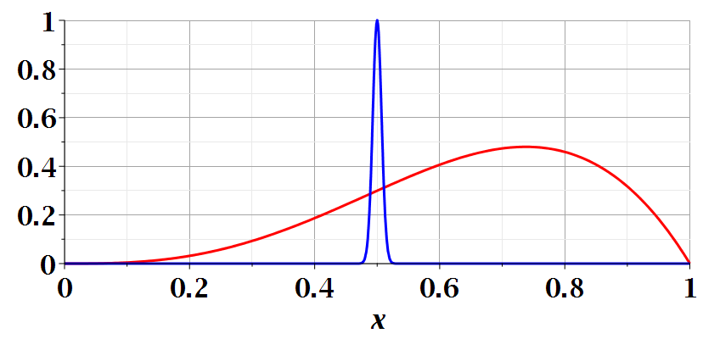
Properties of the Dirac delta function

Slide 5
Properties of the Dirac delta function -- continued

Slide 6
Properties of the Dirac delta function -- continued
=0 provided that G(∞) is well-behaved
Note: Shankar has minus sign issue….

Slide 7
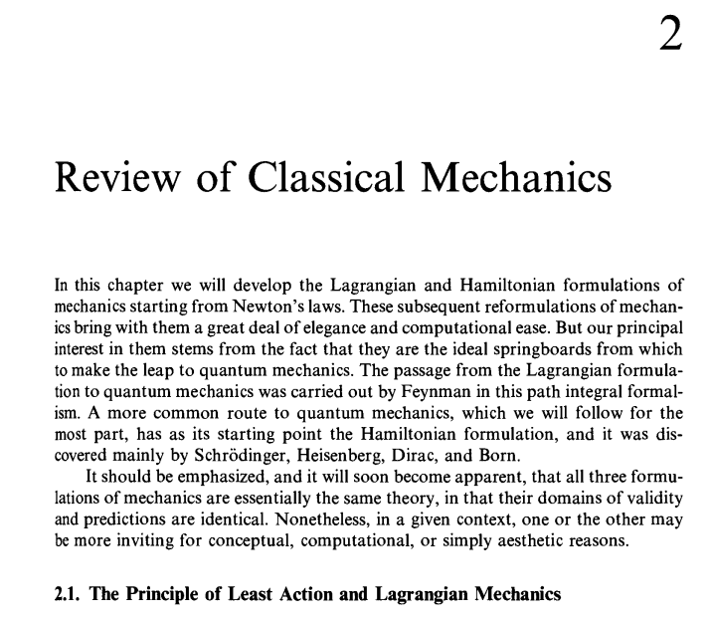
Material to skim:

Slide 8
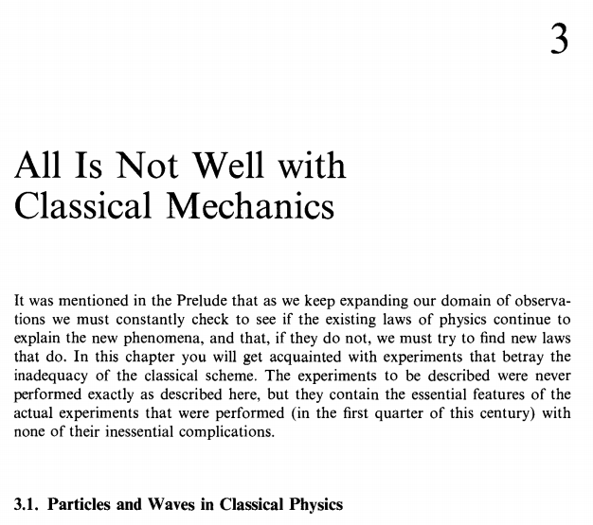
Material to skim:

Slide 9
Start reading Chapter 4 in Shankar
Mathematical formalisms that can
describe quantum phenomena --

Slide 10
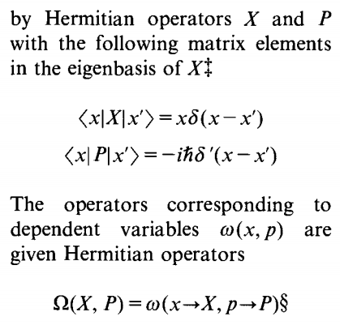

Slide 12
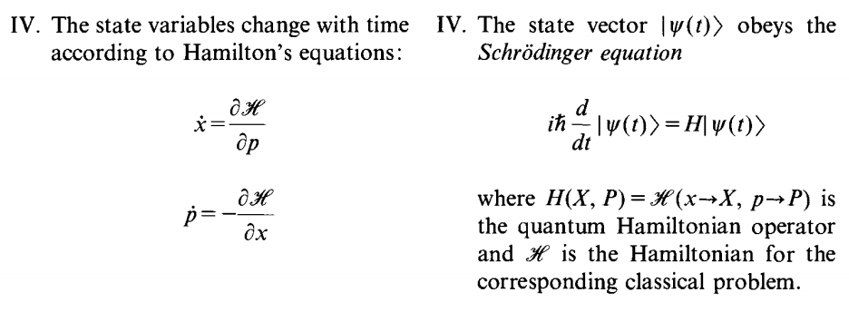

Slide 13
Expectation values
Uncertainty values

Slide 15
Further considerations --

Slide 16
Time evolution

Slide 17
Time evolution -- continued

Slide 18
Time evolution -- continued

Slide 19
Other examples

Slide 20
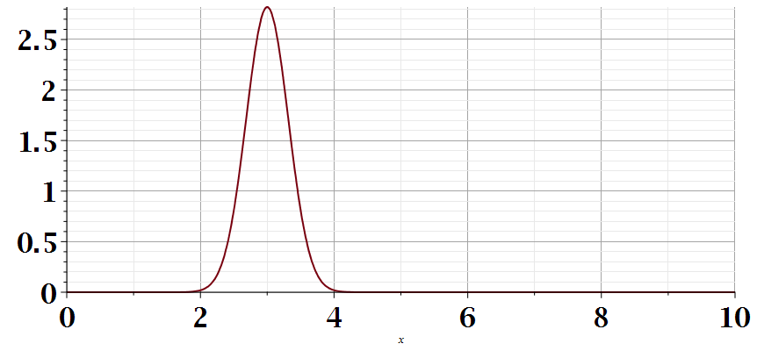
x

Slide 21
Example continued

