Slide 1
PHY 712 Quantum Mechanics
12-12:50 PM MWF Olin 103
Plan for Lecture 5:
Reading: Chapters #5 in Shankar; quantum mechanical systems in 1-dim
Free particle
Particle bound in a box

Slide 2
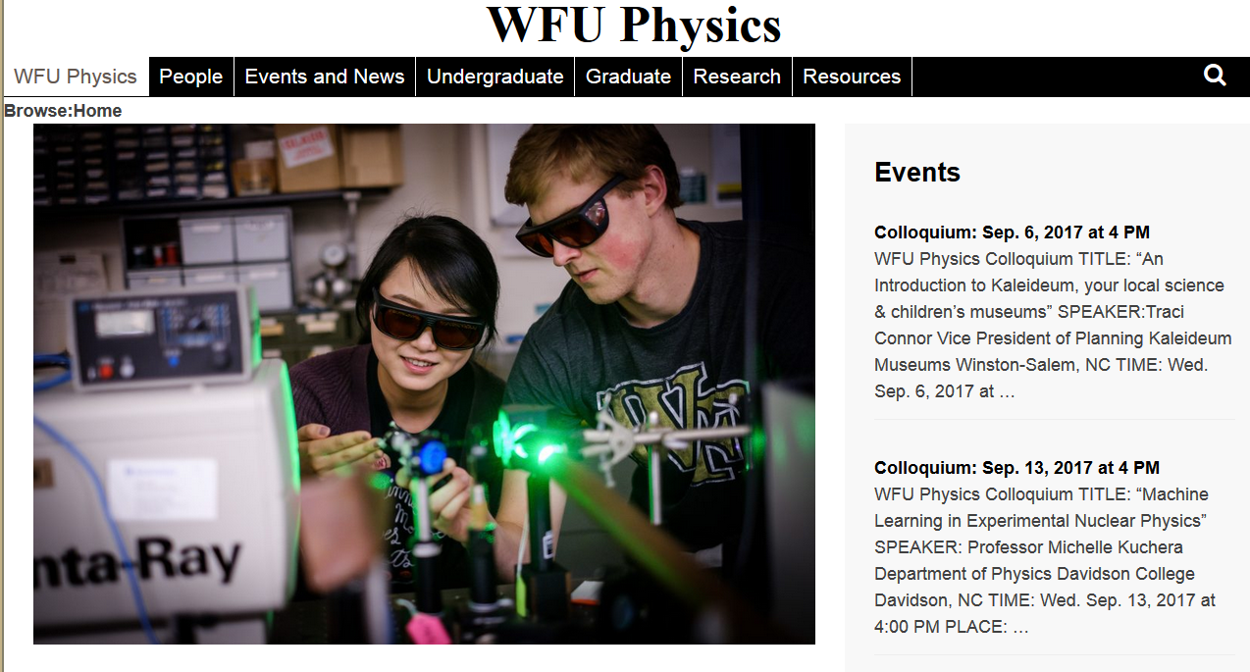

Slide 3
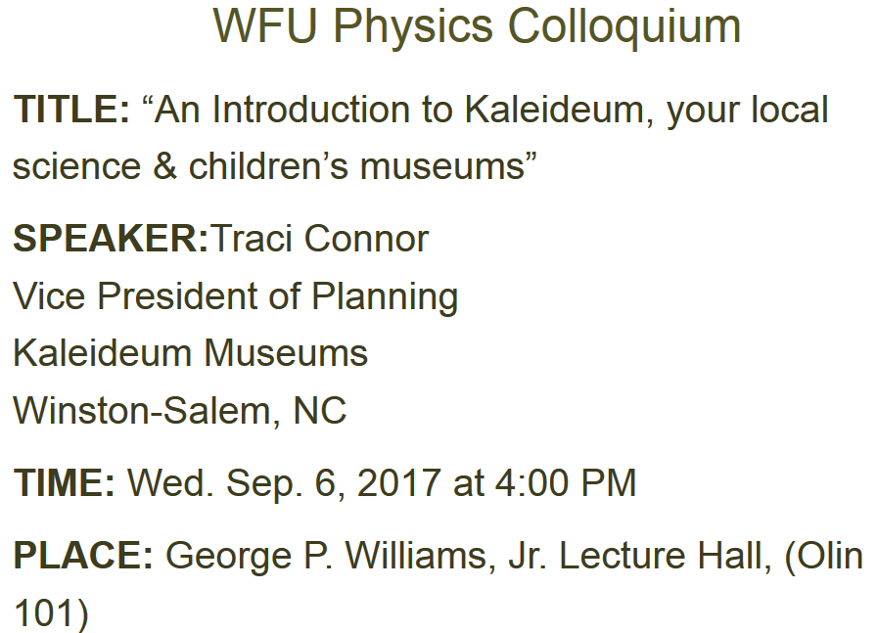

Slide 4
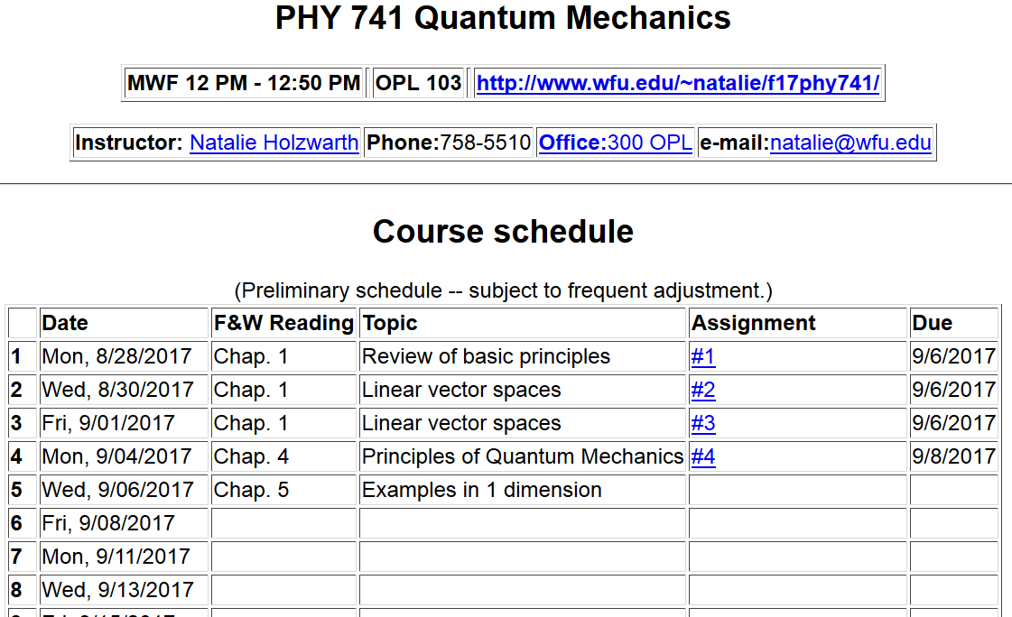

Slide 5
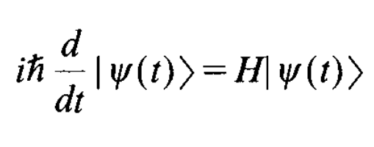
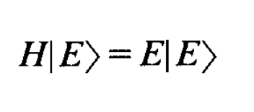
Formal solution of the Schrödingder equation
Solution in terms of eigenstates |E> of H:
E
E
coefficients to be determined

Slide 6
Formal solution of the Schrödingder equation -- continued
E
➔

Slide 7
Formal solution of the Schrödingder equation -- continued

Slide 8
Example – particle free to move in one dimension

Slide 9
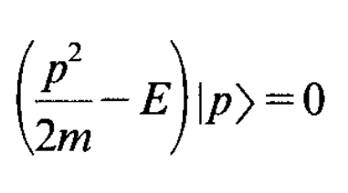
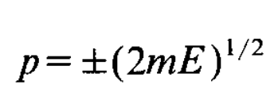
Example – particle free to move in one dimension
Relationship between the eigenvalues p and E:
coefficients

Slide 10
Example – particle free to move in one dimension
Determination of the propagator for this case
In order to evaluate this expression, we need to have a functional form for the eigenstates |p>.

Slide 11
Example – particle free to move in one dimension

Slide 12
Example – particle free to move in one dimension

Slide 13
Example – particle free to move in one dimension

Slide 14
Digression – justification for integration result
(see appendix A of your text)

Slide 15
Example – particle free to move in one dimension

Slide 16
Example – particle free to move in one dimension
Time evolution of a Gaussian wave packet:
Probability density:

Slide 17
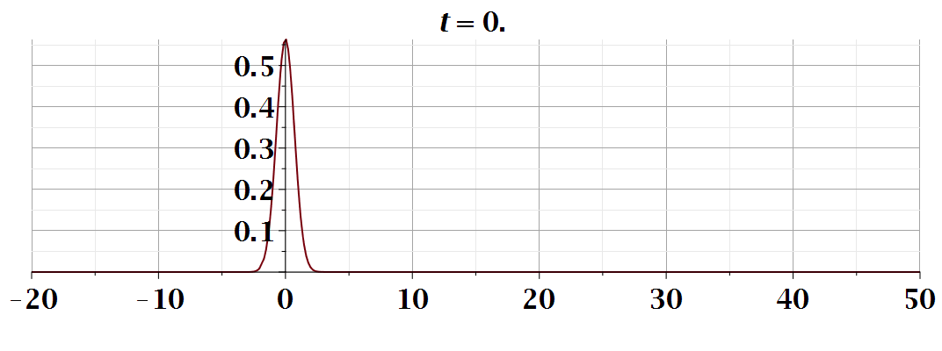

Slide 18
Summary of results for free particle
In this case, the energy spectrum is continuous
Notion of “density of states”

Slide 19
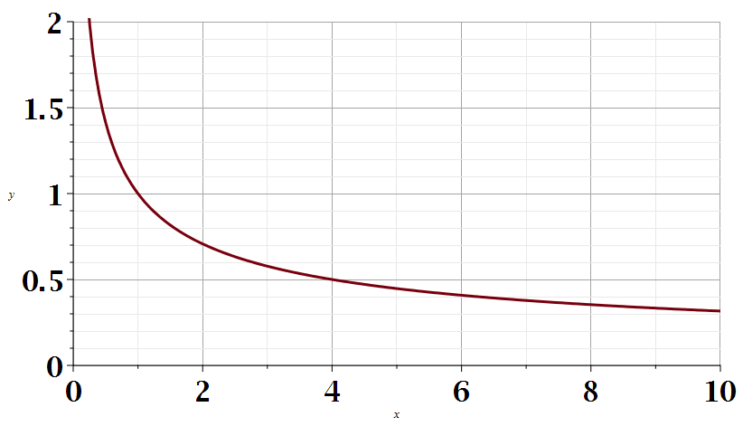
Notion of density of states for continuum spectrum
Example: one-dimensional free particle

