Slide 1
PHY 711 Classical Mechanics and Mathematical Methods
10-10:50 AM MWF Olin 103
Plan for Lecture 1:
Welcome & overview
Class structure & announcements
Introduction to algebraic manipulation software – Maple and Mathematica
Start reading Chap. 1 for next time

Slide 2
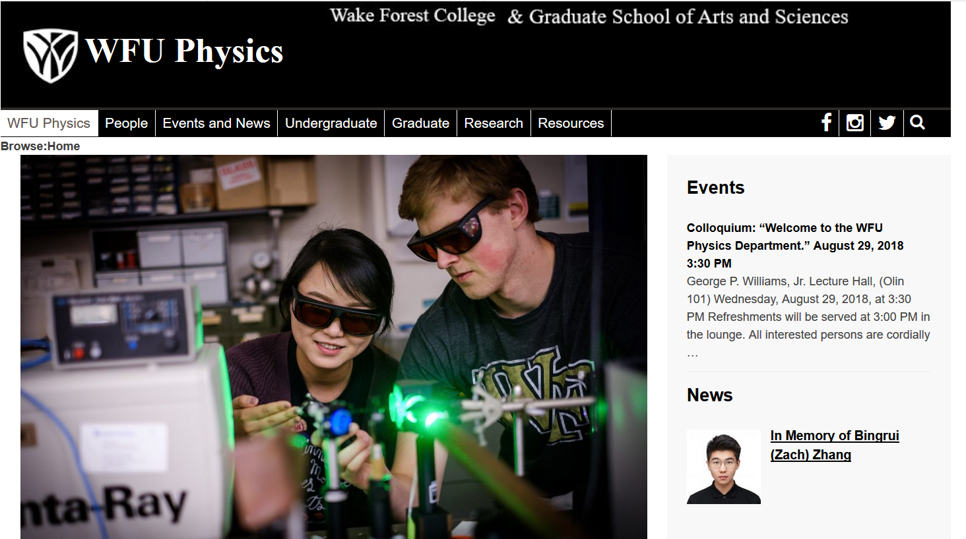
Comment about Physics Colloquia
http://www.physics.wfu.edu

Slide 3
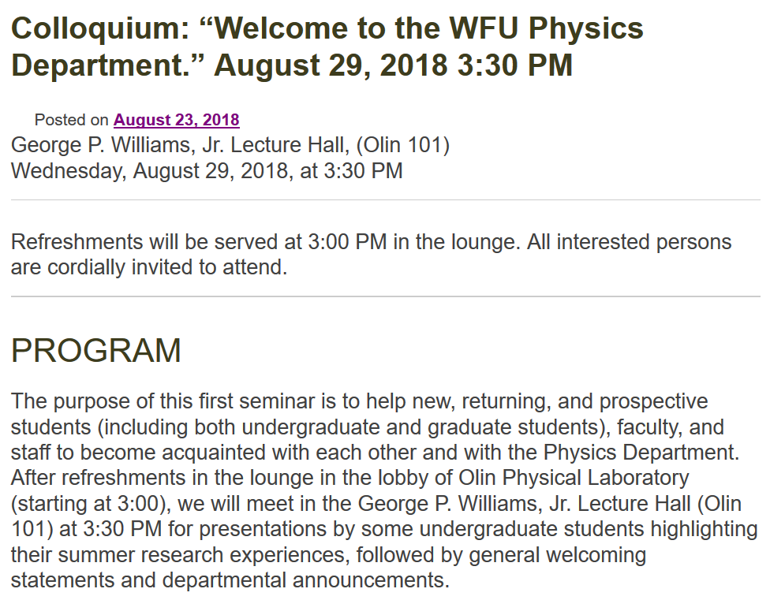

Slide 4
Note:
PHY 711 will not meet on
Wed. 8/29/2018
PHY 711 will meet on
Fri. 8/31/2018
Mon. 9/3/2018
Wed. 9/5/2018
Fri. 9/7/2018
………..

Slide 5
Textbook:

Slide 6
Topics
Classical Mechanics
Scattering theory
Accelerated reference frames
Calculus of variation
Lagrangian formalism
Hamiltonian formalism
Oscillations about equilibrium
Wave equations
Rigid rotation; moments of inertia
Physics of fluids
Sound waves in fluids and solids
Surface waves
Heat conduction
Viscous fluids
Elastic continua
Math Methods
Use of Maple and/or Mathematica
Solutions methods for differential equations
Green’s function methods
Special functions
Matrix properties; eigenvalues and eigenvectors
Fourier transforms
Laplace transforms
Contour integration

Slide 7
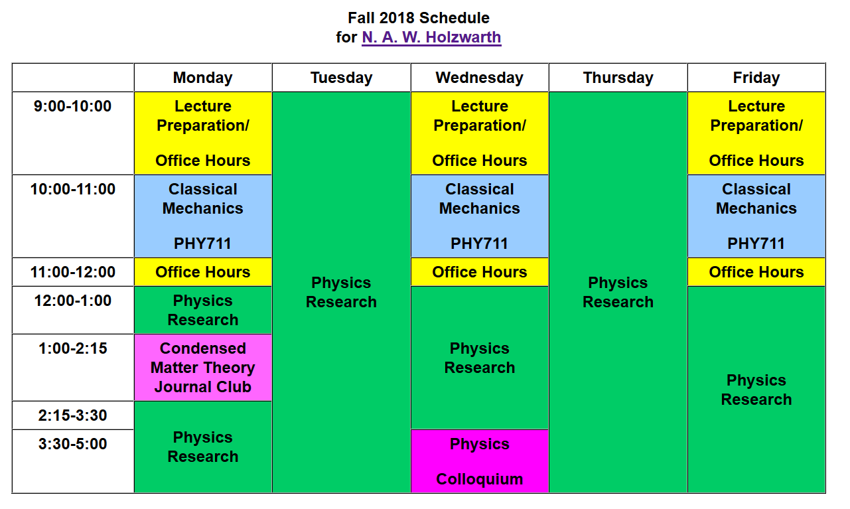
email: natalie@wfu.edu office: Olin 300

Slide 8
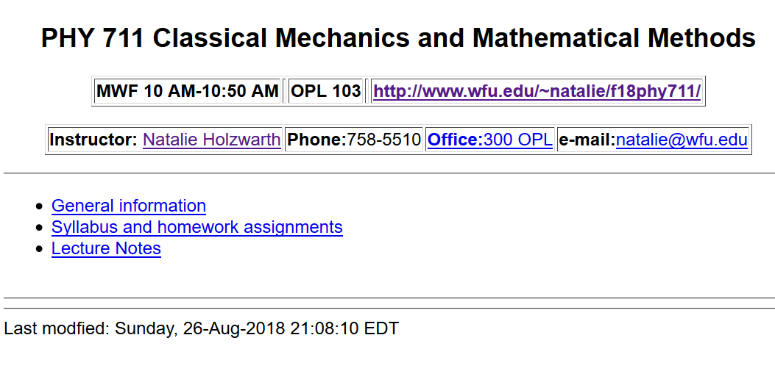
Course webpage: http://www.wfu.edu/~natalie/f18phy711

Slide 9
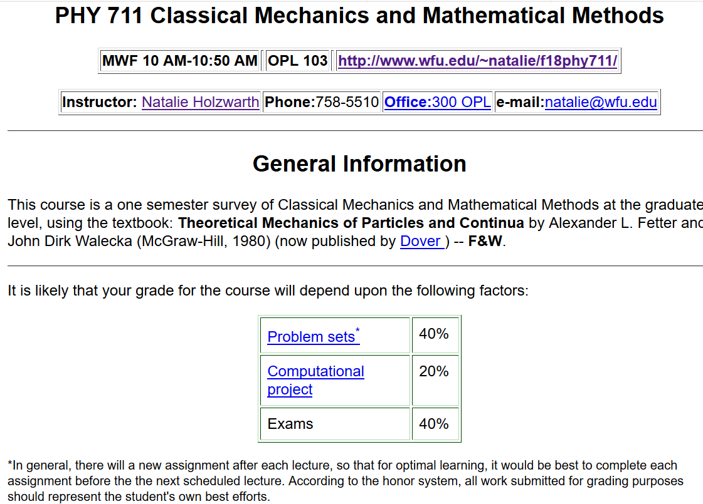
Course webpage:
http://www.wfu.edu/~natalie/f18phy711

Slide 10
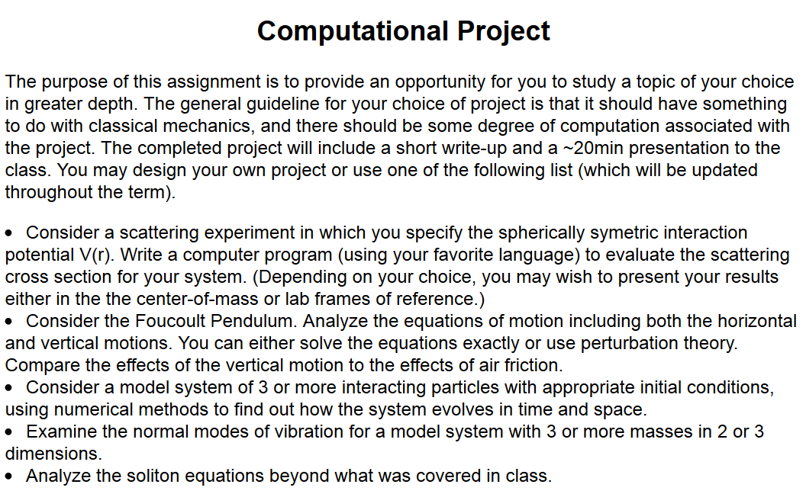
Course webpage: http://www.wfu.edu/~natalie/f18phy711

Slide 11
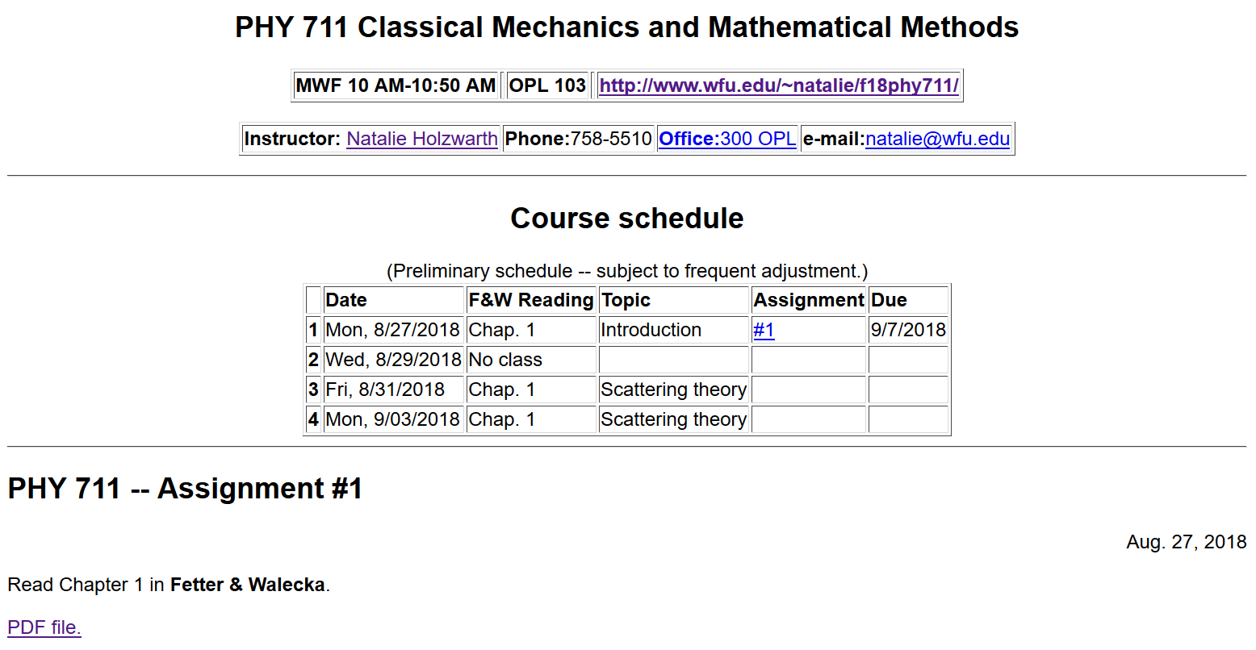
Course webpage: http://www.wfu.edu/~natalie/f18phy711/homework

Slide 12
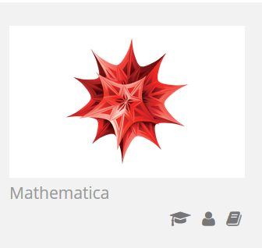
Comment on software useful for this course
https://software.wfu.edu/
Installation straightforward; takes a while ..
Please contact me or yipcw@wfu.edu if you have trouble.

Slide 13
Other possibilities –
http://www.wolframalpha.com/

Slide 14
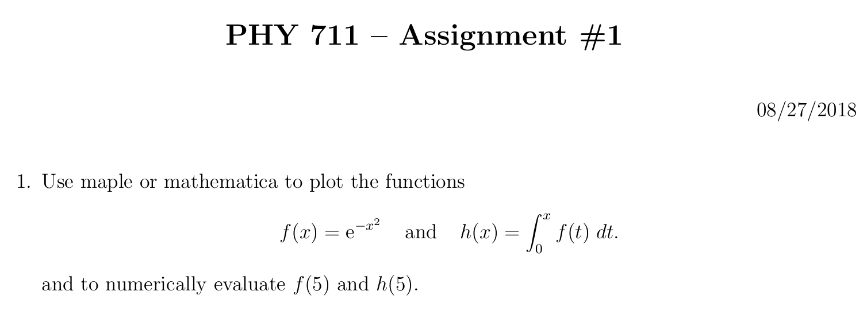

Slide 15
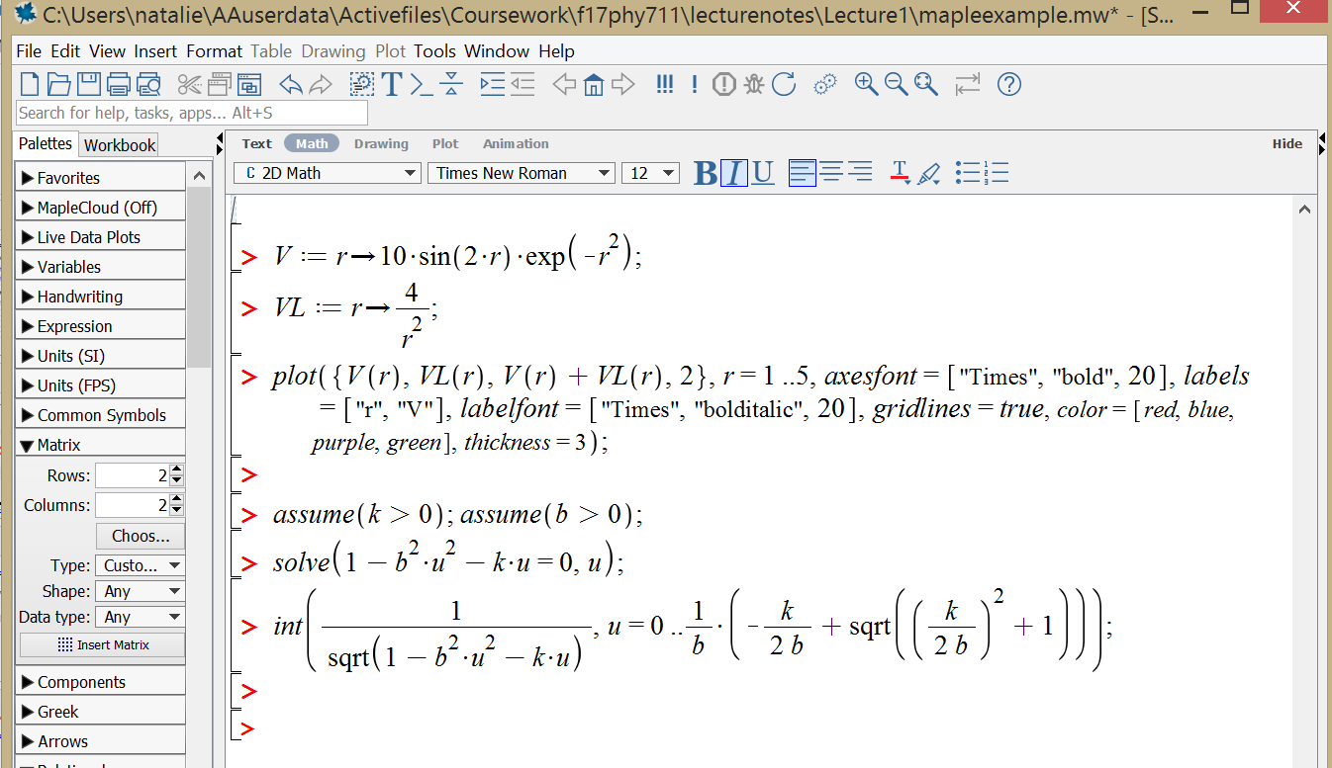
Example Maple file: mapleexample.mw

Slide 16
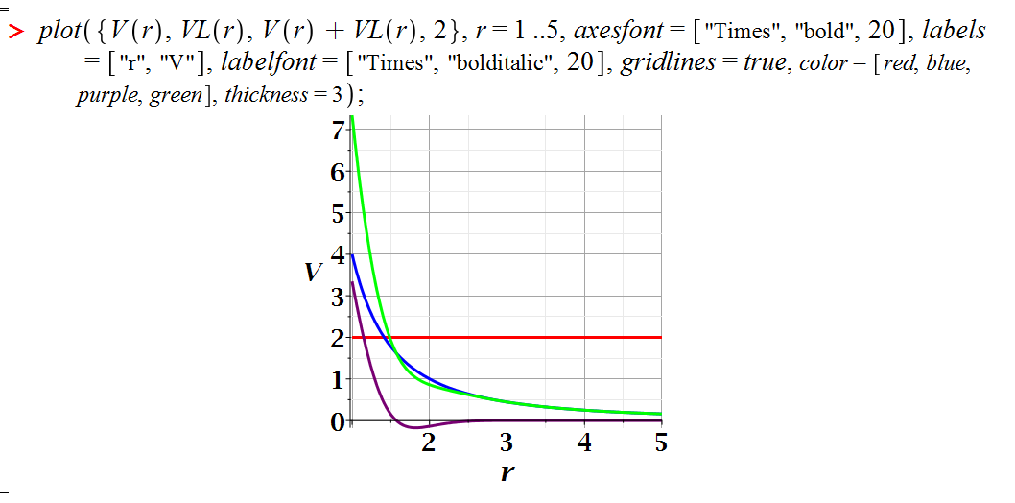
Maple exercise – continued:

Slide 17
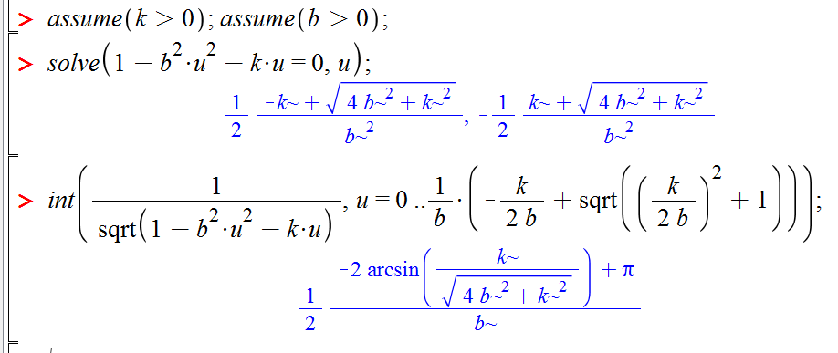
Maple exercise – continued:
Solving an algebraic equation and evaluating an integral:

Slide 18
Brief assessment exercise.

