Slide 1
PHY 711 Classical Mechanics and Mathematical Methods
10-10:50 AM MWF Olin 103
Plan for Lecture 10:
Continue reading Chapter 3 & 6
Constants of the motion
Conserved quantities
Legendre transformations

Slide 2
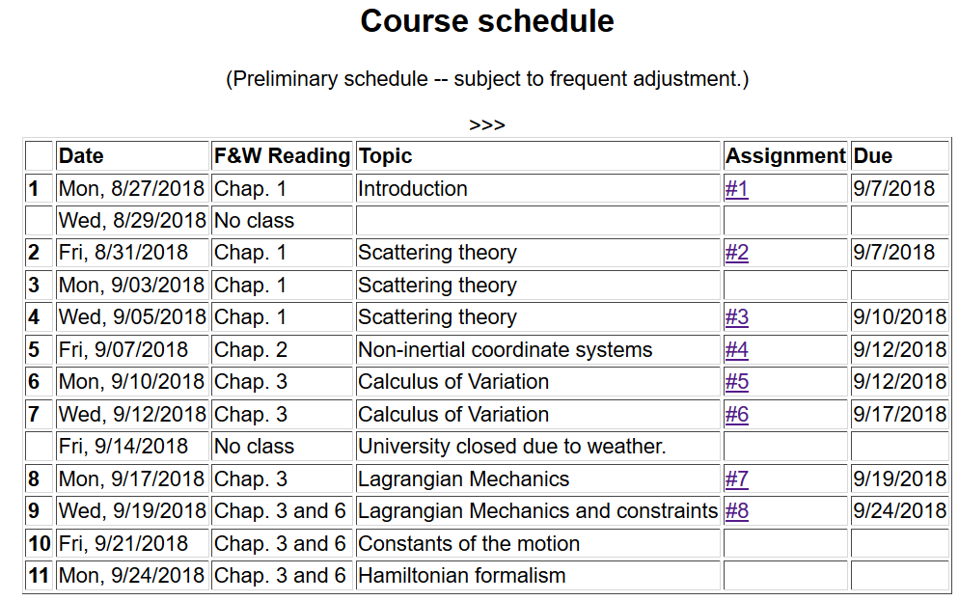

Slide 3
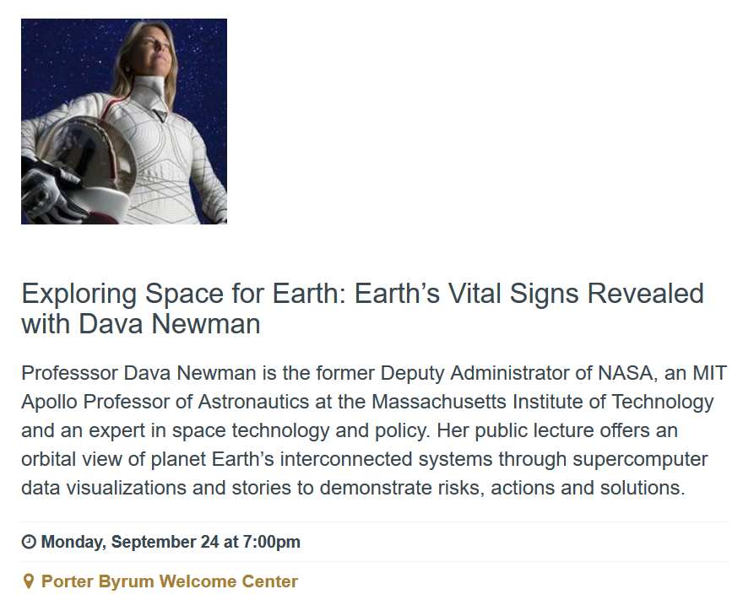
Public Talk – ΦΒΚ Lecturer -- Mon. 9/24/2018 at 7 PM

Slide 4
Physics Colloquium:
Tue. 9/25/2018 at 4 PM
Olin 101
Prof. Dava Newman
ΦΒΚ Lecturer from MIT

Slide 5
Summary of Lagrangian formalism (without constraints)

Slide 6
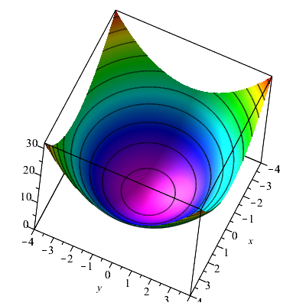
Consider a particle of mass m moving frictionlessly on a parabola z=c(x²+y²) under the influence of gravity. Find the equations of motion, particularly showing stable circular motion.

Slide 10
Examples of constants of the motion:

Slide 11
Examples of constants of the motion:

Slide 12
Recall alternative form of Euler-Lagrange equations:

Slide 13
Additional constant of the motion:

Slide 14
Additional constant of the motion -- continued:

Slide 15
Other examples

Slide 16
Other examples

Slide 17
Lagrangian picture
Switching variables – Legendre transformation

Slide 18
Mathematical transformations for continuous functions of several variables & Legendre transforms:
Simple change of variables:

Slide 19
Simple change of variables -- continued:

Slide 20
Simple change of variables -- continued:
?
?

Slide 21
Mathematical transformations for continuous functions of several variables & Legendre transforms continued:

Slide 22
For thermodynamic functions:

Slide 24
Lagrangian picture
Switching variables – Legendre transformation

Slide 25
Hamiltonian picture – continued

