Slide 1
PHY 711 Classical Mechanics and Mathematical Methods
10-10:50 AM MWF Olin 103
Plan for Lecture 11:
Continue reading Chapter 3 & 6
Constructing the Hamiltonian
Hamilton’s canonical equation
Examples

Slide 2
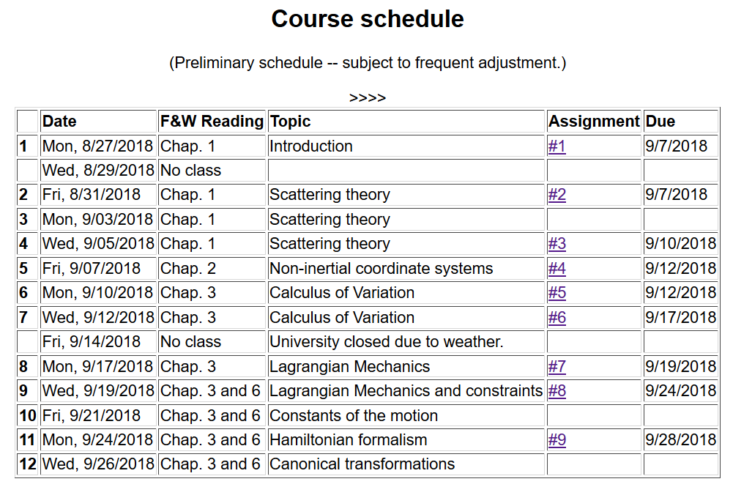

Slide 3
12:15 PM today in Olin 105

Slide 4
Public Talk – ΦΒΚ Lecturer -- Mon. 9/24/2018 at 7 PM

Slide 5
Physics Colloquium:
Tue. 9/25/2018 at 4 PM
Olin 101
Prof. Dava Newman
ΦΒΚ Lecturer from MIT

Slide 6
Lagrangian picture
Switching variables – Legendre transformation

Slide 7
Hamiltonian picture – continued

Slide 8
Direct application of Hamiltonian’s principle using the Hamiltonian function --

Slide 9
Hamilton’s principle continued:
Canonical equations
0

Slide 10
Constants of the motion in Hamiltonian formalism

Slide 11
Recipe for constructing the Hamiltonian and analyzing the equations of motion

Slide 14
Other examples

Slide 15
Other examples

Slide 16
Canonical equations of motion for constant magnetic field:

Slide 17
Canonical equations of motion for constant magnetic field -- continued:

Slide 19
Poisson brackets:
Recall:

Slide 20
Poisson brackets -- continued:

Slide 21
Poisson brackets -- continued:
Liouville theorem

Slide 22
Phase space

Slide 23
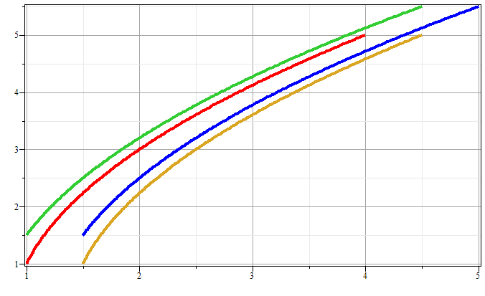
Phase space diagram for one-dimensional motion due to constant force
p
x

Slide 24
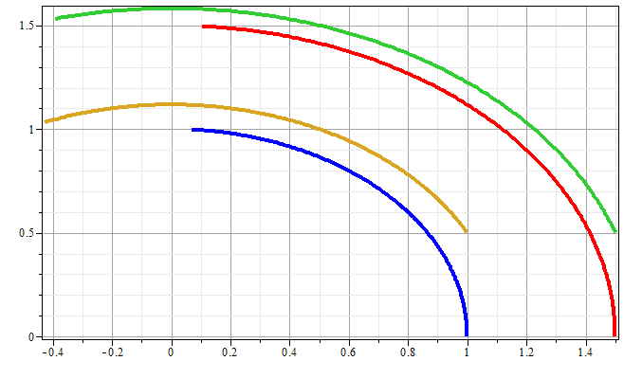
Phase space diagram for one-dimensional motion due to spring force
p
x

Slide 25
Liouville’s Theorem (1838)
The density of representative points in phase space corresponding to the motion of a system of particles remains constant during the motion.

Slide 26
Liouville’s theorem
(x,p+Δp)
(x+Δx,p+Δp)
p
(x,p)
(x+Δx,p)
x

Slide 27
Liouville’s theorem -- continued
(x,p+Δp)
(x+Δx,p+Δp)
p
(x,p)
(x+Δx,p)
x

Slide 28
Liouville’s theorem -- continued
(x,p+Δp)
(x+Δx,p+Δp)
p
(x,p)
(x+Δx,p)
x

Slide 29
Review:
Liouville’s theorem:
Imagine a collection of particles obeying the Canonical equations of motion in phase space.

Slide 30
Proof of Liouville’e theorem:

Slide 32
0

Slide 33
Importance of Liouville’s theorem to statistical mechanical analysis:
In statistical mechanics, we need to evaluate the probability of various configurations of particles. The fact that the density of particles in phase space is constant in time, implies that each point in phase space is equally probable and that the time average of the evolution of a system can be determined by an average of the system over phase space volume.

