Slide 1
PHY 711 Classical Mechanics and Mathematical Methods
10-10:50 AM MWF Olin 103
Plan for Lecture 12:
Continue reading Chapter 3 & 6
Hamiltonian formalism
Phase space & Liouville’s theorem
Modern applications

Slide 2
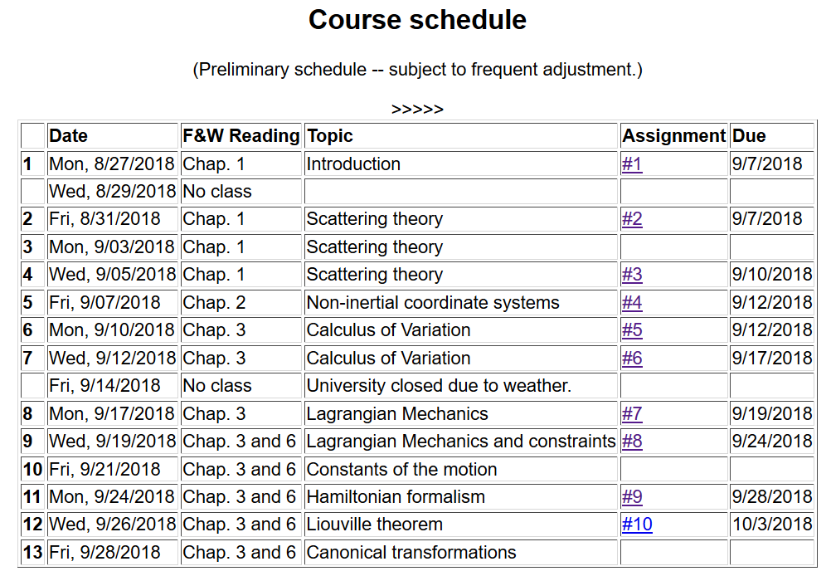

Slide 4
Hamiltonian formalism

Slide 5
Phase space

Slide 6
Liouville’s Theorem (1838)
The density of representative points in phase space corresponding to the motion of a system of particles remains constant during the motion.

Slide 7
Importance of Liouville’s theorem to statistical mechanical analysis:
In statistical mechanics, we need to evaluate the probability of various configurations of particles. The fact that the density of particles in phase space is constant in time, implies that each point in phase space is equally probable and that the time average of the evolution of a system can be determined by an average of the system over phase space volume.

Slide 8
Modern usage of Lagrangian and Hamiltonian formalisms
J. Chem. Physics 72 2384-2393 (1980)

Slide 9
“Molecular dynamics” is a subfield of computational physics focused on analyzing the motions of atoms in fluids and solids with the goal of relating the atomistic and macroscopic properties of materials. Ideally molecular dynamics calculations can numerically realize the statistical mechanics viewpoint.

Slide 10
r_{ij}
➔From this Lagrangian, can find the 3N coupled 2nd order differential equations of motion and/or find the corresponding Hamiltonian, representing the system at constant energy, volume, and particle number N (N,V,E ensemble).

Slide 11
Lagrangian and Hamiltonian forms

Slide 12
H. C. Andersen wanted to adapt the formalism for modeling an (N,V,E) ensemble to one which could model a system at constant pressure (P).
P
V constant
P constant, V variable

Slide 13
PV contribution to potential energy
kinetic energy of “balloon”

Slide 15
Relationship between system representations
Scaled Original
Equations of motion in “original” coordinates:

Slide 16
Physical interpretation:

Slide 17
Digression on numerical evaluation of differential equations

Slide 18
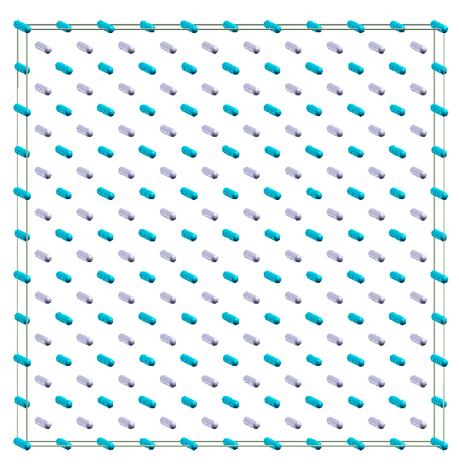
Example simulation for NPT molecular dynamics simulation of Li₂O using 1500 atoms with θ=0
Use LAMMPS code
http://LAMMPS.sandia.gov

Slide 19
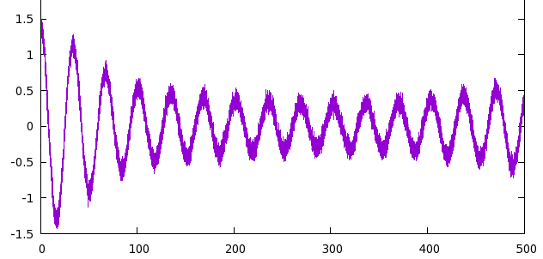
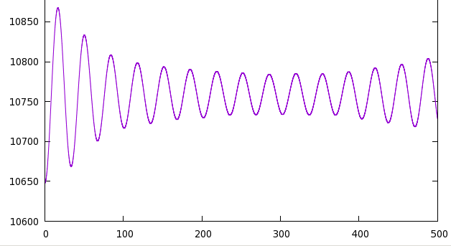
P (GPa)
t (ps)
V (Å³)
t (ps)

Slide 20
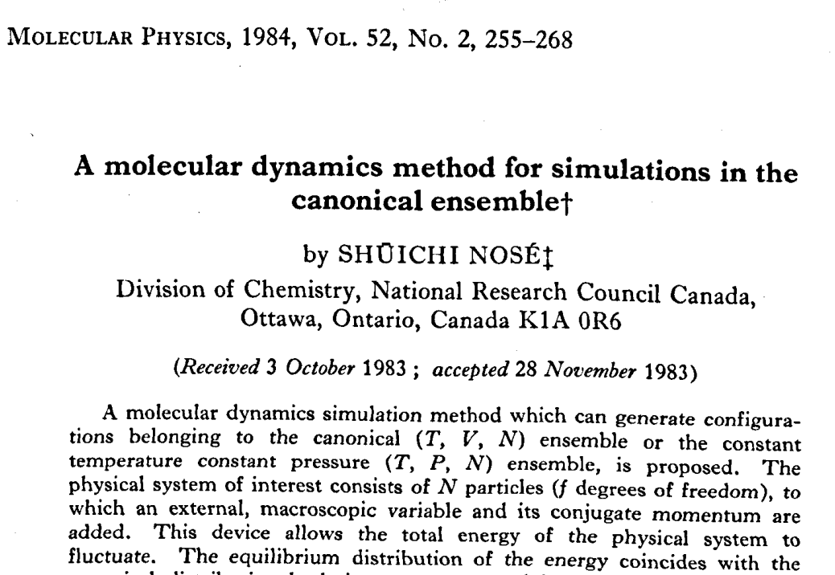

Slide 21
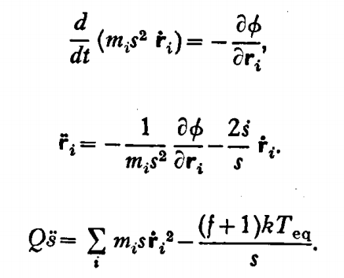
fictitious mass
velocity scaling
Equations of motion:

Slide 22
Time averaged relationships
Hamiltonian

Slide 23
Nose’ was able to show that his effective Hamiltonian well approximates such a canonical distribution.

Slide 24
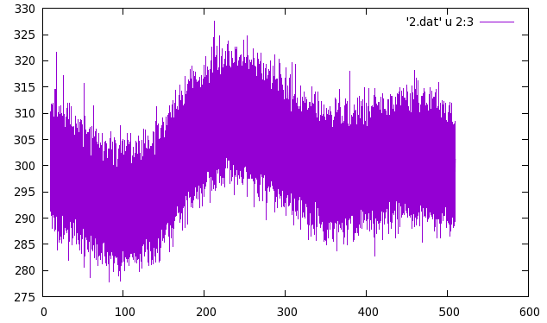
From LAMMPS simulation (using modified Nose’ algorithm)
T (K)
t (ps)

