Slide 1
PHY 711 Classical Mechanics and Mathematical Methods
10-10:50 AM MWF Olin 103
Plan for Lecture 17:
Start reading Chapter 7
Comments on linear vs. non-linear equations
Masses coupled by springs ⬅➔masses coupled by string
Mechanics one-dimensional continuous system
The wave equation

Slide 3
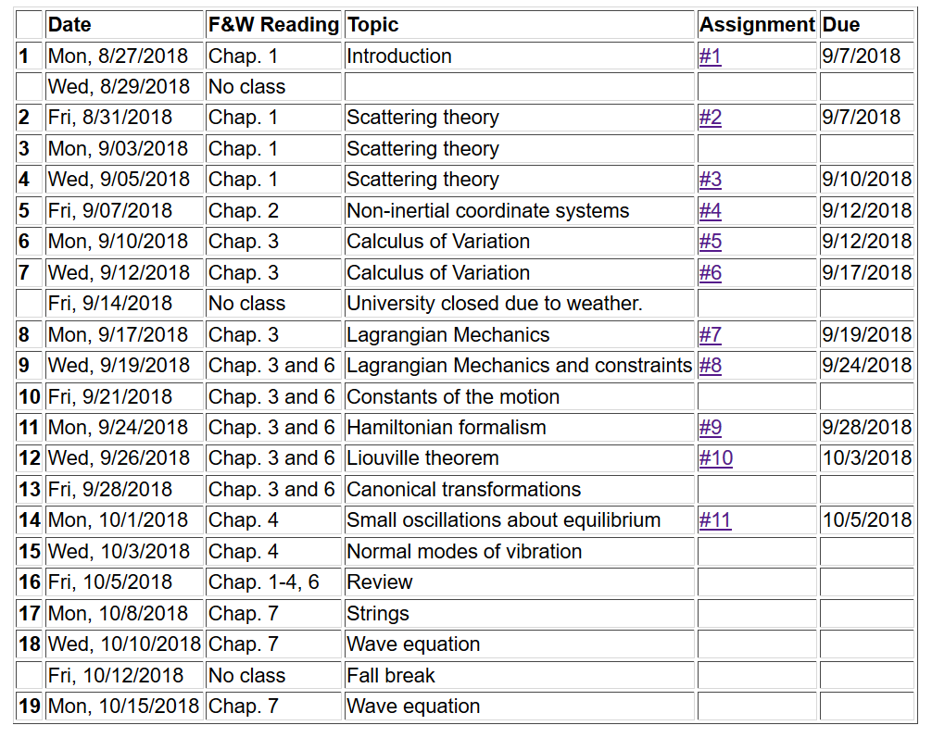

Slide 6
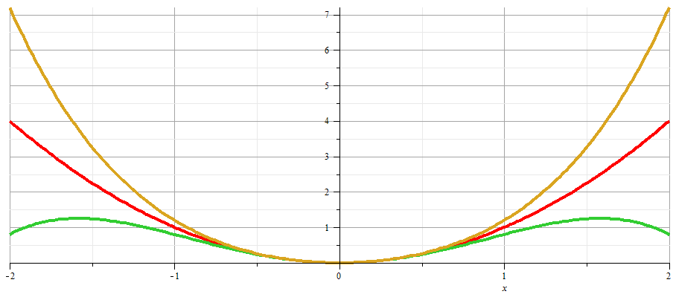
x

Slide 10
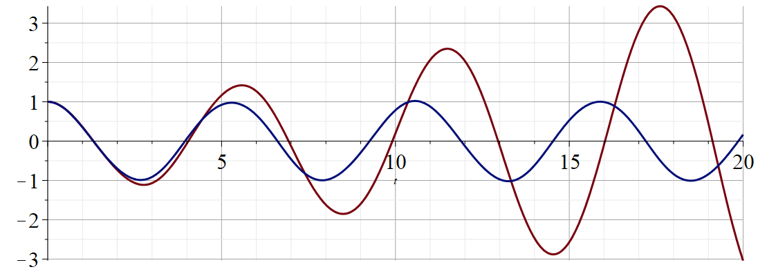
Regrouped expansion
x
t
Original perturbation expansion

Slide 11
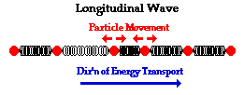
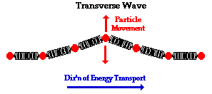
Returning to linear case; continuum limit --
Longitudinal versus transverse vibrations
Images from web page:
http://www.physicsclassroom.com/class/waves/u10l1c.cfm

Slide 12
Longitudinal case: a system of masses and springs:
m
m
m

Slide 13
system parameter with units of (velocity)²

Slide 14
Transverse displacement:
τ
μ(x,t)

Slide 20
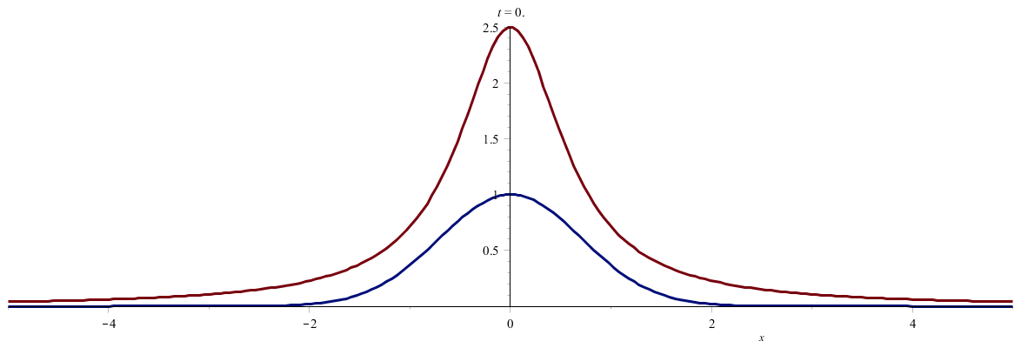

Slide 21
