Slide 1
PHY 711 Classical Mechanics and Mathematical Methods
10-10:50 AM MWF Olin 103
Plan for Lecture 18:
Continue reading Chapter 7
More comments on non-linear equation example
The wave equation
Sturm-Liouville equation
Green’s function solution methods

Slide 2
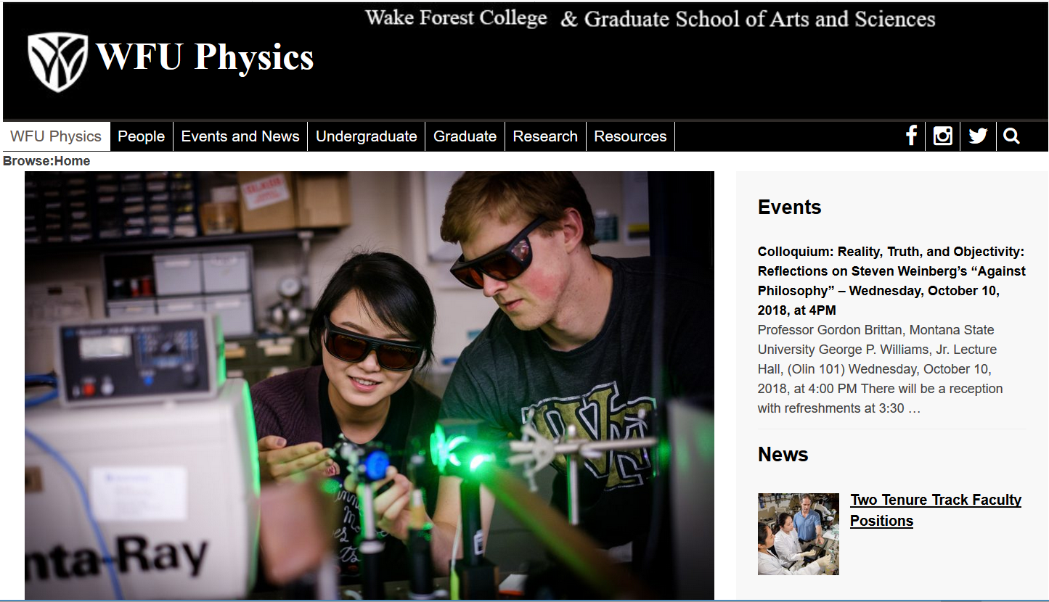

Slide 3
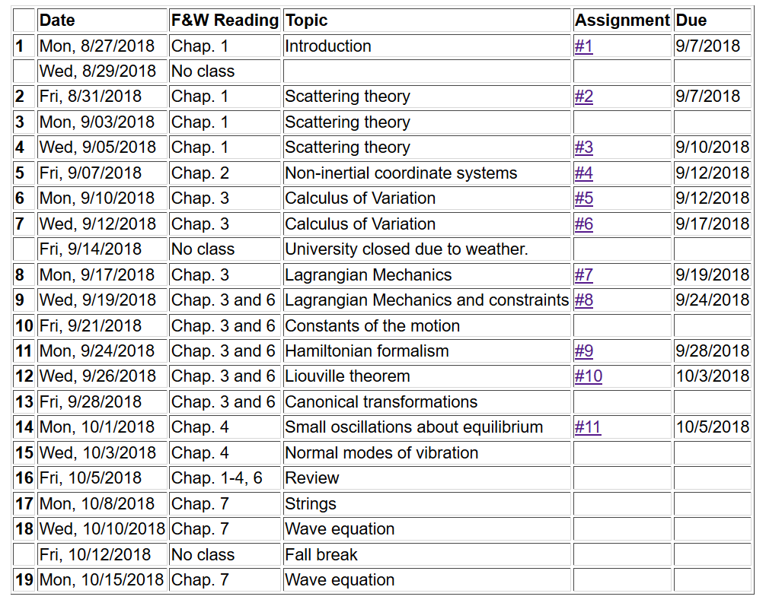

Slide 5
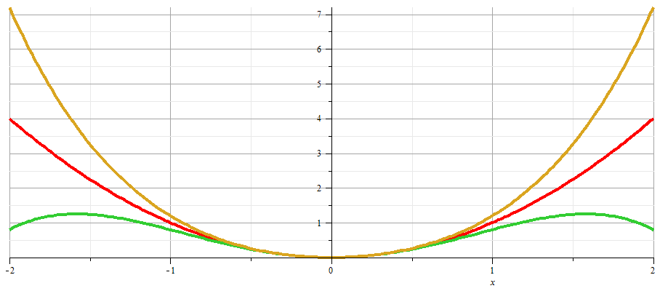
x

Slide 7
Blows up at large t

Slide 9
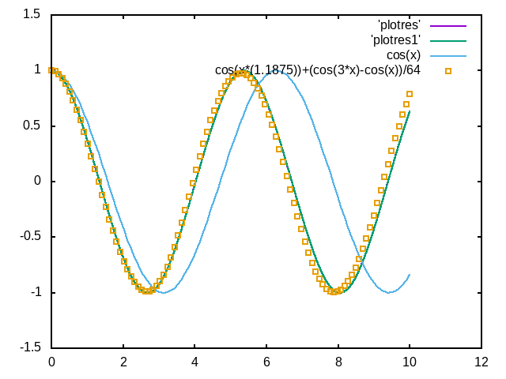
Result for ω=1, ε=0.5
Numerical results
x
t

Slide 10
Back to linear equations --

Slide 11
Linear second-order ordinary differential equations
Sturm-Liouville equations
given functions
applied force
solution to be determined
Homogenous problem: F(x)=0

Slide 12
Examples of Sturm-Liouville eigenvalue equations --

Slide 13
Solution methods of Sturm-Liouville equations (assume all functions and constants are real):

Slide 14
Comment on “completeness”
It can be shown that for any reasonable function h(x), defined within the interval a < x <b, we can expand that function as a linear combination of the eigenfunctions f_{n}(x)
These ideas lead to the notion that the set of eigenfunctions f_{n}(x) form a ``complete'' set in the sense of ``spanning'' the space of all functions in the interval
a < x <b, as summarized by the statement:

Slide 15
Variation approximation to lowest eigenvalue
In general, there are several techniques to determine the eigenvalues λ_{n} and eigenfunctions f_{n}(x). When it is not possible to find the ``exact'' functions, there are several powerful approximation techniques. For example, the lowest eigenvalue can be approximated by minimizing the function
where is a variable function which satisfies the
correct boundary values. The ``proof'' of this inequality is
based on the notion that can in principle be expanded
in terms of the (unknown) exact eigenfunctions f_{n}(x):
where the coefficients C_{n} can be
assumed to be real.

Slide 16
Estimation of the lowest eigenvalue – continued:
From the eigenfunction equation, we know that
It follows that:

Slide 17
Rayleigh-Ritz method of estimating the lowest eigenvalue

Slide 18
Green’s function solution methods
Recall:

Slide 19
Solution to inhomogeneous problem by using Green’s functions
Solution to homogeneous problem

Slide 20
Example Sturm-Liouville problem:

Slide 25
General method of constructing Green’s functions using homogeneous solution

