Slide 1
PHY 711 Classical Mechanics and Mathematical Methods
10-10:50 AM MWF Olin 103
Plan for Lecture 19:
Read Chapter 7 & Appendices A-D
Generalization of the one dimensional wave equation ➔ various mathematical problems and techniques including:
Sturm-Liouville equations
Eigenvalues; orthogonal function expansions
Green’s functions methods
Laplace transformation
Contour integration methods

Slide 2
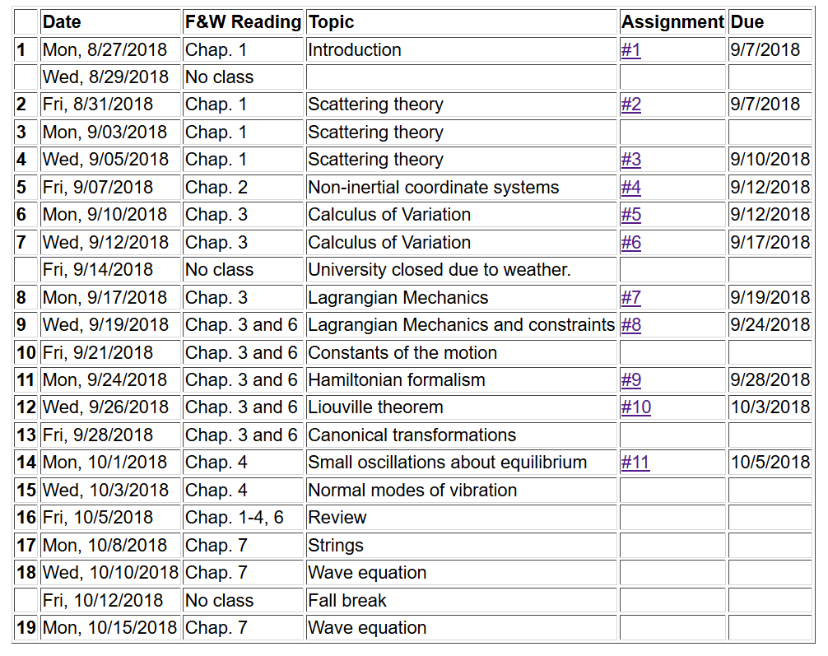

Slide 3
Remember:
Mid term exam due tomorrow (Tuesday) --

Slide 4
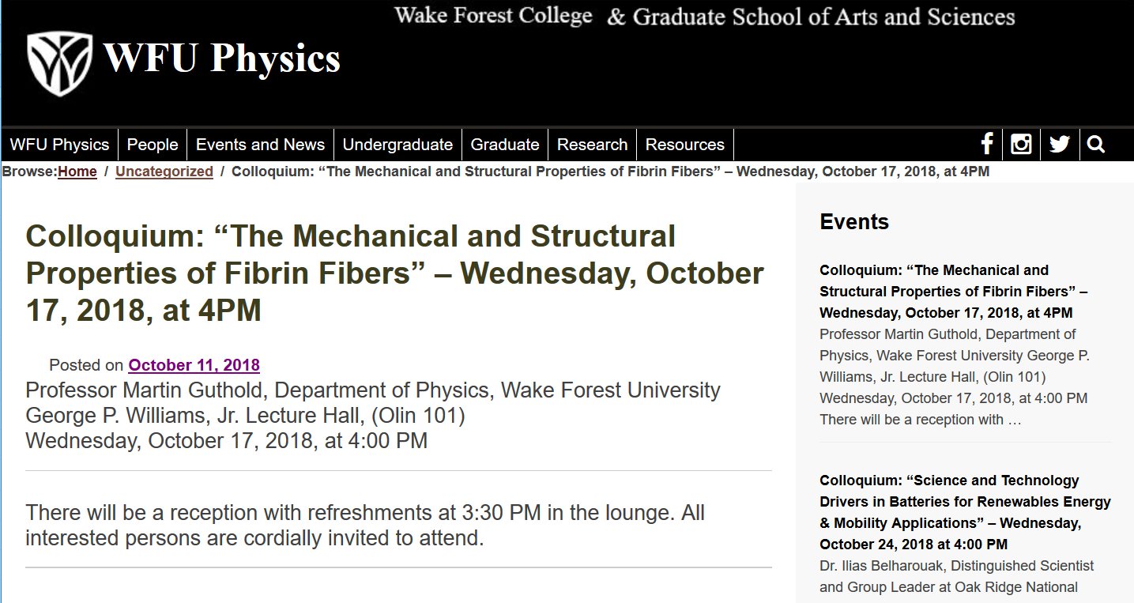

Slide 5
Eigenvalues and eigenfunctions of Sturm-Liouville equations

Slide 6
Variation approximation to lowest eigenvalue
In general, there are several techniques to determine the eigenvalues λ_{n} and eigenfunctions f_{n}(x). When it is not possible to find the ``exact'' functions, there are several powerful approximation techniques. For example, the lowest eigenvalue can be approximated by minimizing the function
where is a variable function which satisfies the
correct boundary values. The ``proof'' of this inequality is
based on the notion that can in principle be expanded
in terms of the (unknown) exact eigenfunctions f_{n}(x):
where the coefficients C_{n} can be
assumed to be real.

Slide 7
Estimation of the lowest eigenvalue – continued:
From the eigenfunction equation, we know that
It follows that:

Slide 8
Rayleigh-Ritz method of estimating the lowest eigenvalue

Slide 9
Rayleigh-Ritz method of estimating the lowest eigenvalue

Slide 10
Recap -- Rayleigh-Ritz method of estimating the lowest eigenvalue
Exact answer

Slide 11
Comment on “completeness” of set of eigenfunctions
It can be shown that for any reasonable function h(x), defined within the interval a < x <b, we can expand that function as a linear combination of the eigenfunctions f_{n}(x)
These ideas lead to the notion that the set of eigenfunctions f_{n}(x) form a ``complete'' set in the sense of ``spanning'' the space of all functions in the interval
a < x <b, as summarized by the statement:

Slide 12
Some details –
suggested that:

Slide 13
Green’s function solution methods

Slide 14
Green’s function solution methods
Recall:

Slide 15
Solution to inhomogeneous problem by using Green’s functions
Solution to homogeneous problem

Slide 16
Example Sturm-Liouville problem:

Slide 18
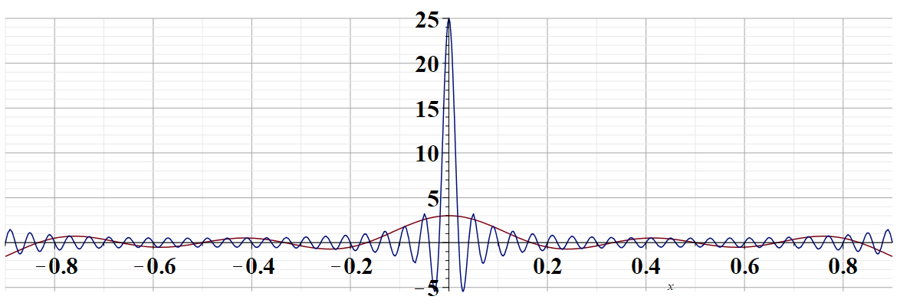
For L=2
n=1..50
n=1..5
x’ –x for x=1

Slide 21
(after some algebra)

Slide 22
General method of constructing Green’s functions using homogeneous solution

