Slide 1
PHY 711 Classical Mechanics and Mathematical Methods
10-10:50 AM MWF Olin 103
Plan for Lecture 2:
Brief comment on quiz
Particle interactions
Notion of center of mass reference fame
Introduction to scattering theory

Slide 2
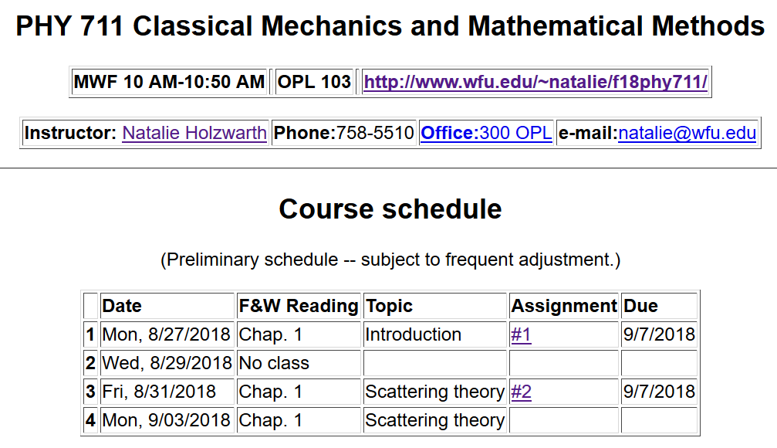

Slide 4
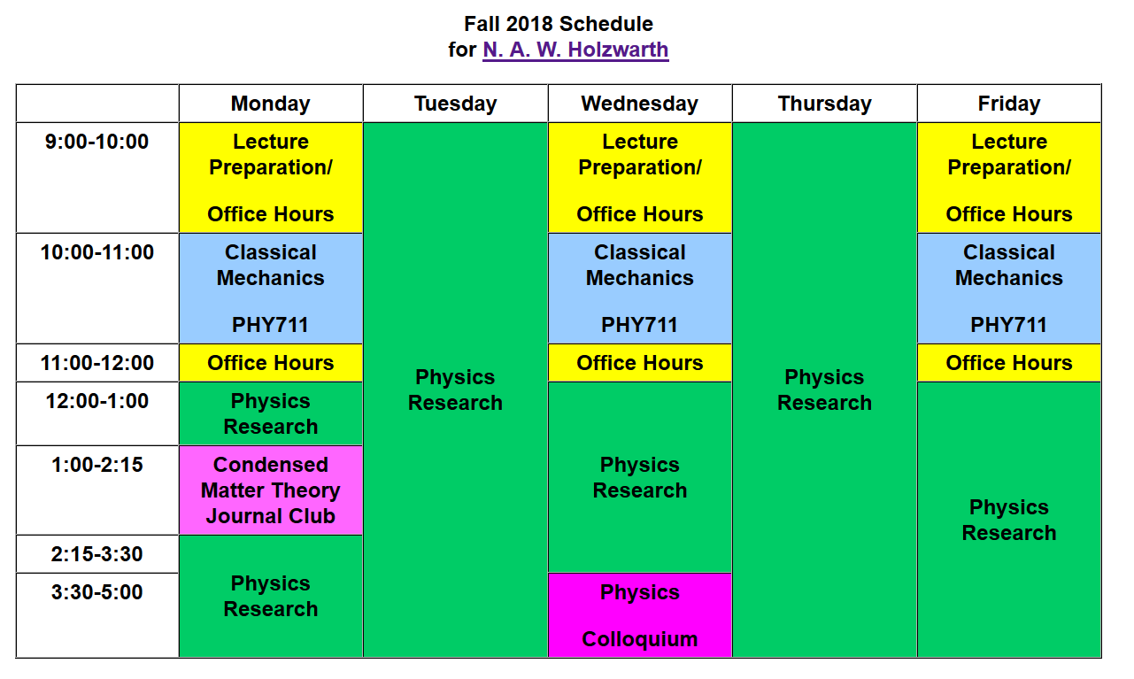
Schedule additional office hours by email: natalie@wfu.edu
office: Olin 300

Slide 5
Comment on quiz questions
1.
3.

Slide 6
Scattering theory:
detector

Slide 7
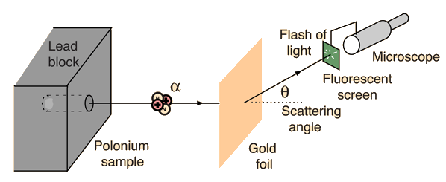
Example: Diagram of Rutherford scattering experiment
http://hyperphysics.phy-astr.gsu.edu/hbase/rutsca.html

Slide 8
b
Figure from Marion & Thorton, Classical Dynamics

Slide 9
Note: The notion of cross section is common to many areas of physics including classical mechanics, quantum mechanics, optics, etc. Only in the classical mechanics can we calculate it from a knowledge of the particle trajectory as it relates to the scattering geometry.
b
Figure from Marion & Thorton, Classical Dynamics
Note: We are assuming that the process is isotropic in φ

Slide 10
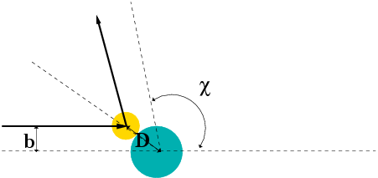
Simple example – collision of hard spheres
Microscopic view:

Slide 11
Simple example – collision of hard spheres -- continued
Hard sphere:

Slide 12
Relationship of scattering cross-section to particle interactions --
Classical mechanics of a conservative 2-particle system.
1
2

Slide 13
Typical two-particle interactions –

Slide 14
Relationship between center of mass and laboratory frames of reference

Slide 15
Classical mechanics of a conservative 2-particle system -- continued

Slide 16
Note: The following analysis will be carried out in the center of mass frame of reference.
In laboratory frame: In center-of-mass frame:
V₁
v₁
μ
m₁
r
origin
v_{CM}
m_{target}
Also note: We are assuming that the interaction between particle and target V(r) conserves energy and angular momentum.

Slide 17
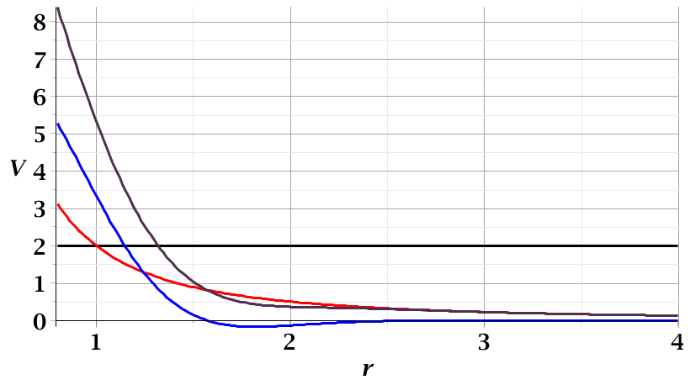
For a continuous potential interaction in center of mass reference frame:
Need to relate these parameters to differential cross section
➔ to be discussed on Friday
V(r)
E_{rel}
r_{min}

Slide 18
It is often convenient to analyze the scattering cross section in the center of mass reference frame.
Relationship between normal laboratory reference and center of mass:
Laboratory reference frame:
Before After
m₁
m₂
u₁
v₁
ψ
u₂=0
ζ
v₂
Center of mass reference frame:
Before After
m₁
m₂
V₁
U₁
U₂
θ
θ
V₂

Slide 19
Relationship between center of mass and laboratory frames of reference -- continued

Slide 20
Relationship between center of mass and laboratory frames of reference
V_{CM}
V₁
v₁
θ
ψ
For elastic
scattering

Slide 21
Digression – elastic scattering
Also note:

Slide 22
Relationship between center of mass and laboratory frames of reference – continued (elastic scattering)
V_{CM}
V₁
v₁
ψ
θ

Slide 23
Differential cross sections in different reference frames

Slide 24
Differential cross sections in different reference frames – continued:

Slide 25
Example: suppose m₁ = m₂

