Slide 1
PHY 711 Classical Mechanics and Mathematical Methods
10-10:50 AM MWF Olin 103
Plan for Lecture 20:
Read Chapter 7 & Appendices A-D
Generalization of the one dimensional wave equation ➔ various mathematical problems and techniques including:
Orthogonal function expansions
Fourier series
Fourier transforms
Fast Fourier transforms

Slide 2
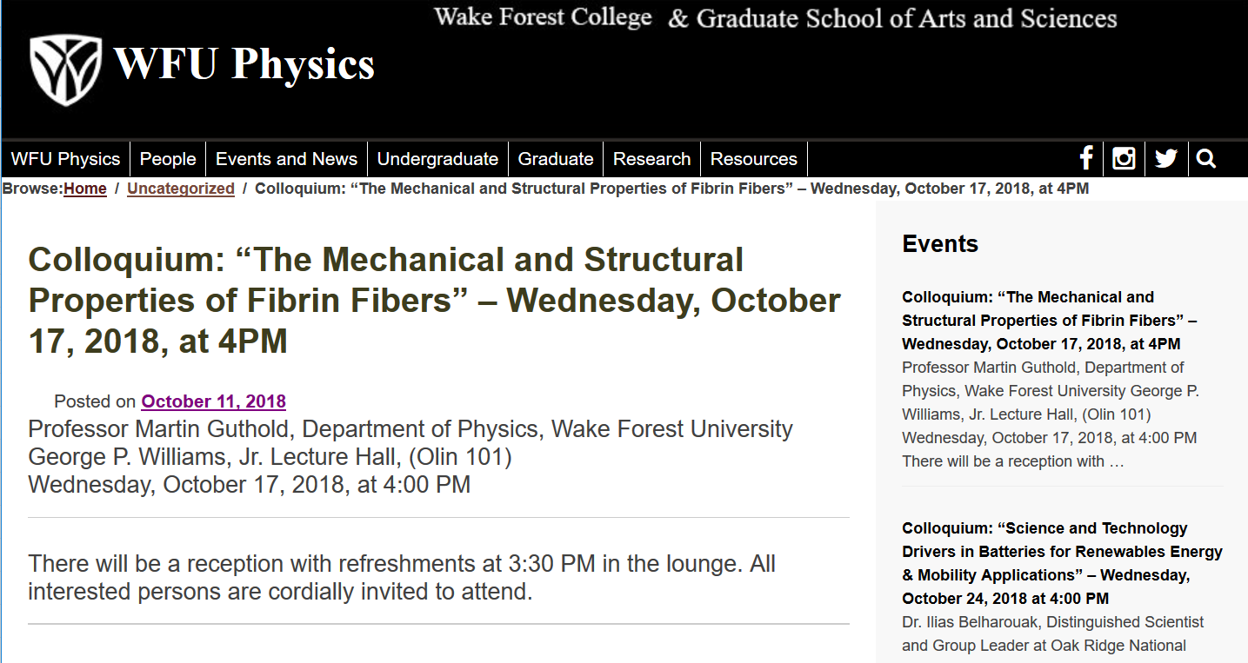

Slide 3
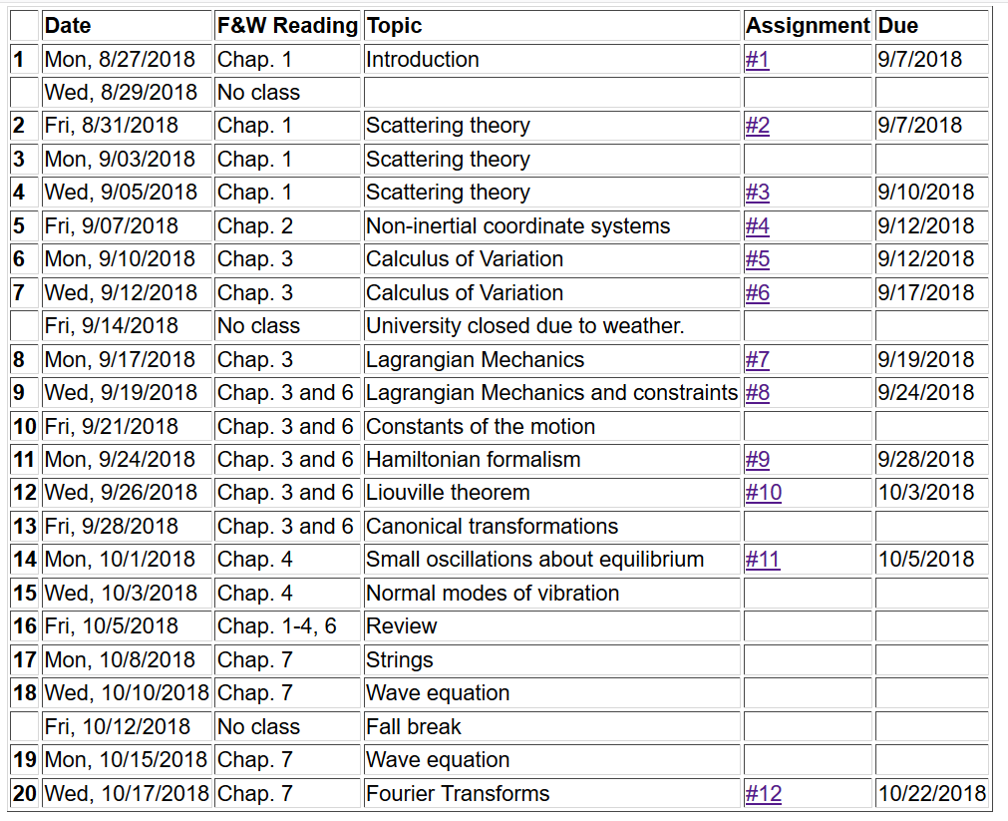

Slide 4
Eigenvalues and eigenfunctions of Sturm-Liouville equations

Slide 6
Example
x

Slide 7
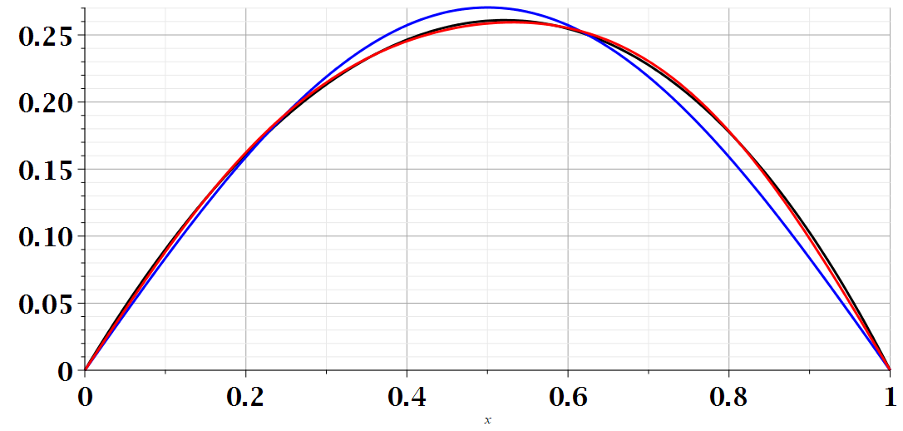
Example
x

Slide 8
Generalization to infinite range
Examples in time domain --

Slide 9
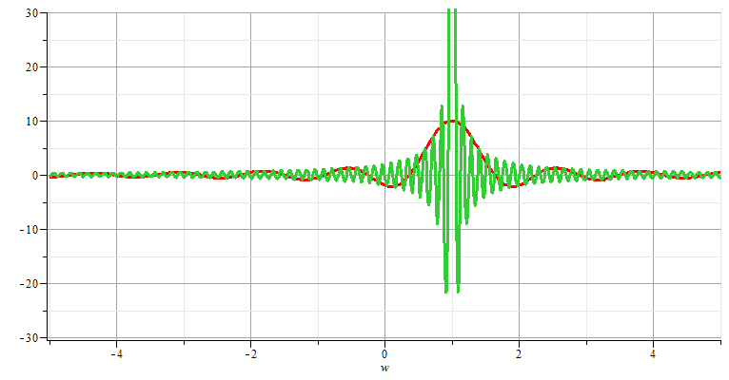
Fourier transforms

Slide 10
Note: The location of the 2π factor varies among texts.

Slide 12
Use of Fourier transforms to solve wave equation

Slide 13
Use of Fourier transforms to solve wave equation -- continued

Slide 17
Example:

Slide 18
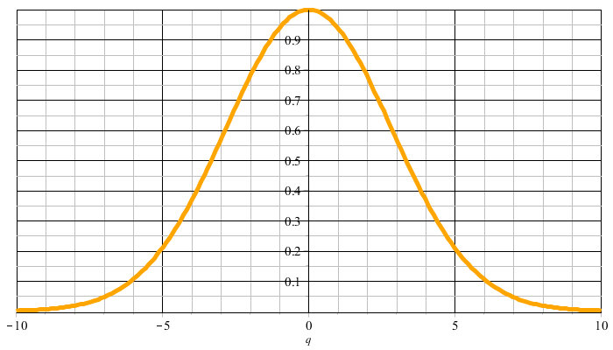
Example:
f(t)
F(νΩ)

Slide 19
F(νΩ)
ν=-M
ν=M

Slide 23
Cooley-Tukey algorithm: J. W. Cooley and J. W. Tukey, “An algorithm for machine calculation of complex Fourier series” Math. Computation 19, 297-301 (1965)

Slide 24
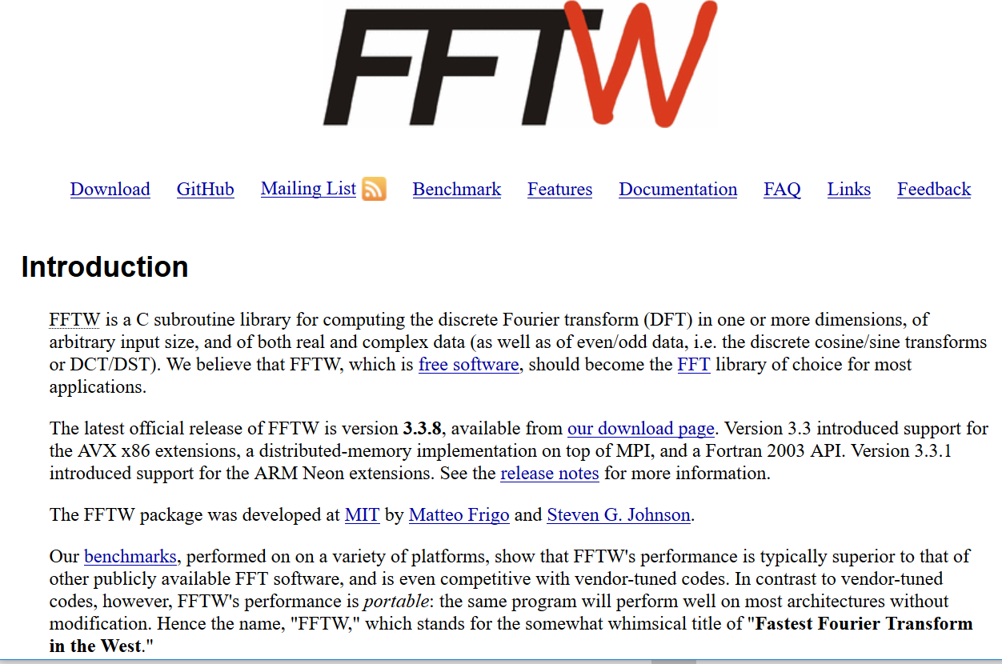
http://www.fftw.org/

