Slide 1
PHY 711 Classical Mechanics and Mathematical Methods
10-10:50 AM MWF Olin 103
Plan for Lecture 21:
    Read Chapter 7 & Appendices A-D
    Generalization of the one dimensional wave equation ➔ various mathematical problems and techniques including:
            Laplace transforms
            Complex variables
            Contour integrals

Slide 2
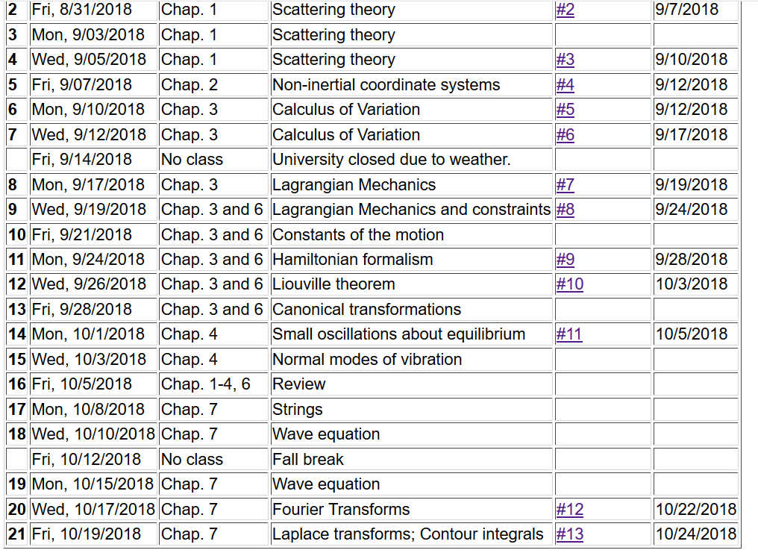

Slide 3
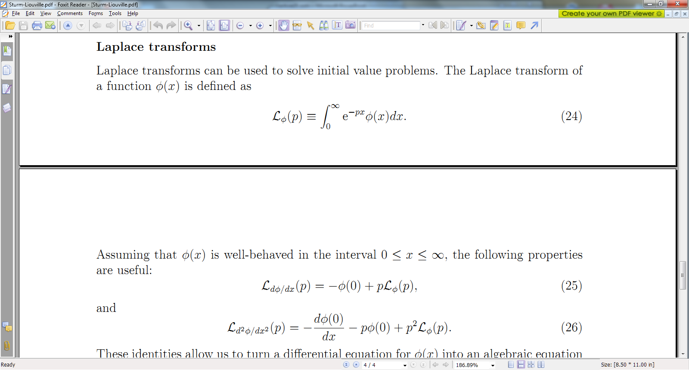

Slide 4
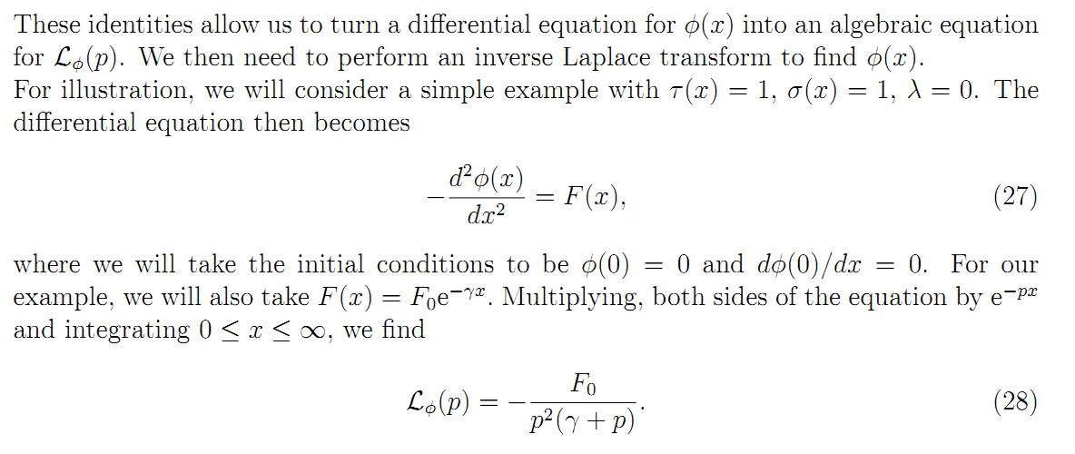

Slide 5
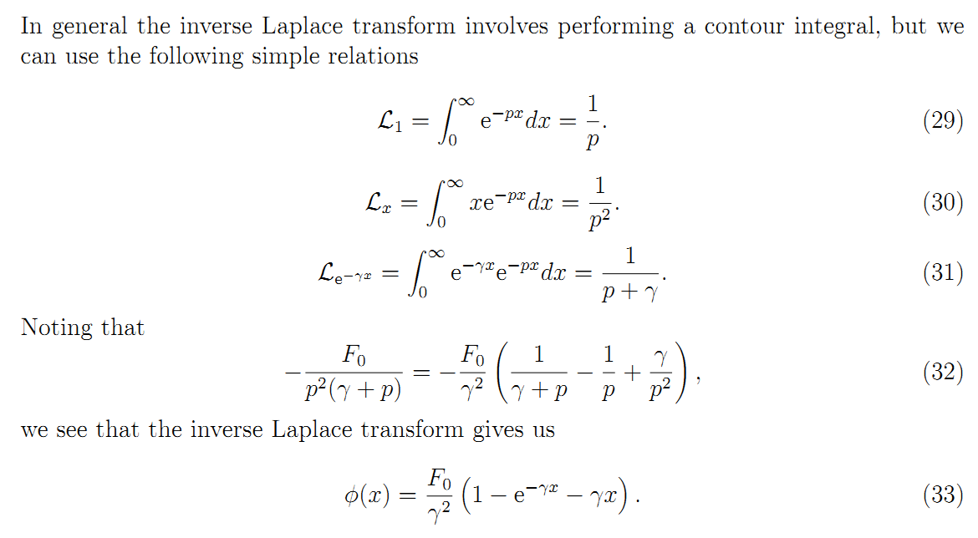

Slide 8
Complex numbers
Functions of complex variables
Derivatives:
Cauchy-Riemann equations

Slide 9
Analytic function

Slide 10
Some details

Slide 11
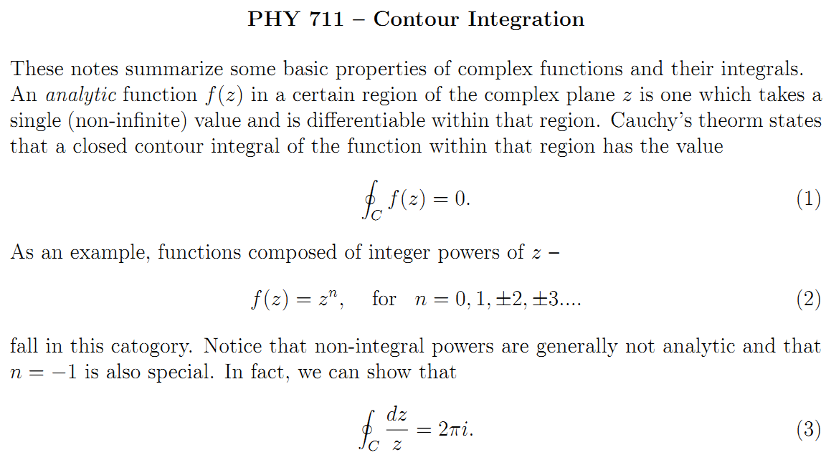

Slide 12
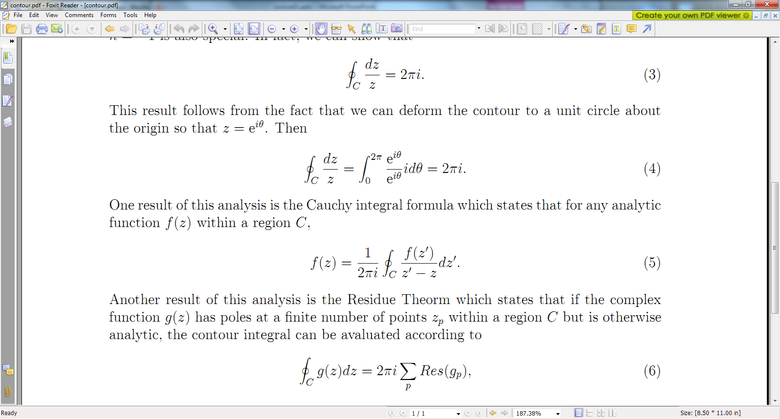

Slide 13
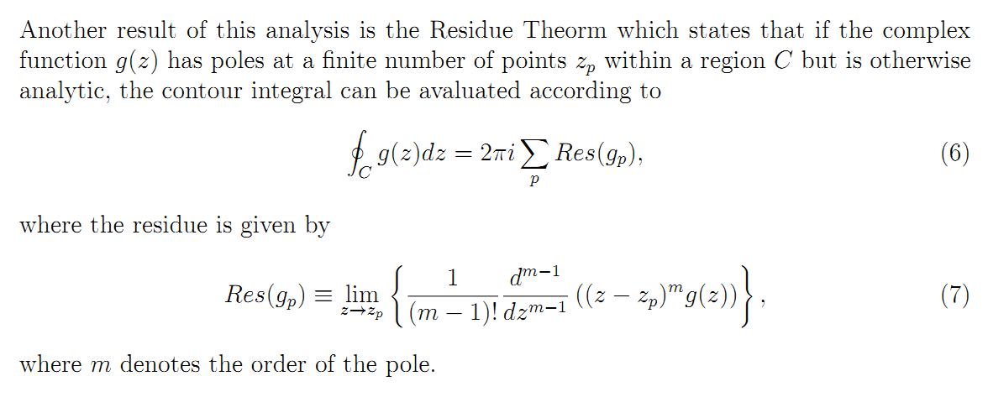

Slide 14
Example:
Im(z)
Re(z)

Slide 15
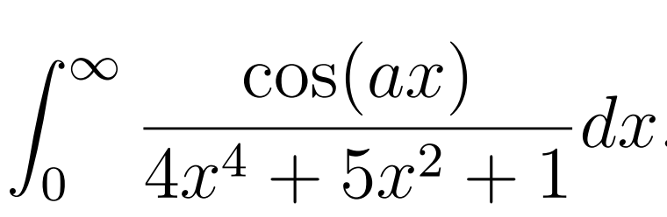
Another example:
Im(z)
Re(z)

Slide 17
Cauchy integral theorem for analytic function f(z):

Slide 18
Example
Im(z)
Re(z)

Slide 19
Example -- continued
Im(z)
Re(z)

Slide 20
Example -- continued
Im(z’)
x
Re(z’)

Slide 21
Example -- continued
Kramers-Kronig relationships

Slide 22
Comment on evaluating principal parts integrals
y’
x’

Slide 23
b(x’)
-2L
-L
L
2L
x’

Slide 24
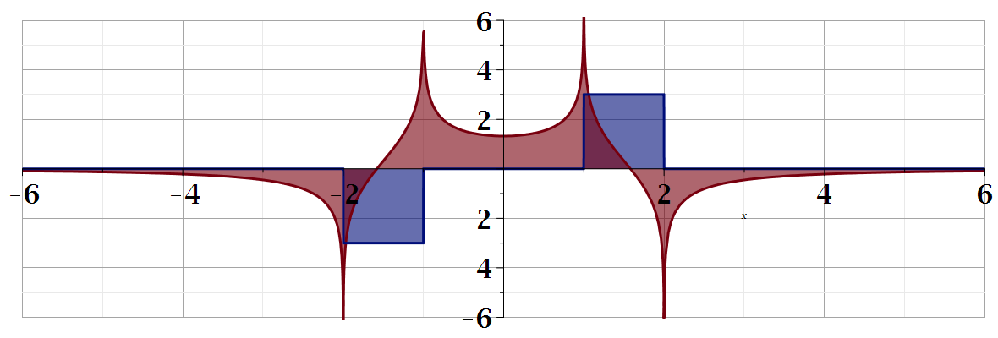
For our example:
b(x)
a(x)

