Slide 1
PHY 711 Classical Mechanics and Mathematical Methods
10-10:50 AM MWF Olin 103
Plan for Lecture 22:
    Read Chapter 7 & Appendices A-D
    Generalization of the one dimensional wave equation ➔ various mathematical problems and techniques including:
            Complex variables
            Contour integrals

Slide 2
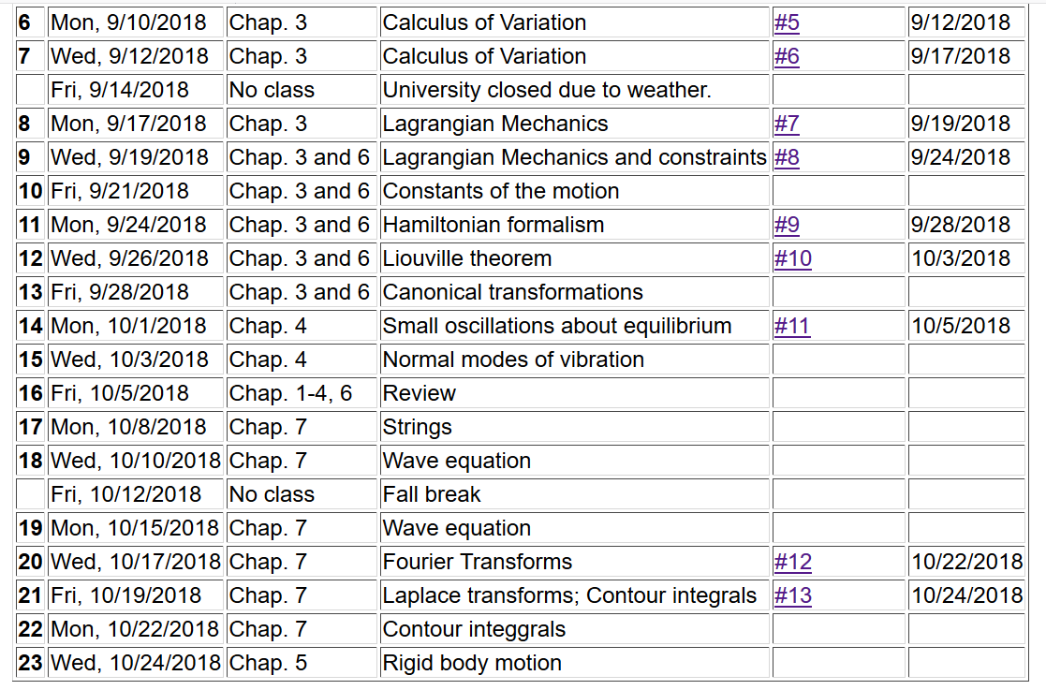

Slide 3



Slide 4
Complex numbers
Functions of complex variables
Derivatives:
Cauchy-Riemann equations

Slide 5

Analytic function
Examples of analytic functions

Slide 6
Examples of non-analytic functions

Slide 7
No contribution
C

Slide 9
Example:
Im(z)
Re(z)
Note:
m=1

Slide 10
Some details:

Slide 11
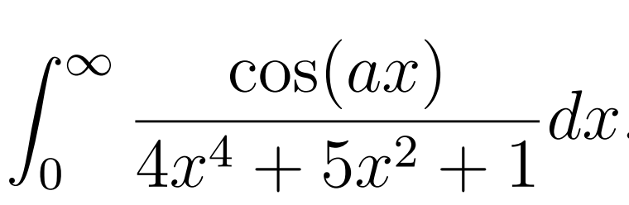
Another example:
Note:
m=1
Im(z)
Re(z)

Slide 13
Another example:
Im(z)
ia
Re(z)
10/30/2017
PHY 711 Fall 2017 -- Lecture 25
13

Slide 15
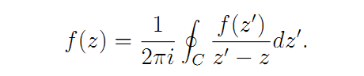
Cauchy integral theorem for analytic function f(z):

Slide 16
Example
Im(z)
Re(z)

Slide 17
Example -- continued
Im(z)
Re(z)

Slide 18
Example -- continued
Im(z’)
x
Re(z’)

Slide 19
Im(z’)
x
Re(z’)

Slide 20
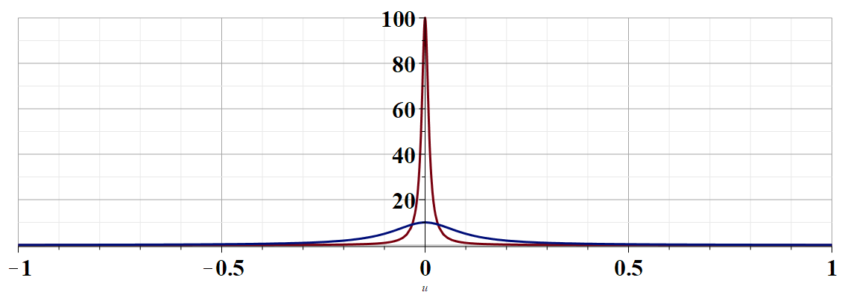
More details --
u

Slide 21
Example -- continued
Kramers-Kronig relationships

Slide 22
Comment on evaluating principal parts integrals
y’
x’

Slide 23
b(x’)
-2L
-L
L
2L
x’

Slide 25
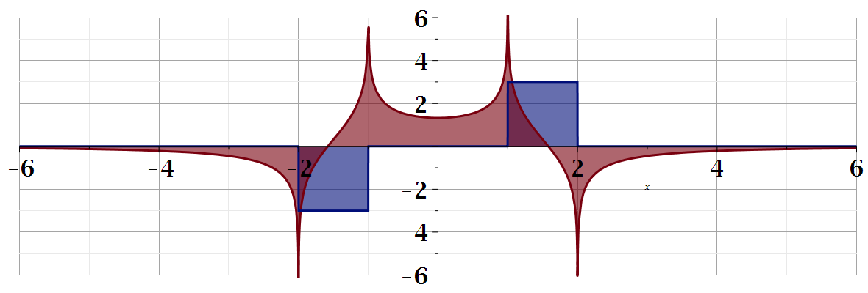
For our example:
b(x)
a(x)

