Slide 1
PHY 711 Classical Mechanics and Mathematical Methods
10-10:50 AM MWF Olin 103
Plan for Lecture 25:
Motions of elastic membranes (Chap. 8)
Review of standing waves on a string
Standing waves on a two dimensional membrane.
Boundary value problems

Slide 2
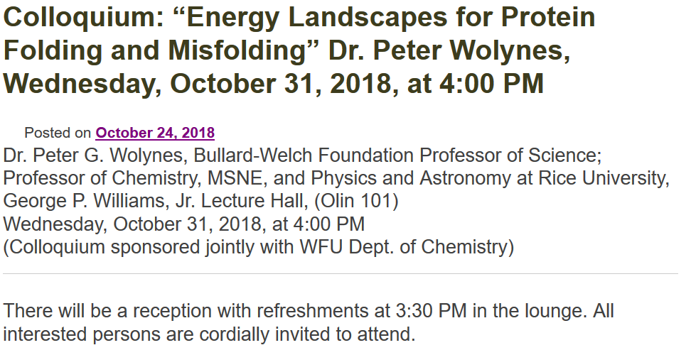

Slide 3
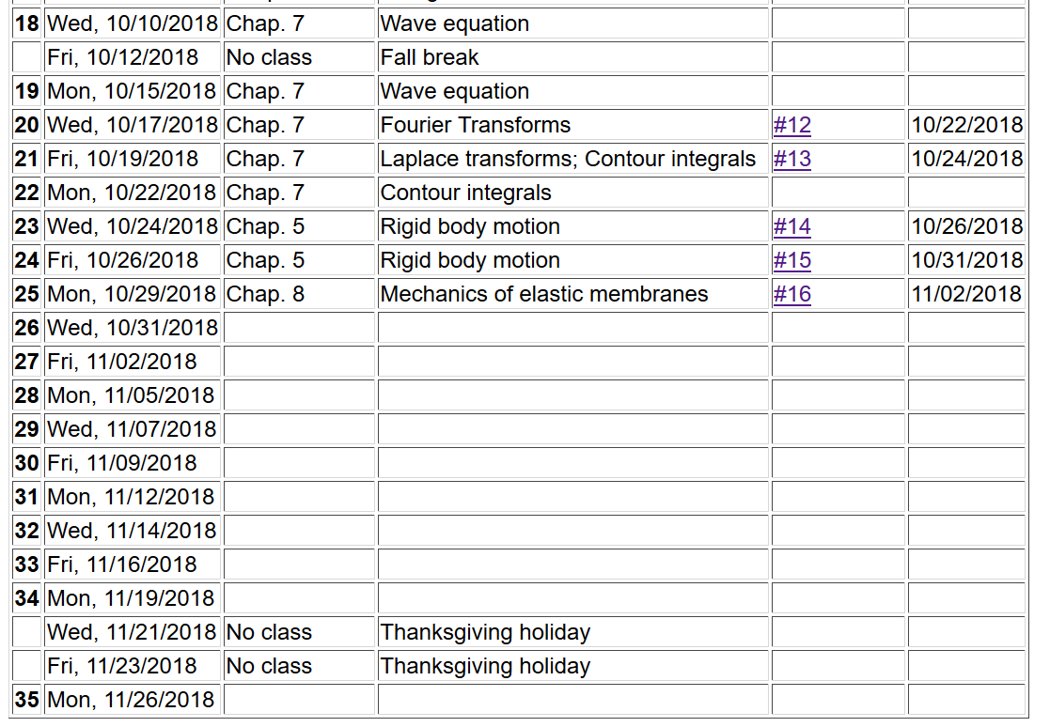

Slide 4
Elastic media in two or more dimensions --
Review of wave equation in one-dimension – here μ(x,t) can describe either a longitudinal or transverse wave.
Traveling wave solutions --

Slide 6
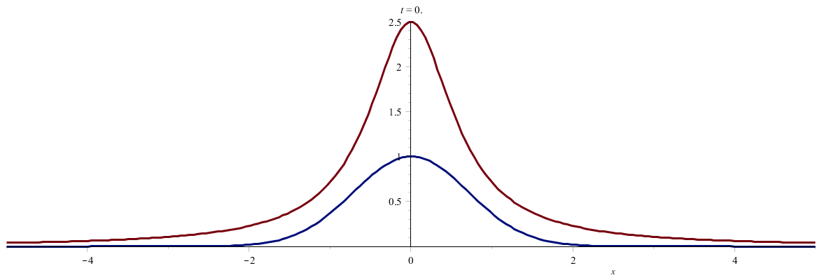

Slide 7
Standing wave solutions of wave equation:

Slide 8
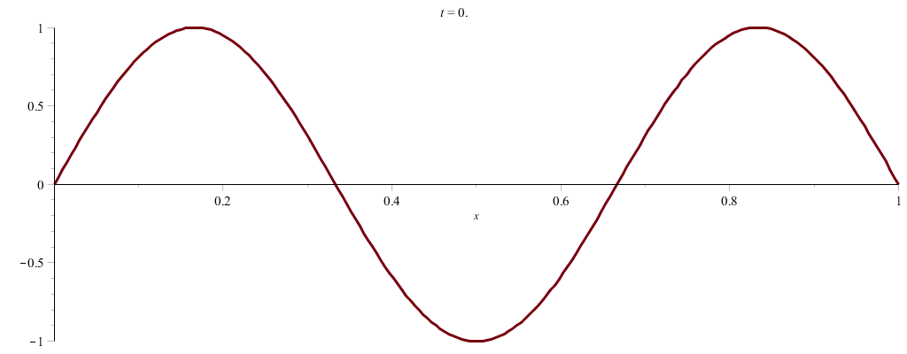

Slide 9
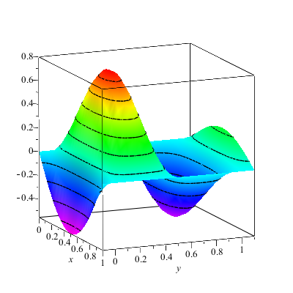
Wave motion on a two-dimensional surface – elastic membrane (transverse wave; linear regime).
u(x,y,t)

Slide 12
Consider a rectangular boundary:
b
a

Slide 13
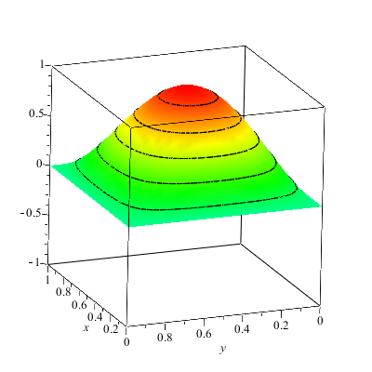
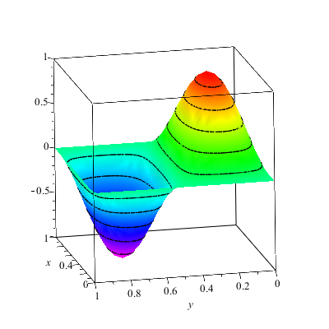
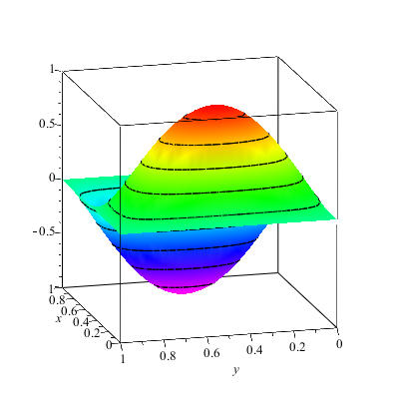
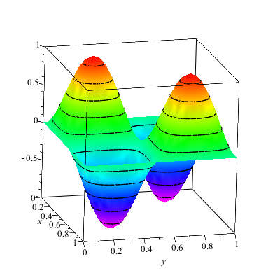

Slide 14
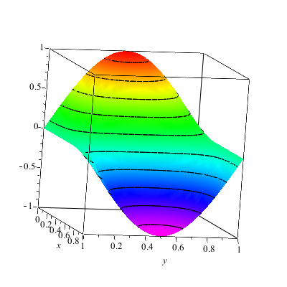
More general boundary conditions:

Slide 15
Consider a circular boundary:
R

Slide 16
Consider circular boundary -- continued

Slide 17
Some properties of Bessel functions

Slide 18
http://dlmf.nist.gov/

Slide 19
Series expansions of Bessel and Neumann functions

Slide 20
Some properties of Bessel functions -- continued

Slide 21
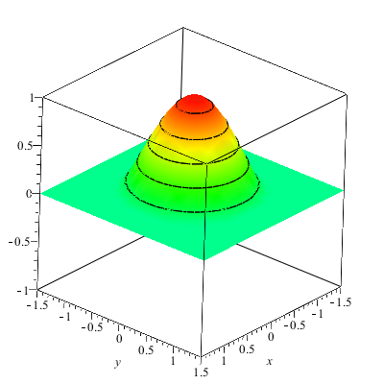
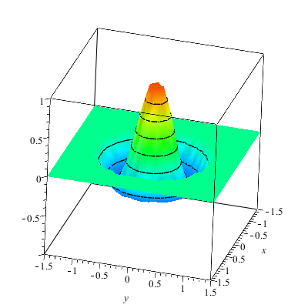

Slide 22
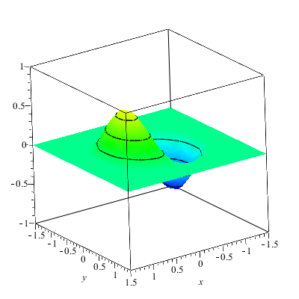
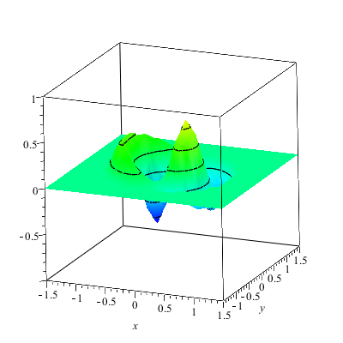

Slide 23
More complicated geometry – annular membrane
a
b

Slide 24
Consider circular boundary -- continued

Slide 25
Normal modes of an annular membrane -- continued
a
b

Slide 26
Normal modes of an annular membrane -- continued
a
b

Slide 27
Normal modes of an annular membrane -- continued
a
b

Slide 28
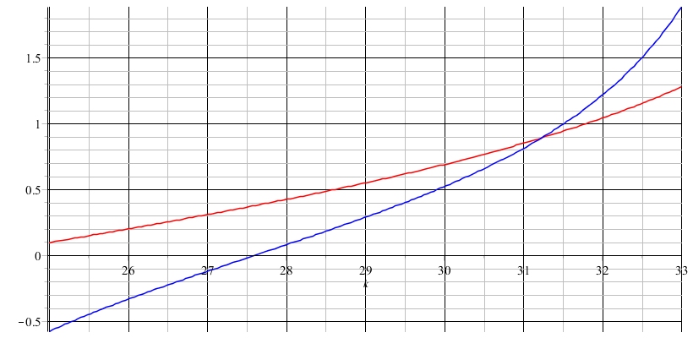
Analysis for m=0 and a=0.1, b=0.2:

Slide 30
a
b

