Slide 1
PHY 711 Classical Mechanics and Mathematical Methods
10-10:50 AM MWF Olin 103
Plan for Lecture 28:
Introduction to hydrodynamics
(Chap. 9 in F & W)
Incompressible fluids
Isentropic fluids

Slide 2
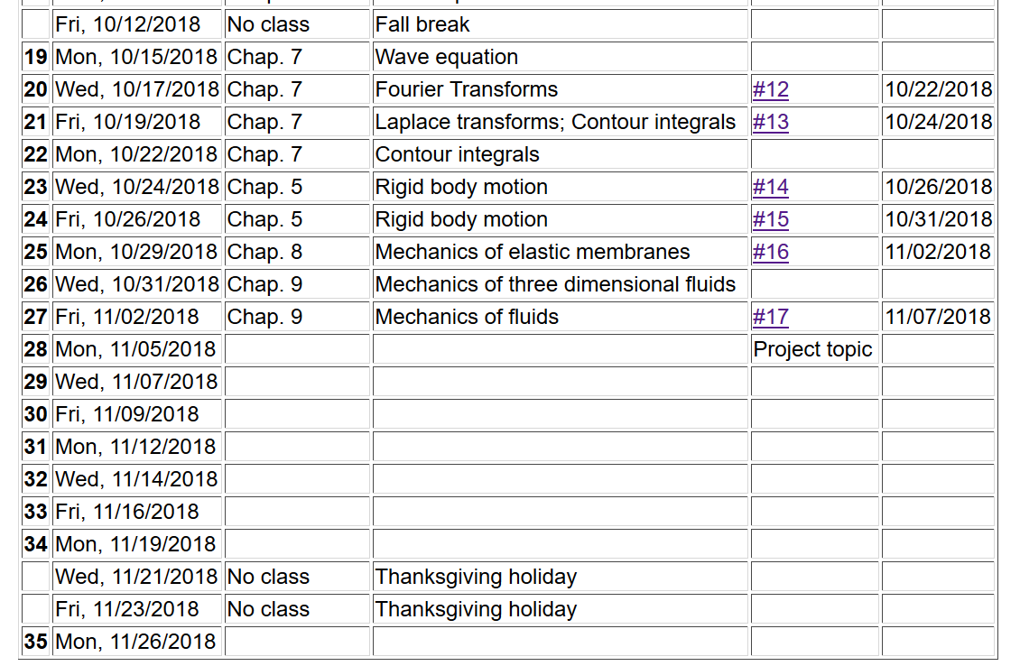

Slide 3
Newton’s equations for fluids
Use Euler formulation; properties described in terms of
stationary spatial grid
t’
t

Slide 4
Euler analysis -- continued
Example:

Slide 5
Some details on the velocity potential

Slide 6
Example – uniform flow
b
a
z

Slide 7
Example – flow around a long cylinder (oriented in the Y direction)
^
X
^
v₀ Z
r=a
^
θ
v₀ Z
^
Z

Slide 11
Spherical system continued:
(Continue analysis for homework)

Slide 12
Solution of Euler’s equation for fluids

Slide 13
Bernoulli’s integral of Euler’s equation for constant ρ
For incompressible fluid

Slide 14
Solution of Euler’s equation for fluids -- isentropic

Slide 15
Solution of Euler’s equation for fluids – isentropic (continued)

Slide 16
Solution of Euler’s equation for fluids – isentropic (continued)

Slide 17
Solution of Euler’s equation for fluids – isentropic (continued)

Slide 18
Summary of Bernoulli’s results
For incompressible fluid
For isentropic fluid with internal energy density ε

Slide 19
Application of fluid equations to the case of air in equilibrium plus small perturbation

Slide 23
Analysis of wave velocity in an ideal gas:

