Slide 1
PHY 711 Classical Mechanics and Mathematical Methods
10-10:50 AM MWF Olin 103
Plan for Lecture 3:
Textbook reading: Chapter 1
Introduction to scattering theory
Center of mass reference fame and its relationship to “laboratory” reference frame
Evaluation of the differential scattering cross section

Slide 2
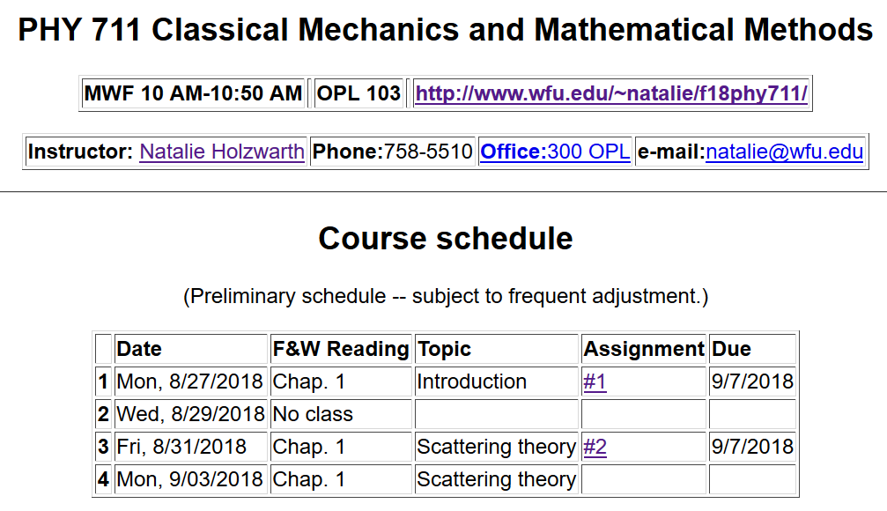

Slide 3
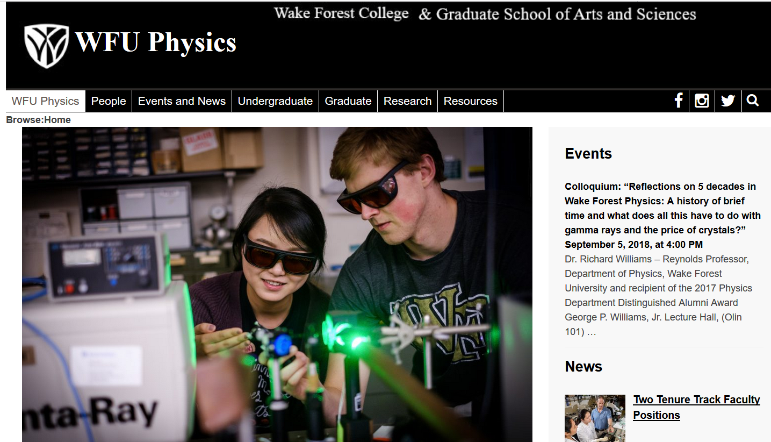

Slide 4
Note: Part b is hard. Do the best you can.

Slide 5
Scattering theory:
detector

Slide 6
b
Figure from Marion & Thorton, Classical Dynamics

Slide 7
Note: The notion of cross section is common to many areas of physics including classical mechanics, quantum mechanics, optics, etc. Only in the classical mechanics can we calculate it from a knowledge of the particle trajectory as it relates to the scattering geometry.
b
Figure from Marion & Thorton, Classical Dynamics
Note: We are assuming that the process is isotropic in φ

Slide 8
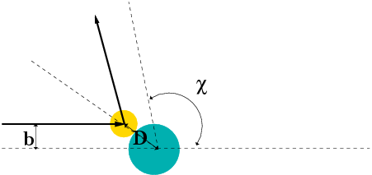
Simple example – collision of hard spheres
Microscopic view:

Slide 9
Simple example – collision of hard spheres -- continued
Hard sphere:

Slide 10
Relationship of scattering cross-section to particle interactions --
Classical mechanics of a conservative 2-particle system.
1
2

Slide 11
Typical two-particle interactions –

Slide 12
Relationship between center of mass and laboratory frames of reference

Slide 13
Classical mechanics of a conservative 2-particle system -- continued

Slide 14
constants
vary in time
For scattering analysis only need to know trajectory before and after
the collision.

Slide 15
Note: The following analysis will be carried out in the center of mass frame of reference.
In laboratory frame: In center-of-mass frame:
V₁
v₁
μ
m₁
r
origin
v_{CM}
m_{target}
Also note: We are assuming that the interaction between particle and target V(r) conserves energy and angular momentum.

Slide 16
It is often convenient to analyze the scattering cross section in the center of mass reference frame.
Relationship between normal laboratory reference and center of mass:
Laboratory reference frame:
Before After
m₁
m₂
u₁
v₁
ψ
u₂=0
ζ
v₂
Center of mass reference frame:
Before After
m₁
m₂
V₁
U₁
U₂
θ
θ
V₂

Slide 17
Relationship between center of mass and laboratory frames of reference -- continued

Slide 18
Relationship between center of mass and laboratory frames of reference
V_{CM}
V₁
v₁
θ
ψ
For elastic
scattering

Slide 19
Digression – elastic scattering
Also note:

Slide 20
Relationship between center of mass and laboratory frames of reference – continued (elastic scattering)
V_{CM}
V₁
v₁
ψ
θ

Slide 21
Differential cross sections in different reference frames

Slide 22
Differential cross sections in different reference frames – continued:

Slide 23
Example: suppose m₁ = m₂

Slide 24
Summary --
Differential cross sections in different reference frames – continued:
For elastic scattering

Slide 25
Example: suppose m₁ = m₂

Slide 26
Example of hard spheres
θ

Slide 27
Hard sphere example – continued
m₁=m₂
Center of mass frame
Lab frame

Slide 28
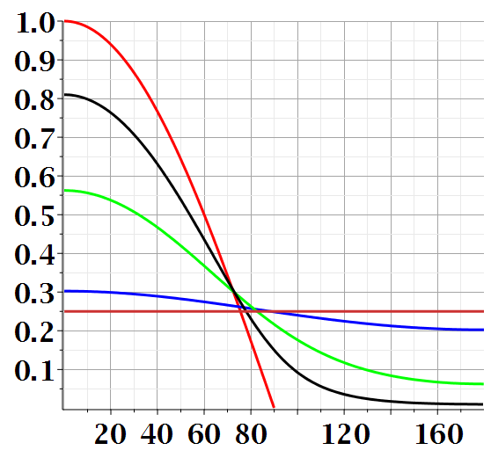
Scattering cross section for hard sphere in lab frame for various mass ratios:

Slide 29
Maple syntax:

Slide 30
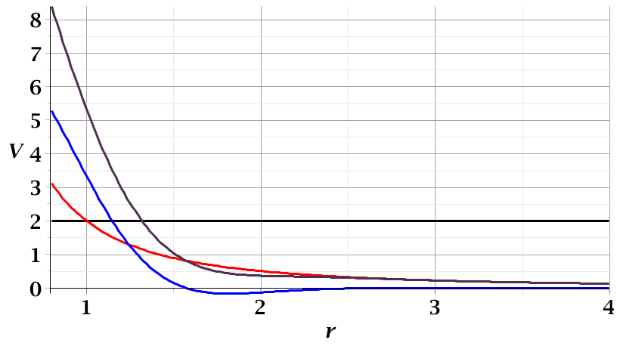
For a continuous potential interaction in center of mass reference frame:
Need to relate these parameters to differential cross section
E_{rel}
r_{min}

Slide 31
Focusing on the center of mass frame of reference:
Typical two-particle interactions –
X
⬅

