Slide 1
PHY 711 Classical Mechanics and Mathematical Methods
10-10:50 AM MWF Olin 103
Plan for Lecture 30: Chap. 9 of F&W
Wave equation for sound in the linear approximation
Sound scattering
Non-linear effects in sound waves

Slide 2
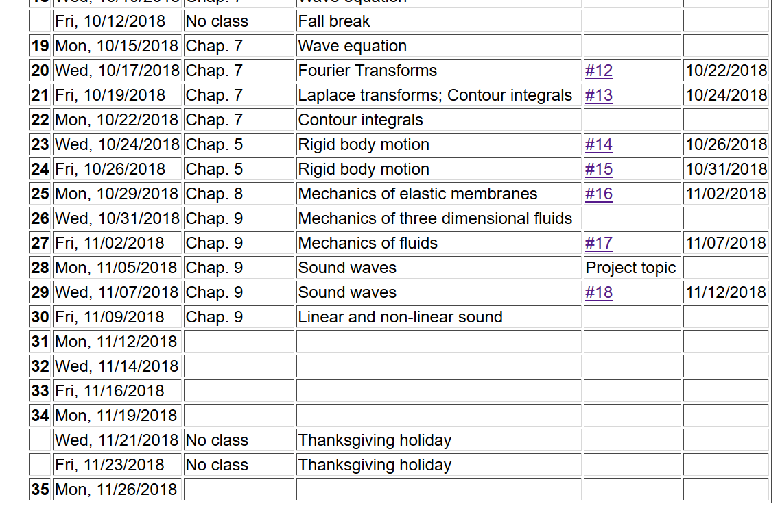

Slide 3
Solutions to wave equation:

Slide 4
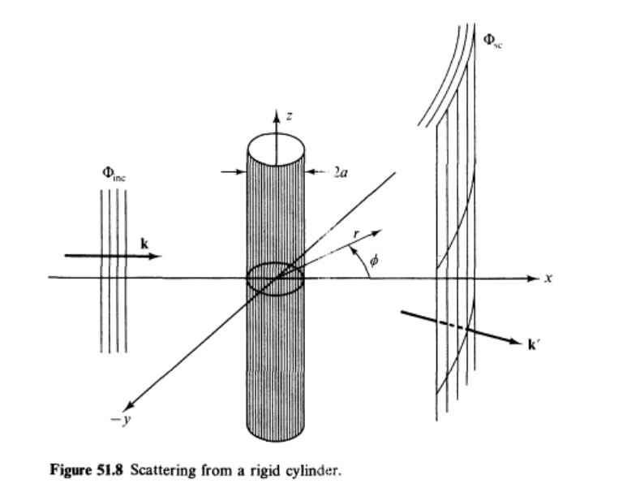
Scattering of sound waves –
for example, from a rigid cylinder
Figure from Fetter and Walecka pg. 337

Slide 5
Scattering of sound waves –
for example, from a rigid cylinder

Slide 8
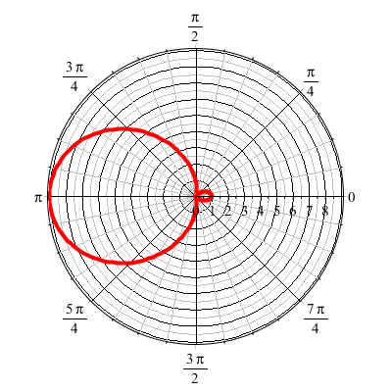
For ka << 1
See Appendix E of F & W

Slide 9
Effects of nonlinearities in fluid equations
-- one dimensional case

Slide 15
Traveling wave solution:

Slide 16
Traveling wave solution -- continued:

Slide 17
Traveling wave solution -- full non-linear case:
w

Slide 18
Visualization continued:

Slide 19
Summary

Slide 20
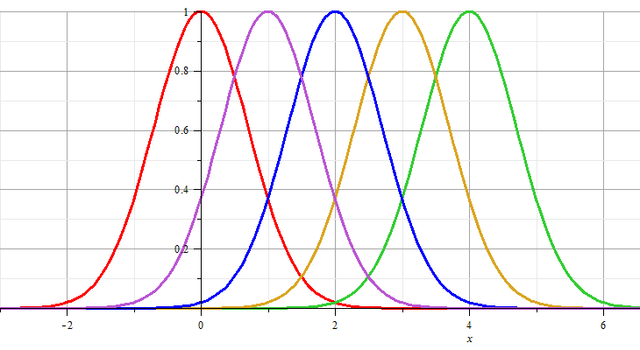
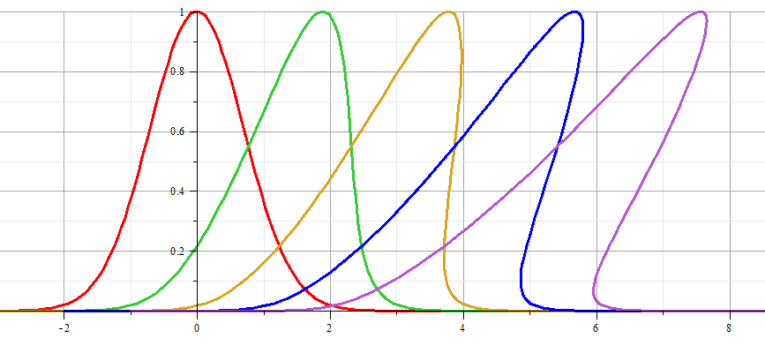
Linear wave:
Non-linear wave:

Slide 21
Linear wave
Non-linear wave

Slide 22
Analysis of shock wave
Plots of δρ
Solution becomes unphysical

Slide 23
Analysis of shock wave -- continued
After shock
t₂
δρ₂, δv₂, δp₂
Before shock
t₁
δρ₁, δv₁, δp₁
Shock front
x
u

Slide 24
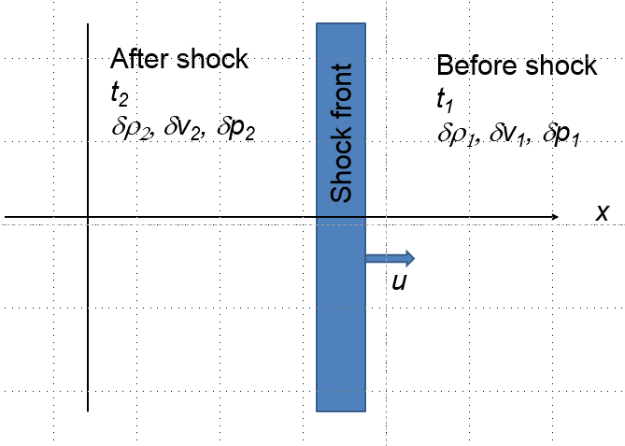
Analysis of shock wave – continued
While analysis in the shock region is complicated, we can use conservation laws to analyze regions 1 and 2

Slide 25
Analysis of shock wave – continued
For adiabatic ideal gas, also considering energy and momentum conservation:

Slide 26
Analysis of shock wave – continued
For adiabatic ideal gas, entropy considerations::

