Slide 1
PHY 711 Classical Mechanics and Mathematical Methods
10-10:50 AM MWF Olin 103
Plan for Lecture 34
Physics of elastic continua –
Chap. 13 in F & W
Stress and strain
Waves in elastic media

Slide 2
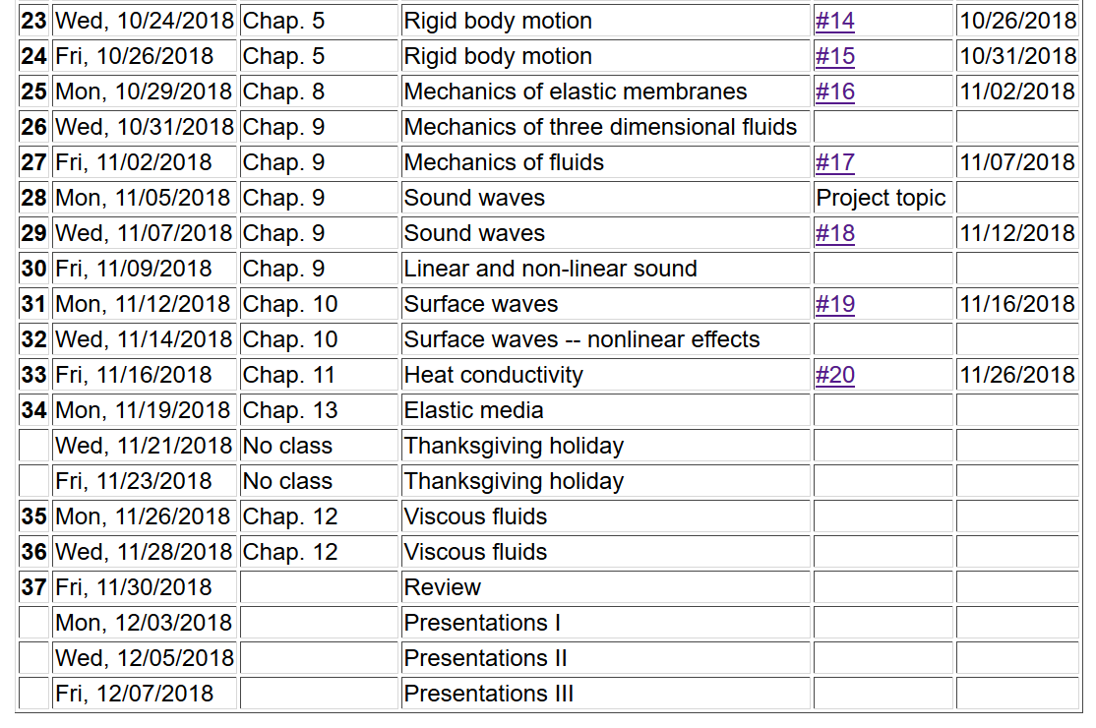
PHY 711 Fall 2013 -- Lecture 34
2

Slide 3
Brief introduction to elastic continua
r₁
r₁’
reference
deformation

Slide 4
Brief introduction to elastic continua -- continued
elastic strain tensor
rotation of material

Slide 5
Brief introduction to elastic continua -- continued
X

Slide 6
Brief introduction to elastic continua -- continued
r₁
r₁’
reference
deformation

Slide 7
Deformation
b
b’
θ
θ’
a
a’

Slide 8
Elastic stress tensor

Slide 9
Elastic stress tensor -- continued

Slide 10
Stress tensor -- continued

Slide 15
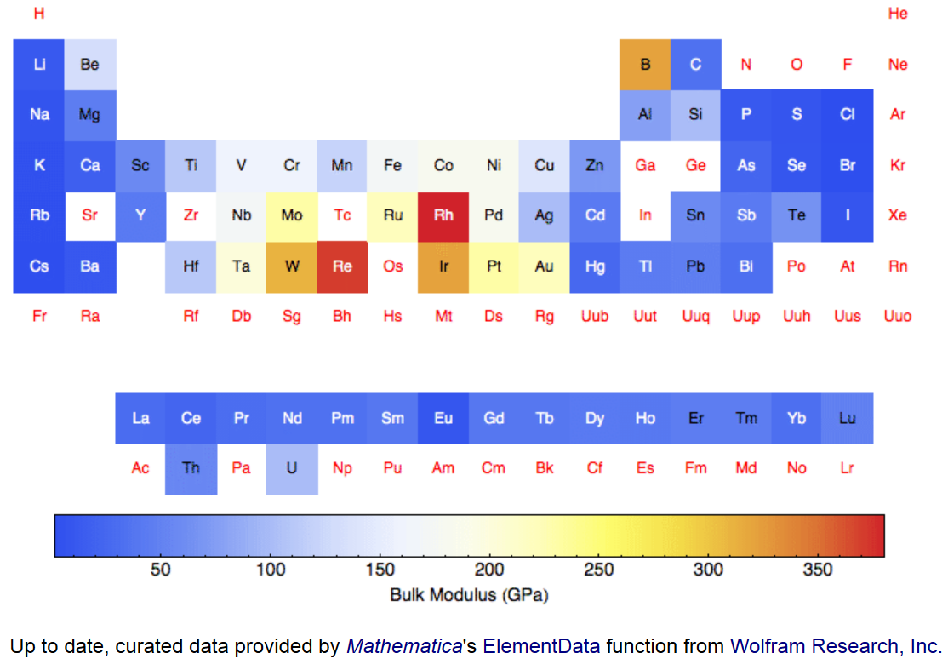
Values of bulk modulus K for elemental materials --

Slide 16
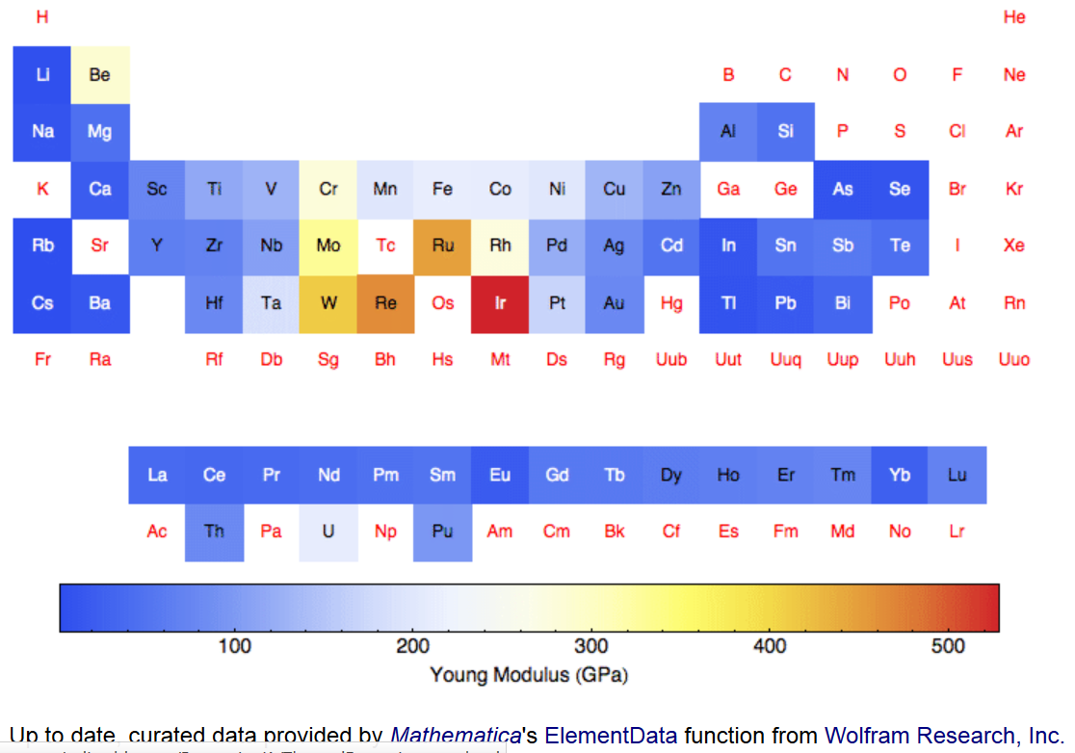
Values of Young’s modulus E for elemental materials --

Slide 17
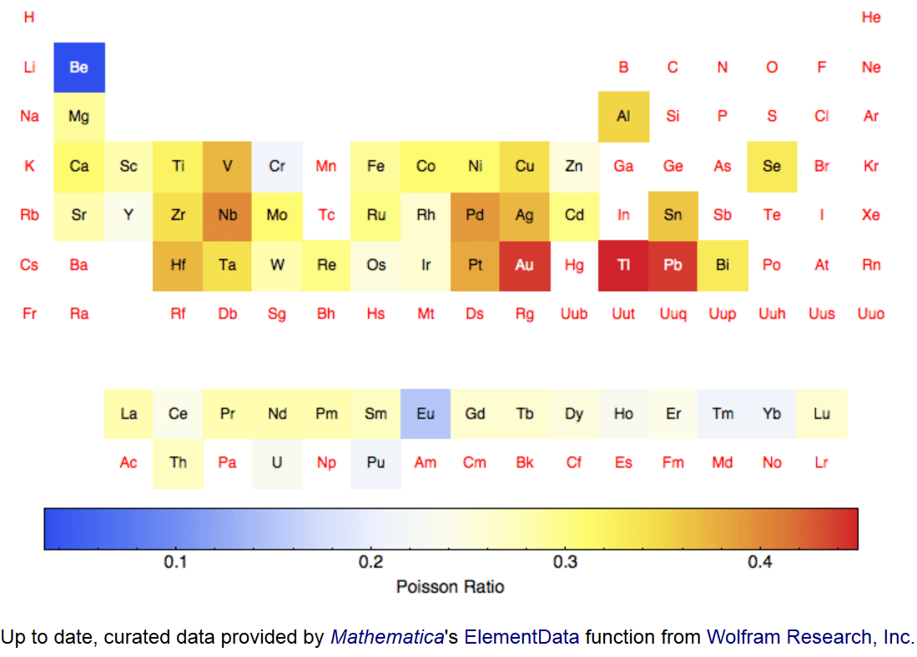
Values of Poisson ratio σ for elemental materials --

Slide 18
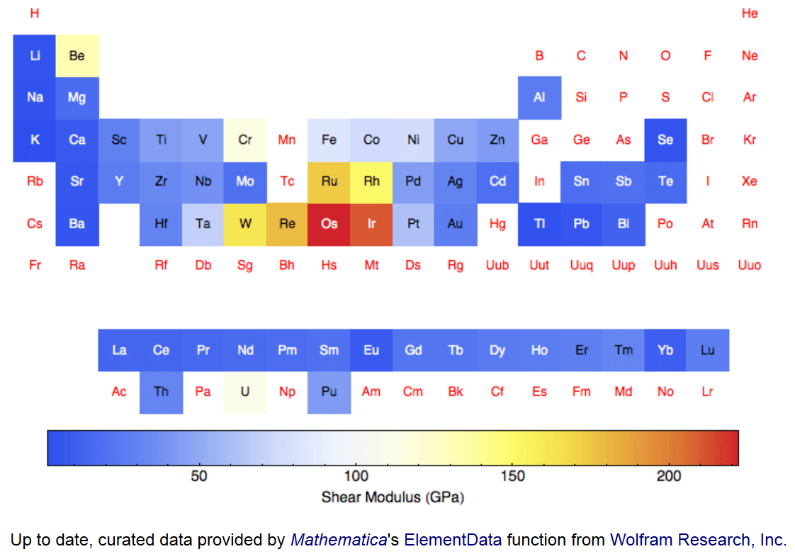
Values of shear modulus μ for elemental materials --

Slide 19
Summary -- Elastic stress tensor
material-dependent empirical parameters

Slide 20
Strain
Stress

Slide 21
surface contribution
bulk contribution

Slide 23
Note that the two relations:

Slide 24
Dynamical equations of motion
external force density

Slide 26
Dynamical equations of elastic continuum

Slide 27
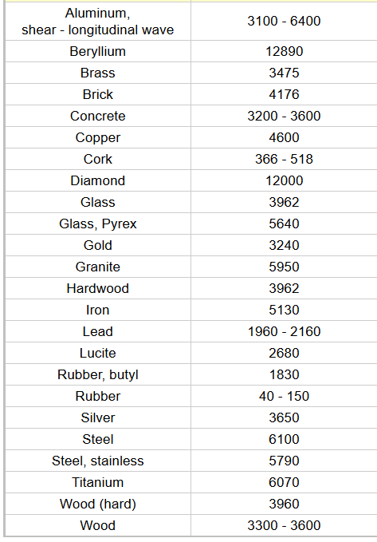
Typical velocities of
longitudinal sound waves
Material c_{l} (m/s)
http://www.engineeringtoolbox.com/sound-speed-solids-d_713.html
air: c_{l}=343 m/s
water: c_{l}=1433 m/s

Slide 28
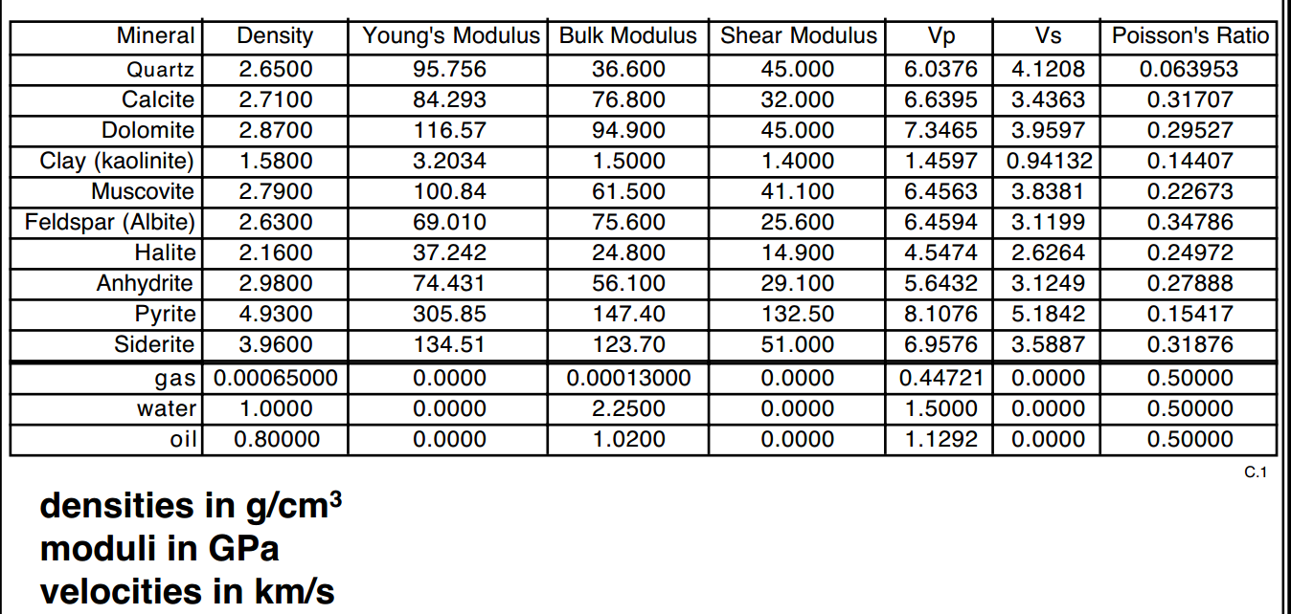
from: https://pangea.stanford.edu/courses/gp262/Notes/5.Elasticity.pdf

Slide 29
Dynamical equations of elastic continuum

Slide 30
Dynamical equations of elastic continuum
Transverse component:

Slide 31
Dynamical equations of elastic continuum
Longitudinal component -- continued:
Transverse component:

Slide 32
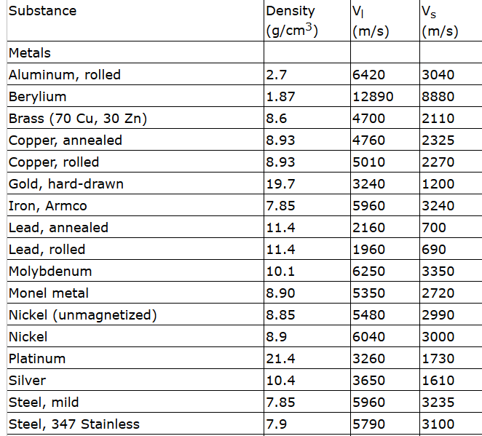
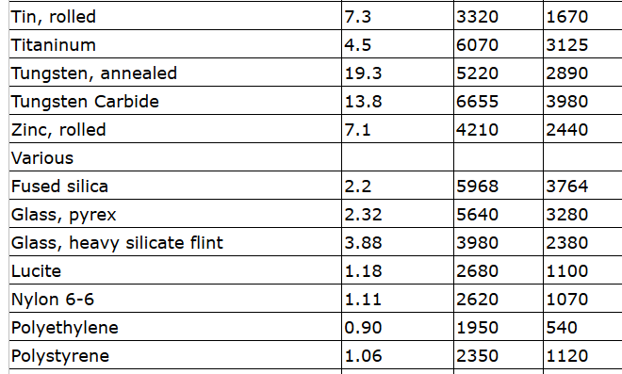
Some values:

Slide 33
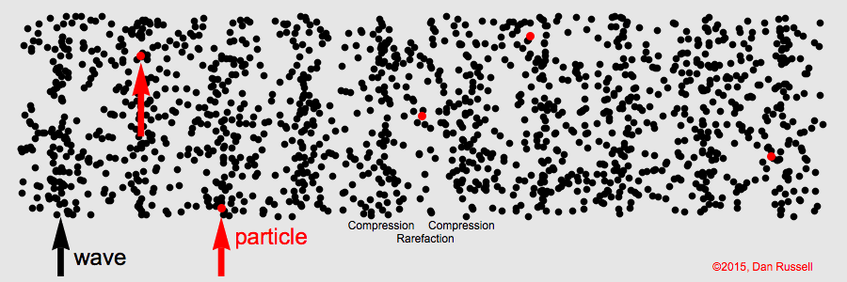
Animations from website:
https://www.acs.psu.edu/drussell/demos/waves/wavemotion.html
Longitudinal wave (p or “primary”)
Transverse wave (s or “secondary”)

Slide 34
Elasticity in solids
z
y
x
vanishes at equilibrium

Slide 35
For the most general case c_{ijkl} have 21 distrinct terms, for a cube there are only 3 unique terms.

Slide 36
Some typical values (Ref. Ashcroft and Mermin (1976))
 | C₁₁ (GPa) | C₁₂(GPa) | C₄₄(GPa)
Na | 7.0 | 6.1 | 4.5
Al | 107 | 61 | 28
Fe | 234 | 136 | 118
Si | 166 | 64 | 80
NaCl | 48.7 | 12.4 | 12.6

