Slide 1
PHY 711 Classical Mechanics and Mathematical Methods
10-10:50 AM MWF Olin 103
Plan for Lecture 35
Viscous fluids – Chap. 12 in F & W
Viscous stress tensor
Navier-Stokes equation
Example for incompressible fluid

Slide 2
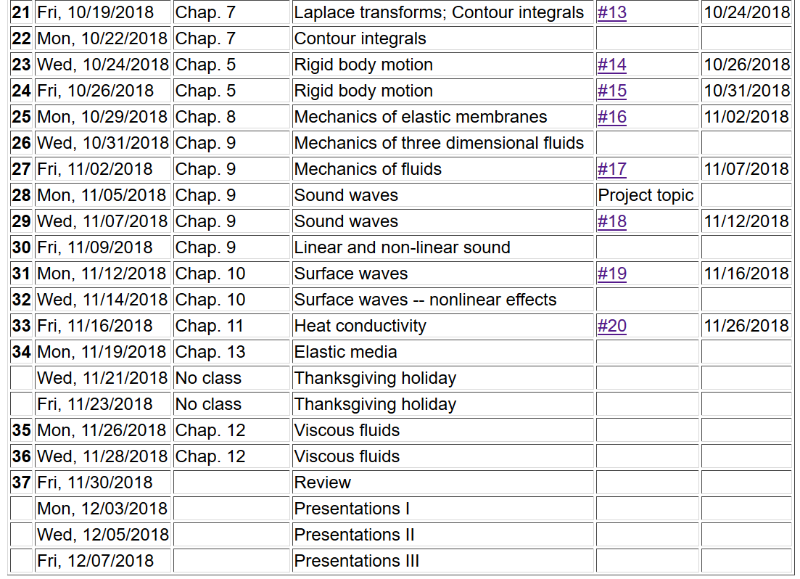
2

Slide 3
Signup for presentation times immediately after class (watch for email with link)

Slide 4
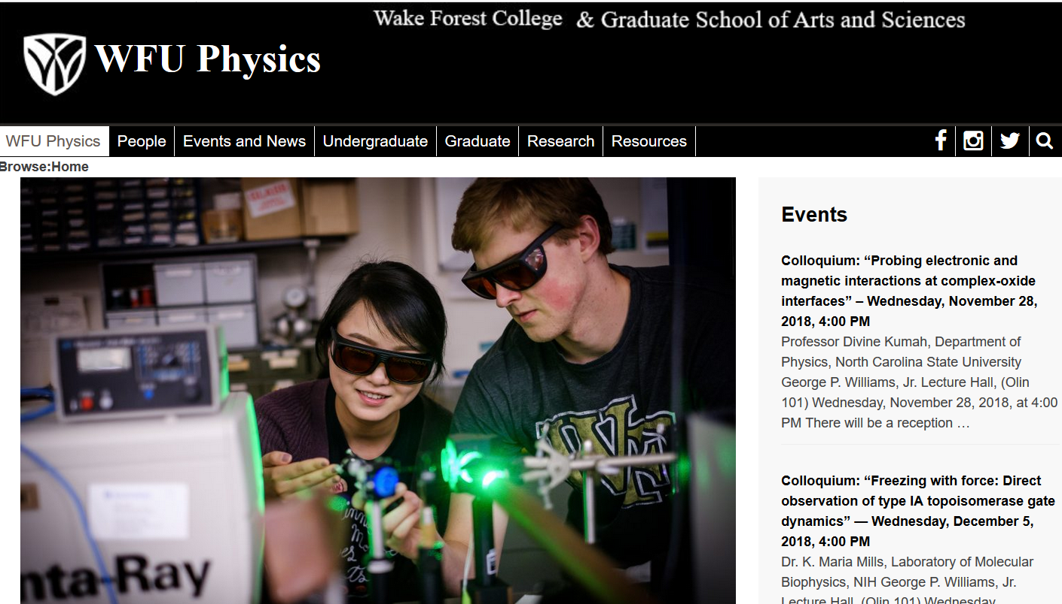

Slide 5
Equations for motion of non-viscous fluid

Slide 6
Equations for motion of non-viscous fluid -- continued

Slide 7
Now consider the effects of viscosity
A
F_{x}
y
v_{x}(y)
x

Slide 8
Effects of viscosity
bulk viscosity
viscosity

Slide 9
Effects of viscosity -- continued

Slide 10
Newton-Euler equations for viscous fluids
Typical viscosities at 20º C and 1 atm:
Fluid | η/ρ (m²/s) | η (Pa s)
Water | 1.00 x 10⁻⁶ | 1 x 10⁻³
Air | 14.9 x 10⁻⁶ | 0.018 x 10⁻³
Ethyl alcohol | 1.52 x 10⁻⁶ | 1.2 x 10⁻³
Glycerine | 1183 x 10⁻⁶ | 1490 x 10⁻³

Slide 11
Example – steady flow of an incompressible fluid in a long pipe with a circular cross section of radius R

Slide 12
Example – steady flow of an incompressible fluid in a long pipe with a circular cross section of radius R -- continued
R
L
v(r)
(uniform pressure gradient)

Slide 13
Example – steady flow of an incompressible fluid in a long pipe with a circular cross section of radius R -- continued
R
L
v(r)

Slide 14
Example – steady flow of an incompressible fluid in a long pipe with a circular cross section of radius R -- continued
R
L
v(r)
Poiseuille formula;
➔Method for measuring η

Slide 15
Example – steady flow of an incompressible fluid in a long tube with a circular cross section of outer radius R and inner radius κR
R
κR
L

Slide 16
Example – steady flow of an incompressible fluid in a long tube with a circular cross section of outer radius R and inner radius κR -- continued
R
κR
L

Slide 17
More discussion of viscous effects in incompressible fluids
u
F_{D}
Plan:
Consider the general effects of viscosity on fluid equations
Consider the solution to the linearized equations for the case of steady-state flow of a sphere of radius R
Infer the drag force needed to maintain the steady-state flow

Slide 18
Typical kinematic viscosities at 20º C and 1 atm:
Fluid | ν (m²/s)
Water | 1.00 x 10⁻⁶
Air | 14.9 x 10⁻⁶
Ethyl alcohol | 1.52 x 10⁻⁶
Glycerine | 1183 x 10⁻⁶

Slide 19
u
F
F_{D}

Slide 20
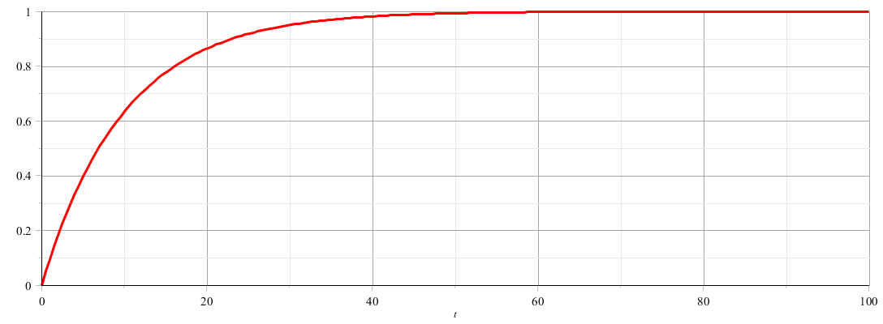
u
F
F_{D}
u
t

Slide 21
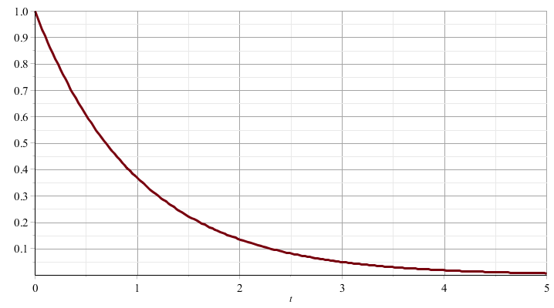
u
F_{D}
u
t

Slide 22
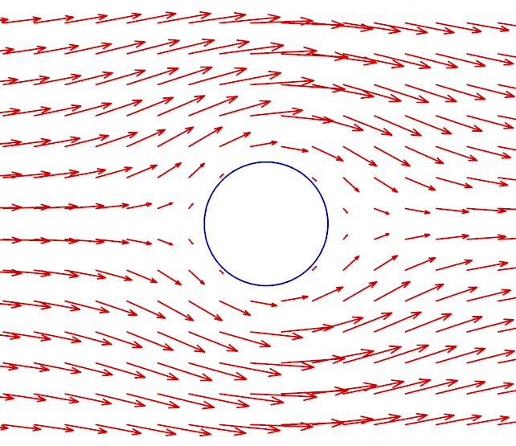
Recall: PHY 711 -- Assignment #17 Nov. 2, 2018
Determine the form of the velocity potential for an incompressible fluid representing uniform velocity in the z direction at large distances from a spherical obstruction of radius a. Find the form of the velocity potential and the velocity field for all r > a. Assume that for r = a, the velocity in the radial direction is 0 but the velocity in the azimuthal direction is not necessarily 0.

Slide 25
Digression

Slide 30
u
F_{D}

