Slide 1
PHY 711 Classical Mechanics and Mathematical Methods
10-10:50 AM MWF Olin 103
Plan for Lecture 36
Viscous fluids – Chap. 12 in F & W
Navier-Stokes equation
Derivation of Stoke’s law
Effects of viscosity on sound waves

Slide 2
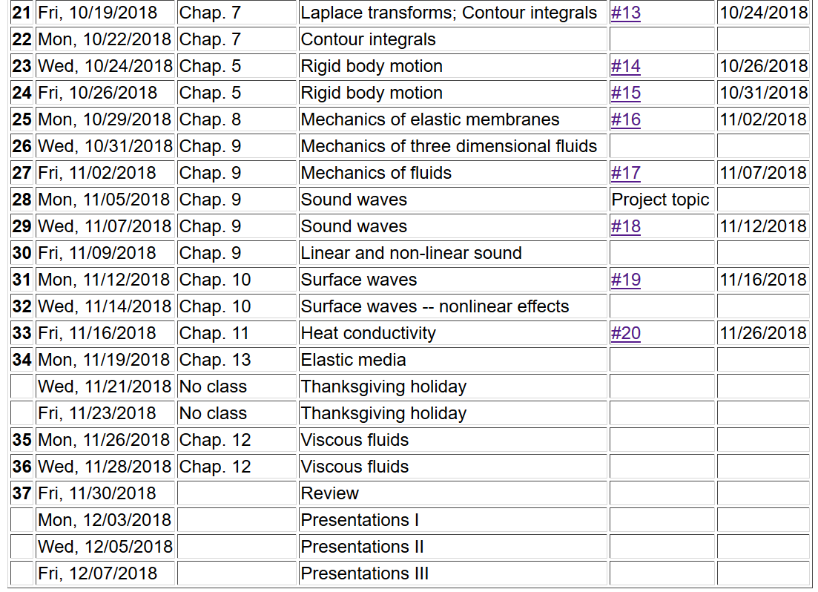
2

Slide 3
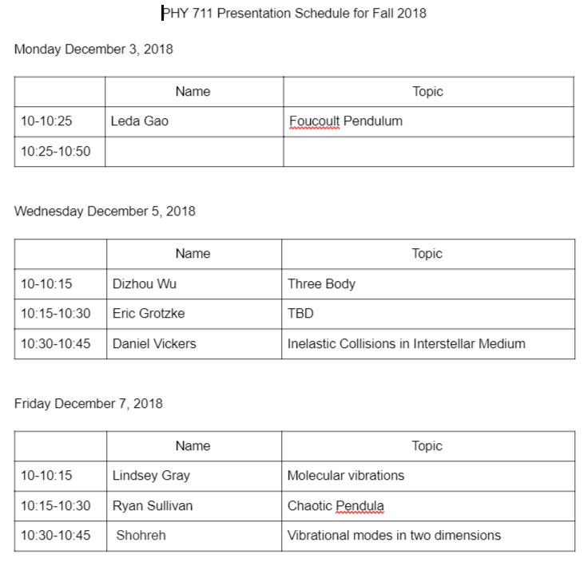
Comments on presentation schedule:

Slide 4
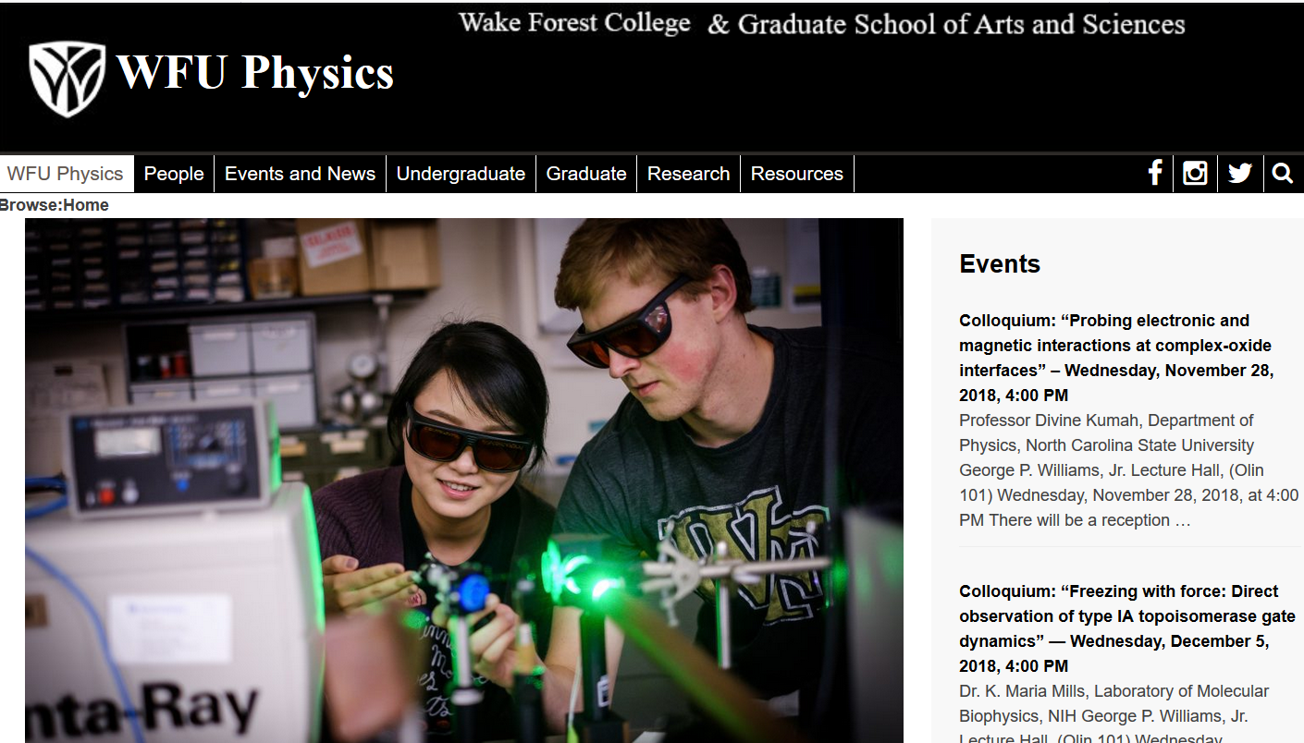

Slide 5
Newton-Euler equations for viscous fluids
Typical viscosities at 20º C and 1 atm:
Fluid | η/ρ (m²/s) | η (Pa s)
Water | 1.00 x 10⁻⁶ | 1 x 10⁻³
Air | 14.9 x 10⁻⁶ | 0.018 x 10⁻³
Ethyl alcohol | 1.52 x 10⁻⁶ | 1.2 x 10⁻³
Glycerine | 1183 x 10⁻⁶ | 1490 x 10⁻³

Slide 6
Viscous effects in incompressible fluids
u
F_{D}
Plan:
Consider the general effects of viscosity on fluid equations
Consider the solution to the linearized equations for the case of steady-state flow of a sphere of radius R
Infer the drag force needed to maintain the steady-state flow

Slide 7
u
F
F_{D}

Slide 8
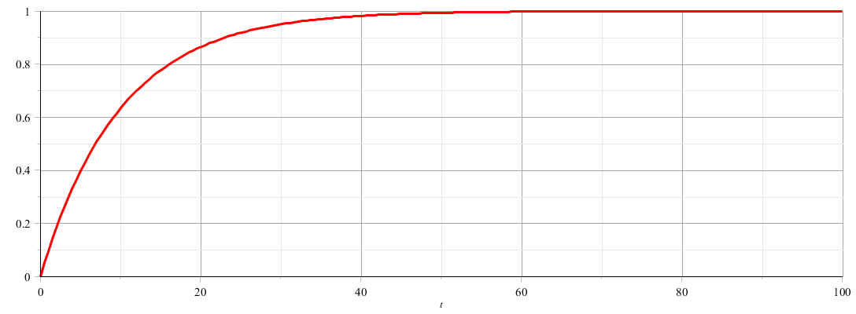
u
F
F_{D}
u
t

Slide 9
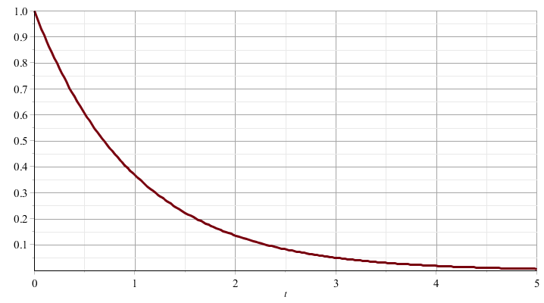
u
F_{D}
u
t

Slide 10
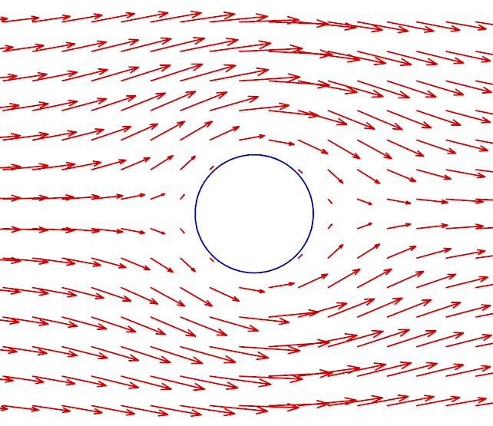
Recall: PHY 711 -- Assignment #17 Nov. 2, 2018
Determine the form of the velocity potential for an incompressible fluid representing uniform velocity in the z direction at large distances from a spherical obstruction of radius a. Find the form of the velocity potential and the velocity field for all r > a. Assume that for r = a, the velocity in the radial direction is 0 but the velocity in the azimuthal direction is not necessarily 0.
Note: in this case, no net pressure is exerted on the sphere.

Slide 13
Digression

Slide 18
u
F_{D}

Slide 19
Recap --
Newton-Euler equations for viscous fluids

Slide 20
Newton-Euler equations for viscous fluids – effects on sound
Without viscosity terms:

Slide 21
Sound waves without viscosity -- continued
➔Pure longitudinal harmonic wave solutions

Slide 22
Newton-Euler equations for viscous fluids – effects on sound
Recall full equations:
viscosity causes heat transfer

Slide 23
Newton-Euler equations for viscous fluids – effects on sound
Note that pressure now depends both on density and entropy so that entropy must be coupled into the equations

Slide 24
Newton-Euler equations for viscous fluids – linearized equations

Slide 25
Linearized equations -- continued
heat capacity at constant volume

Slide 26
Linearized equations -- continued

Slide 27
Newton-Euler equations for viscous fluids – effects on sound
Linearized equations (with the help of various thermodynamic relationships):

Slide 28
Linearized hydrodynamic equations

Slide 29
Linearized hydrodynamic equations; plane wave solutions:
➔Entropy and mechanical modes are independent

Slide 31
Linearized hydrodynamic equations; full plane wave solutions:

Slide 32
Linearized hydrodynamic equations; full plane wave solutions:

Slide 33
Linearized hydrodynamic equations; full plane wave solutions:

