Slide 1
PHY 711 Classical Mechanics and Mathematical Methods
10-10:50 AM MWF Olin 103
Plan for Lecture 37
Review
  Mathematical methods
  Classical mechanics concepts
  Course evaluation

Slide 2
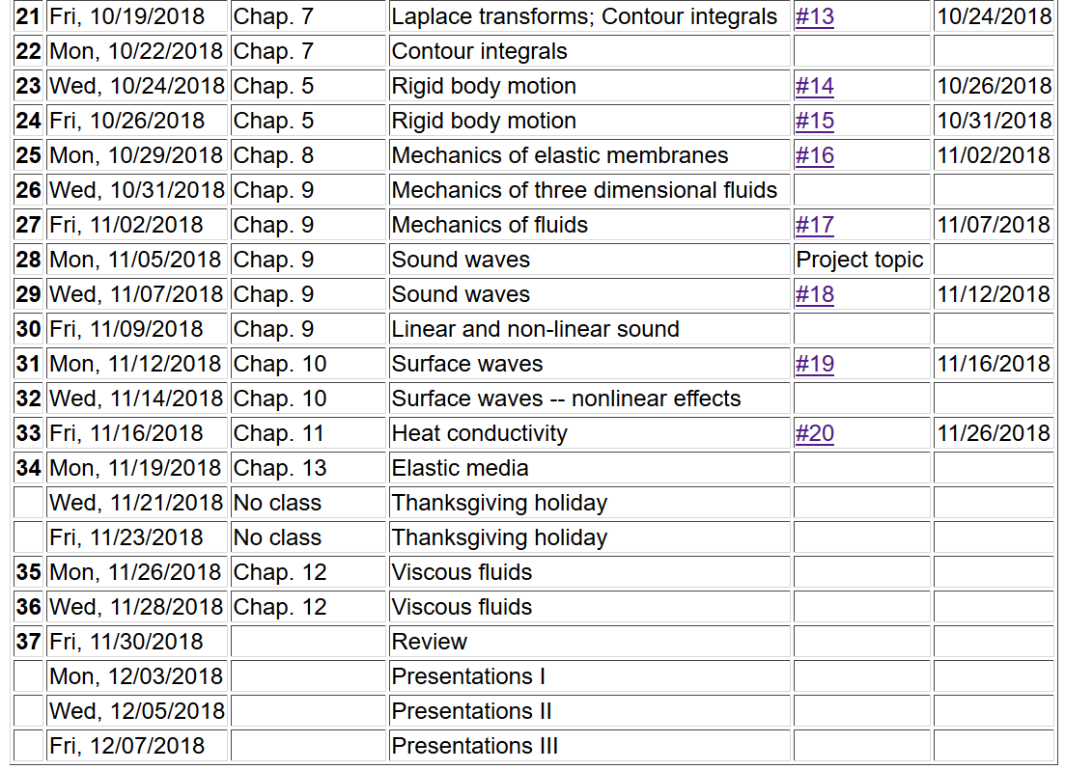
2

Slide 3
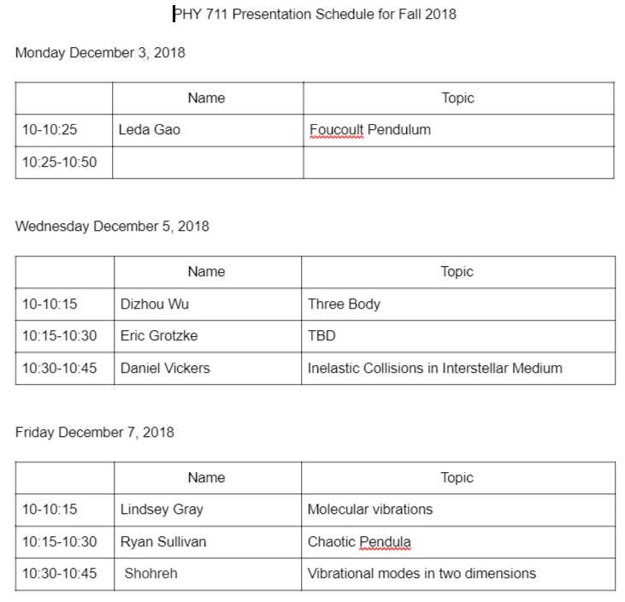
Comments on presentation schedule:

Slide 4


Slide 5
Comment from Lecture 36

Slide 6
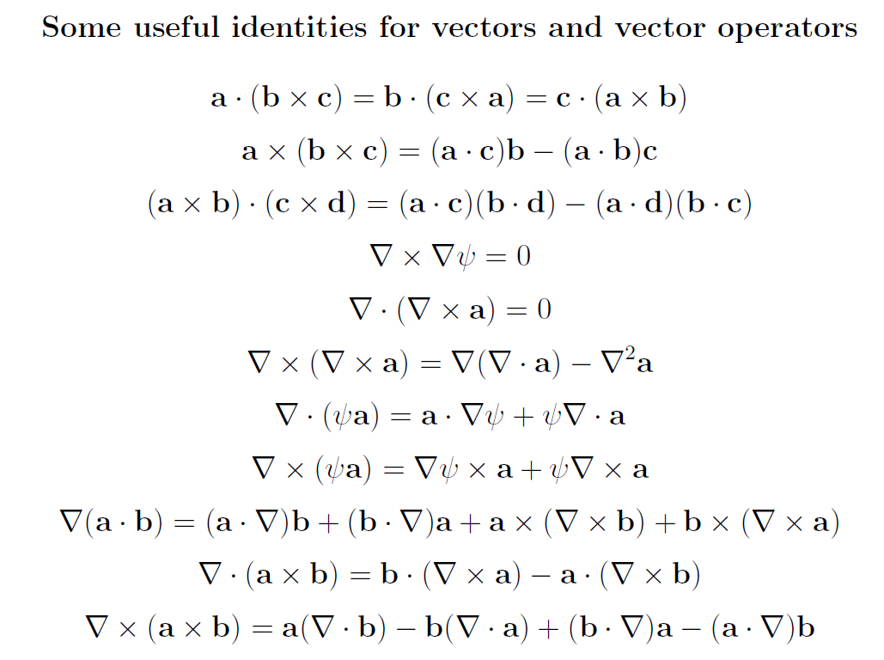
Review of mathematical methods

Slide 7
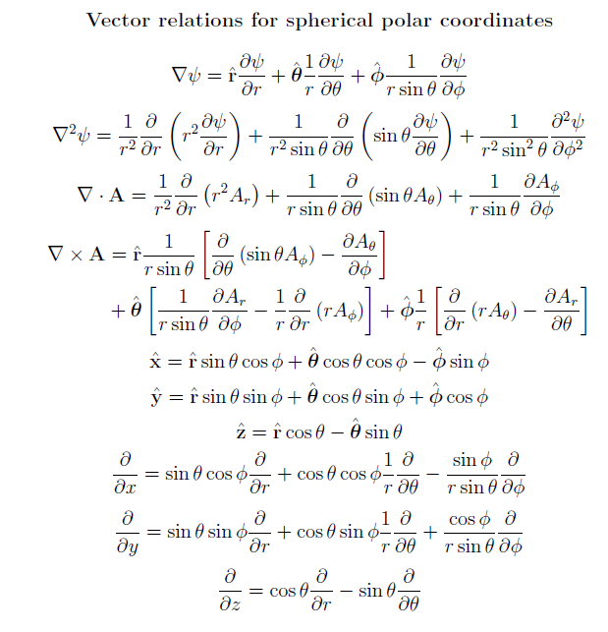

Slide 8
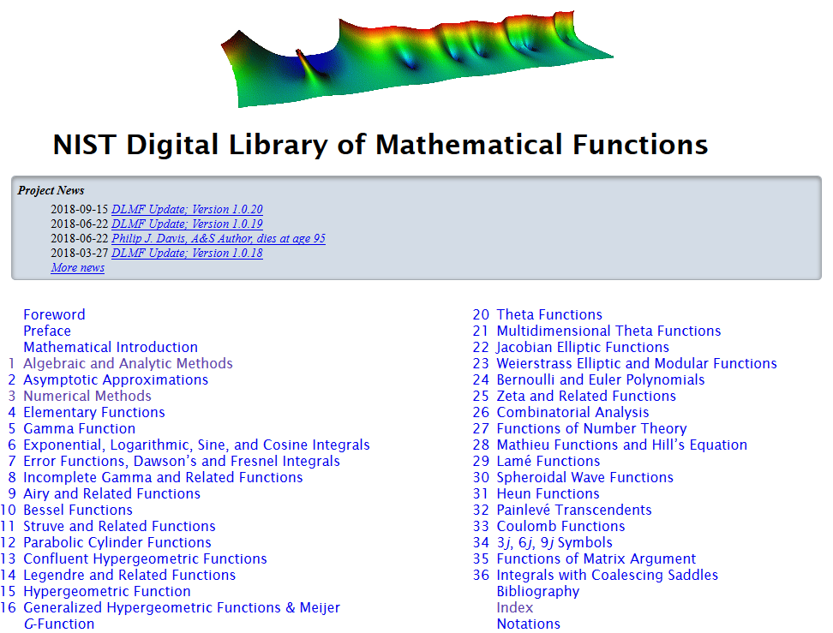
https://dlmf.nist.gov/

Slide 9
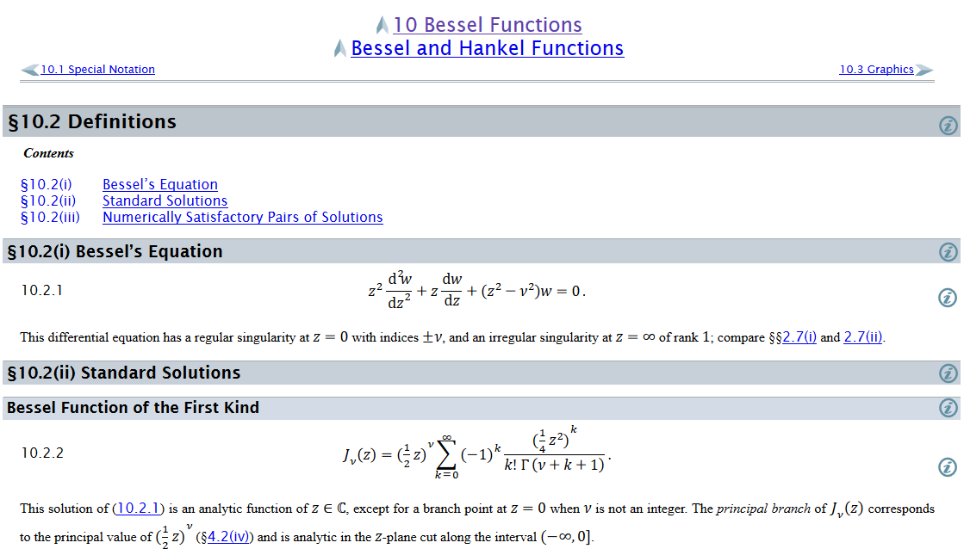
Example – special functions

Slide 10
Complex numbers
Functions of complex variables
Derivatives:
Cauchy-Riemann equations

Slide 11
Analytic function
➔A closed integral of an analytic function is zero.
However:

Slide 12
Contour integration methods --
No contribution
C

Slide 14
Fourier transforms --
Note: The location of the 2π factor varies among texts.

Slide 16
Doubly discrete Fourier Transforms
➔Fast Fourier Transforms (FFT)

Slide 17
Mechanics topics
  Scattering theory
  Lagrangian mechanics
  Hamiltonian mechanics
  Liouville theorem
  Rigid body motion
  Normal modes of oscillation about equilibrium
  Wave motion
  Fluid mechanics (ideal or including viscosity; linear and nonlinear)
  Heat conduction
  Mechanics of elastic response

Slide 18
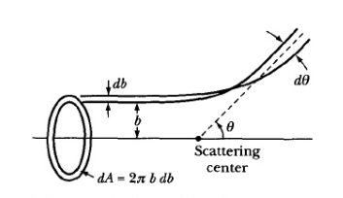
Scattering theory
Note: The notion of cross section is common to many areas of physics including classical mechanics, quantum mechanics, optics, etc. Only in the classical mechanics can we calculate it from a knowledge of the particle trajectory as it relates to the scattering geometry.
b
Figure from Marion & Thorton, Classical Dynamics
Note: We are assuming that the process is isotropic in φ

Slide 19
Lagrangian mechanics

Slide 20
Recipe for constructing the Hamiltonian and analyzing the equations of motion

Slide 21
Liouville’s Theorem (1838)
The density of representative points in phase space corresponding to the motion of a system of particles remains constant during the motion.

Slide 22
Rigid body motion
In a reference frame attached to the object, there are 3 moments of inertia and 3 distinct principal axes
Representation of rotational kinetic energy:

Slide 23
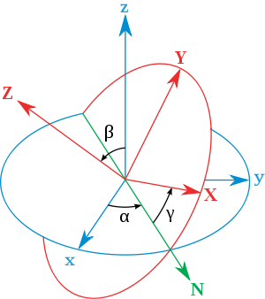
Euler’s transformation between body fixed and inertial reference frames
x
y
y
x

Slide 24

Normal modes of vibration -- potential in 2 and more dimensions
V(x,y)

Slide 25
Example – normal modes of a system with the symmetry of an equilateral triangle -- continued
3
u₃
u₂
1
2
u₁

Slide 26
Example – normal modes of a system with the symmetry of an equilateral triangle -- continued

Slide 27
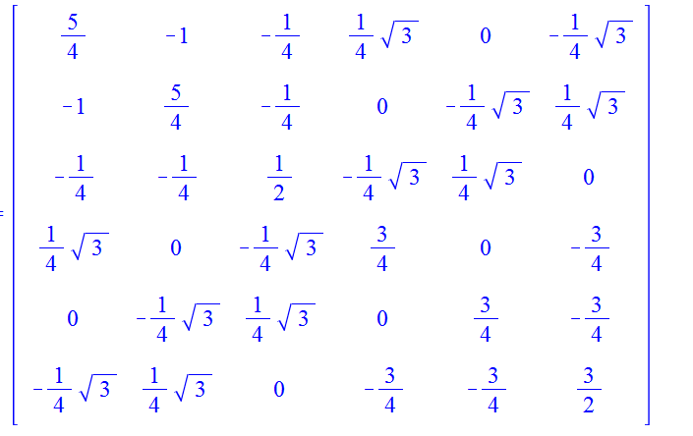
Example – normal modes of a system with the symmetry of an equilateral triangle -- continued
= ω²

Slide 28
Discrete particle interactions → continuous media →
The wave equation

Slide 29
Mechanical motion of fluids
Newton’s equations for fluids
  Use Euler formulation; following “particles” of fluid
Viscosity contributions

Slide 30
Fluid mechanics of incompressible fluid plus surface
Non-linear effects in surface waves:
p₀
ζ
z
h
y
z=0
x

