Slide 1
PHY 711 Classical Mechanics and Mathematical Methods
10-10:50 AM MWF Olin 103
Plan for Lecture 4:
Reading: Chapter 1 F&W
Summary of previous discussion of scattering theory; transformation between lab and center of mass frames
Scattering theory in the center of mass frame; Calculation of the scattering cross section
Cross section for Rutherford scattering

Slide 2
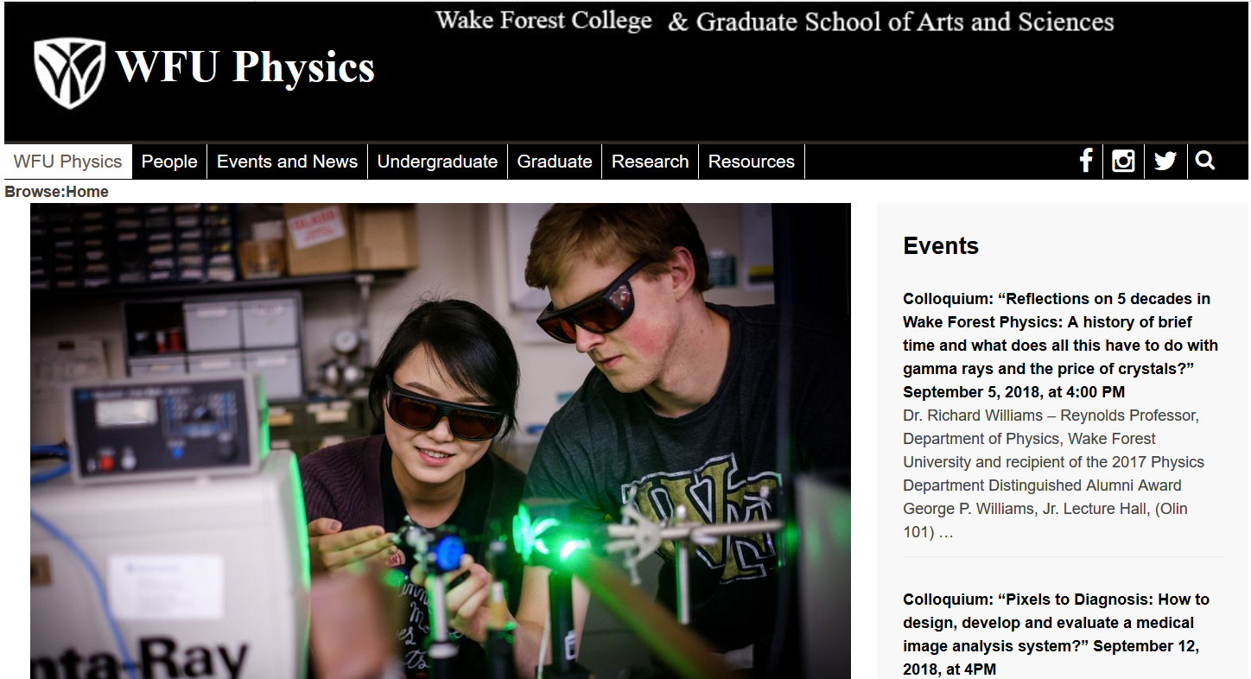
Physics colloquium today --

Slide 3
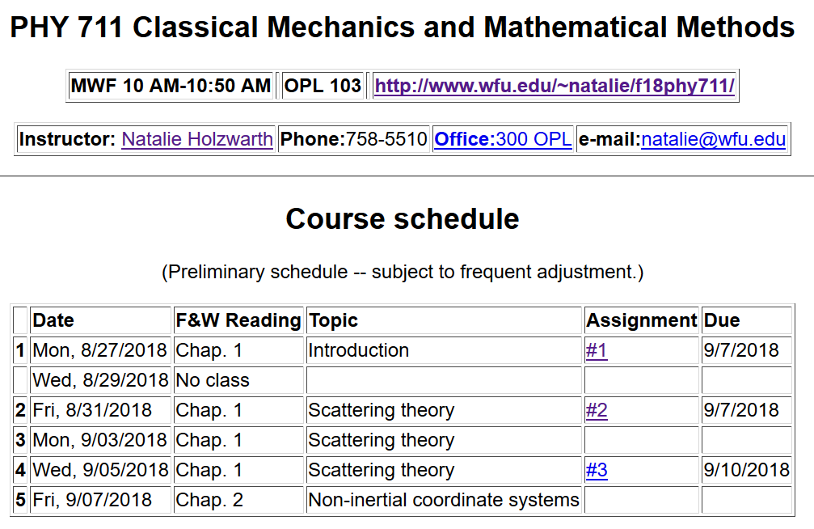

Slide 4
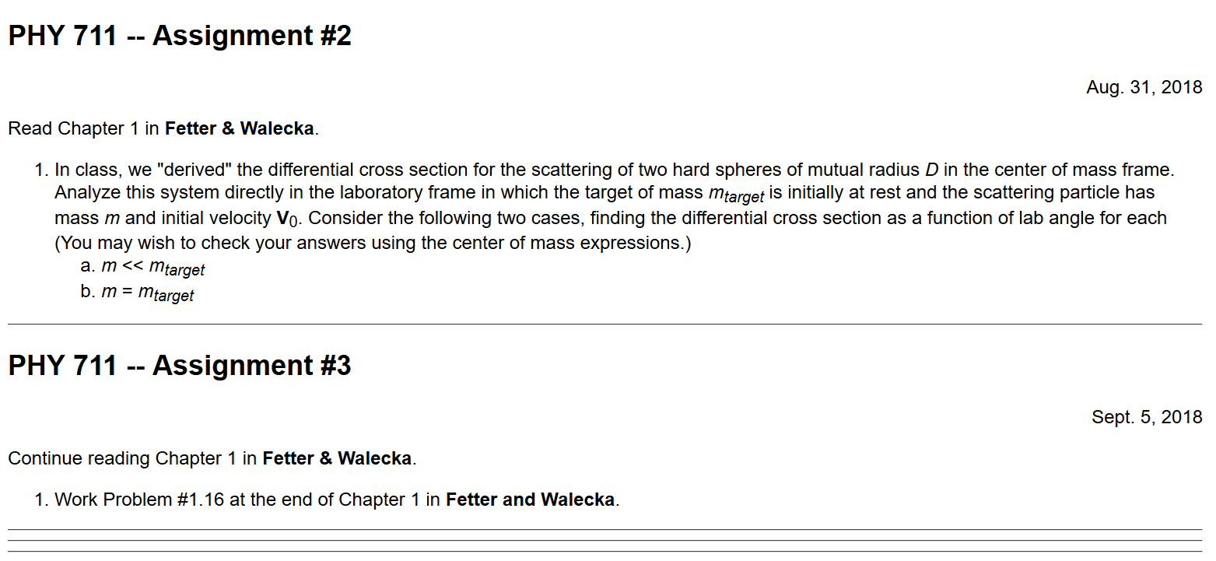

Slide 5
Scattering theory:
detector

Slide 6
b
Figure from Marion & Thorton, Classical Dynamics

Slide 7
Note: Notion of cross section is common to many areas of physics including classical mechanics, quantum mechanics, optics, etc. Only in the classical mechanics can we calculate it using geometric considerations
b
Figure from Marion & Thorton, Classical Dynamics
Note: We are assuming that the process is isotropic in φ

Slide 8
Transformation between center-of-mass and laboratory reference frames:
(assuming that energy is conserved)
V_{CM}
V₁
v₁
ψ
θ

Slide 9
Differential cross sections in different reference frames –

Slide 10
Differential cross sections in different reference frames –
Example: suppose m₁ = m₂

Slide 11
Focusing on the center of mass frame of reference:
Typical two-particle interactions –
X
⬅

Slide 12
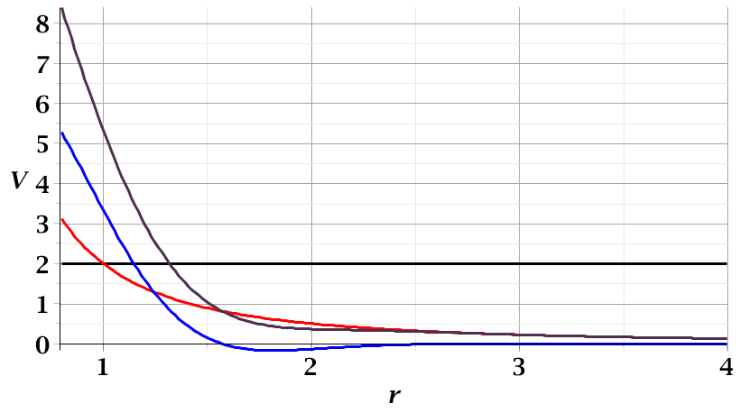
For a continuous potential interaction in center of mass reference frame:
Need to relate these parameters to differential cross section
E_{rel}
r_{min}

Slide 13
➔Need to find an equation for r(φ)
φ
r_{min}
r(φ)

Slide 19
Relationship between φ_{max} and θ:

Slide 21
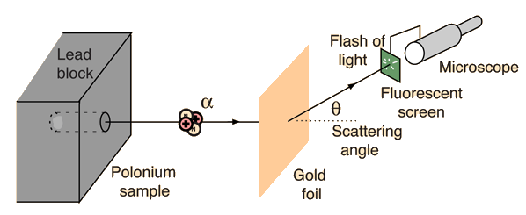
Example: Diagram of Rutherford scattering experiment
http://hyperphysics.phy-astr.gsu.edu/hbase/rutsca.html

Slide 24
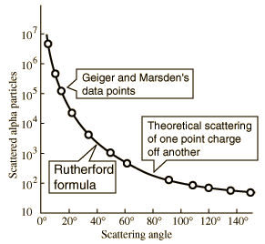
What happens as
θ →0?
From webpage: http://hyperphysics.phy-astr.gsu.edu/hbase/nuclear/rutsca2.html#c3

Slide 25
Original experiment performed with α particles on gold

Slide 26
Recap of equations for scattering cross section in the center of mass frame of reference

