Slide 1
PHY 711 Classical Mechanics and Mathematical Methods
10-10:50 AM MWF Olin 103
Plan for Lecture 5:
Reading: Chapter 2 of Fetter & Walecka
Physics described in accelerated coordinate frames
    Linear acceleration
    Angular acceleration
    Foucault pendulum

Slide 2
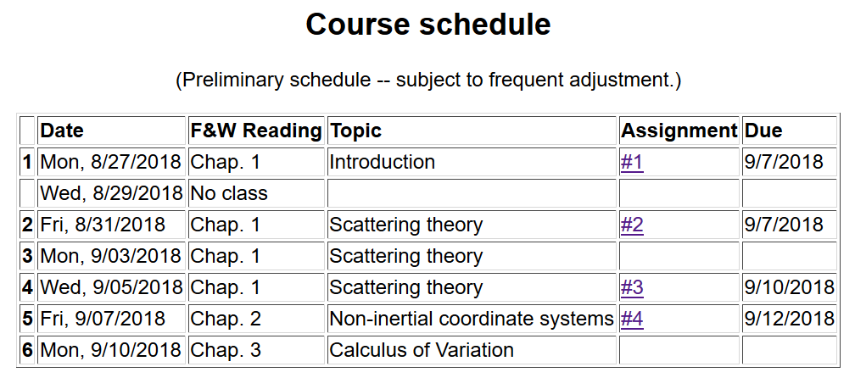

Slide 3


Slide 4
Physics in accelerated reference frames

Slide 5
Physical laws as described in non-inertial coordinate systems
  Newton’s laws are formulated in an inertial frame of reference
  For some problems, it is convenient to transform the the equations into a non-inertial coordinate system

Slide 6
Comparison of analysis in “inertial frame” versus “non-inertial frame”

Slide 7
Properties of the frame motion (rotation only):
dΩ
dΩ

Slide 8
Properties of the frame motion (rotation only):
dΩ
dΩ

Slide 9
Properties of the frame motion (rotation only):
dΩ
dΩ

Slide 10
Properties of the frame motion (rotation only) -- continued
Effects on acceleration (rotation only):

Slide 11
Application of Newton’s laws in a coordinate system which has an angular velocity and linear acceleration
Newton’s laws; Let r denote the position of particle of mass m:
Centrifugal
force
Coriolis
force

Slide 12
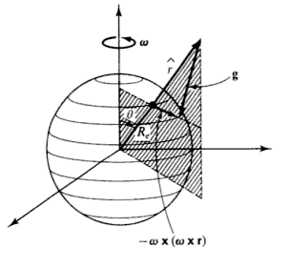
Motion on the surface of the Earth:
Earth’s gravity
Support force

Slide 13
Non-inertial effects on effective gravitational “constant”
0.03 m/s²
9.80 m/s²

Slide 14
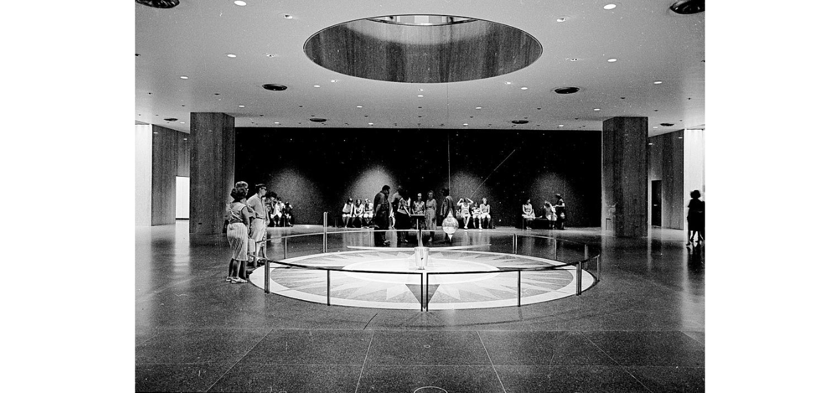
Foucault pendulum
http://www.si.edu/Encyclopedia_SI/nmah/pendulum.htm
The Foucault pendulum was displayed for many years in the Smithsonian's National Museum of American History. It is named for the French physicist Jean Foucault who first used it in 1851 to demonstrate the rotation of the earth.

Slide 15
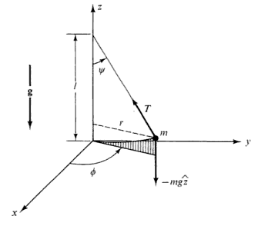
Equation of motion on Earth’s surface
ω
y (east)
z (up)
θ
x (south)

Slide 16
Foucault pendulum continued – keeping leading terms:

Slide 17
Foucault pendulum continued – keeping leading terms:

Slide 18
Foucault pendulum continued – coupled equations:

Slide 19
Foucault pendulum continued – coupled equations:

Slide 21
Summary of approximate solution for Foucault pendulum:

Slide 22
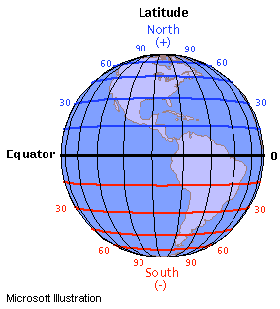
ω
y (east)
z (up)
θ
x (south)

