Slide 1
PHY 711 Classical Mechanics and Mathematical Methods
10-10:50 AM MWF Olin 103
Plan for Lecture 7:
Calculus of variation; Continue reading Chapt. 3
Brachistochrone problem
Calculus of variation with constraints
Application to classical mechanics

Slide 2
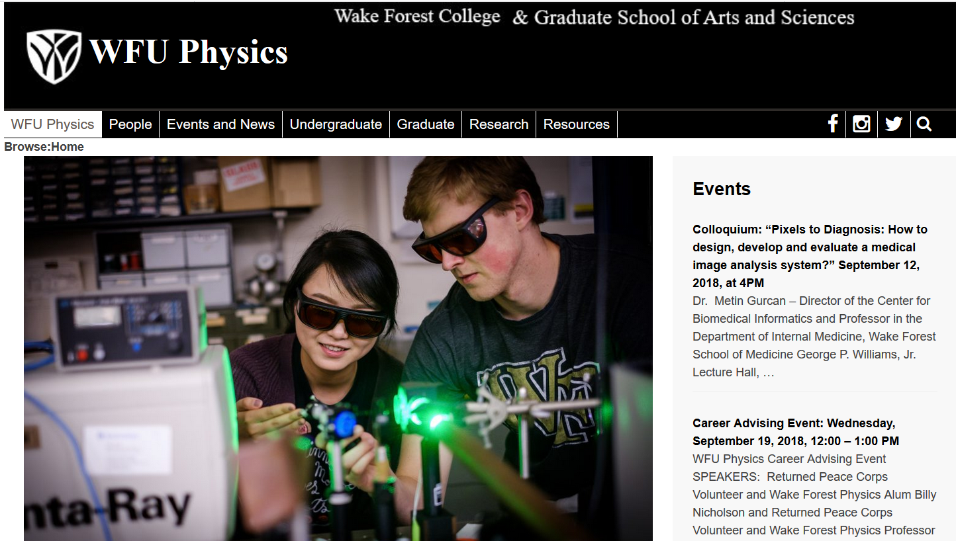

Slide 3
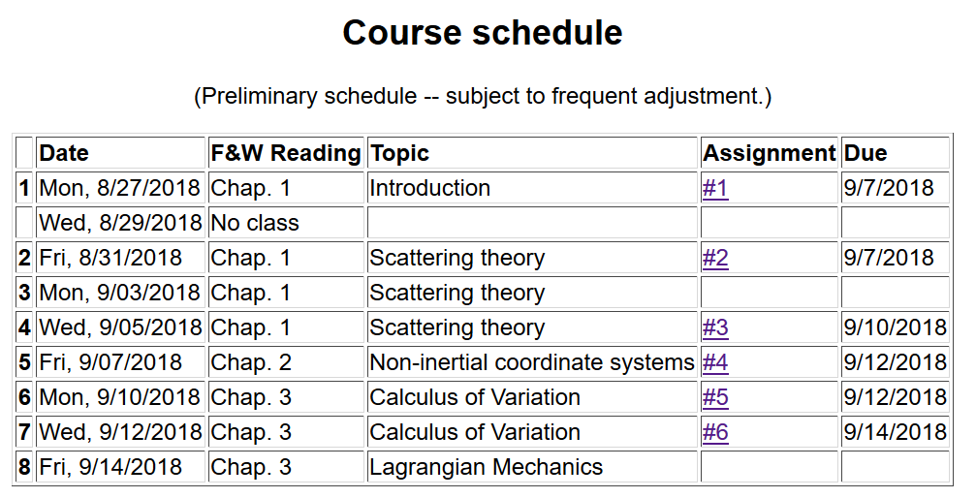

Slide 4
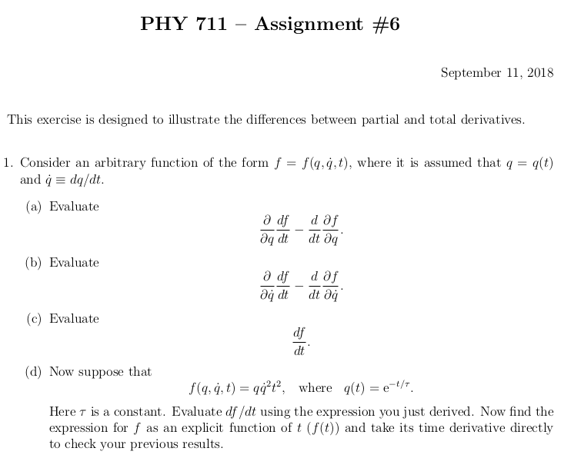

Slide 5
Euler-Lagrange equation
Alternate Euler-Lagrange equation

Slide 6
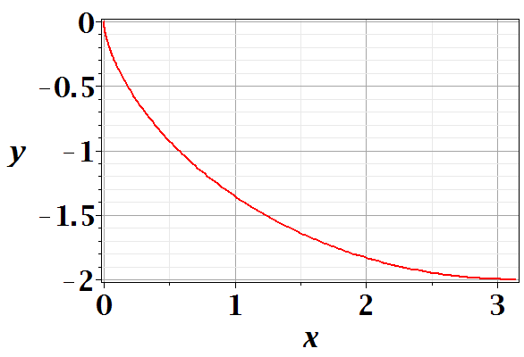
Brachistochrone problem: (solved by Newton in 1696)
http://mathworld.wolfram.com/BrachistochroneProblem.html
A particle of weight mg travels frictionlessly down a path of shape y(x). What is the shape of the path y(x) that minimizes the travel time from
y(0)=0 to y(π)=-2 ?

Slide 9
Parametric equations for Brachistochrone:

Slide 10
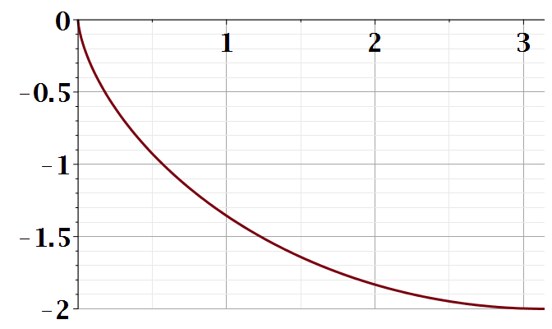
Parametric plot --
plot([theta-sin(theta), cos(theta)-1, theta = 0 .. Pi])
y
x

Slide 11
Summary of the method of calculus of variation --

Slide 13
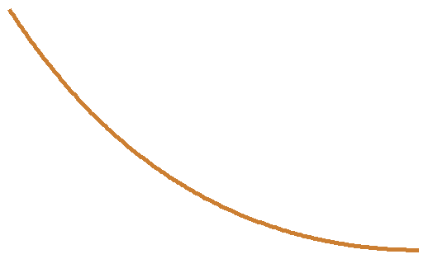
Another example optimization problem:
Determine the shape y(x) of a rope of length L and mass density ρ hanging between two points
x₁ y₁
x₂ y₂

Slide 14
Lagrange multiplier

Slide 18
Summary of results

Slide 19
Application to particle dynamics

Slide 20
Application to particle dynamics
Simple example: vertical trajectory of particle of mass m subject to constant downward acceleration a=-g.

Slide 21
http://www.hamilton2005.ie/

Slide 22
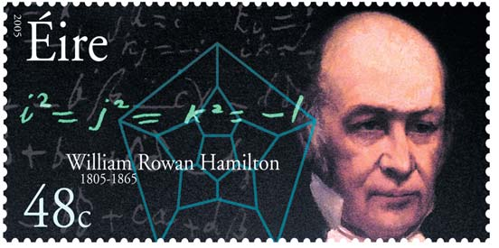
http://rjlipton.wordpress.com

Slide 23
Potential energy
Kinetic energy

