Slide 1
PHY 711 Classical Mechanics and Mathematical Methods
10-10:50 AM MWF Olin 103
Plan for Lecture 8:
Continue reading Chapter 3
D’Alembert’s principle
Hamilton’s principle
Lagrange’s equation in generalized coordinates

Slide 2
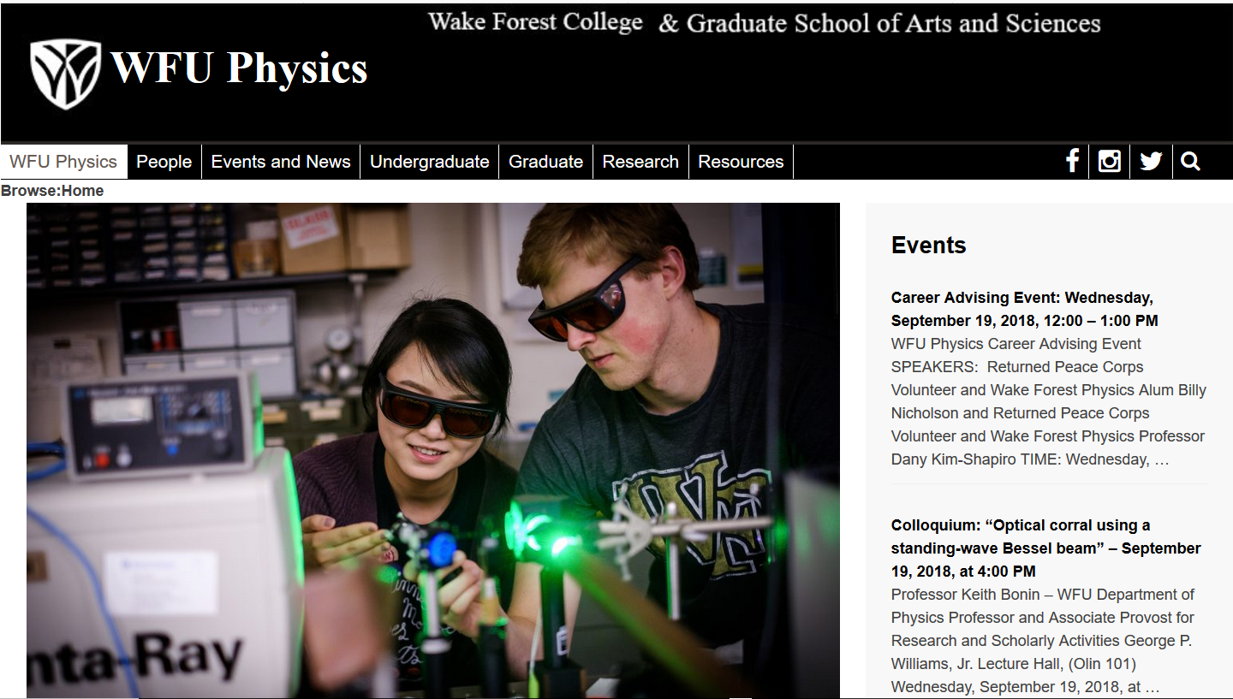

Slide 3
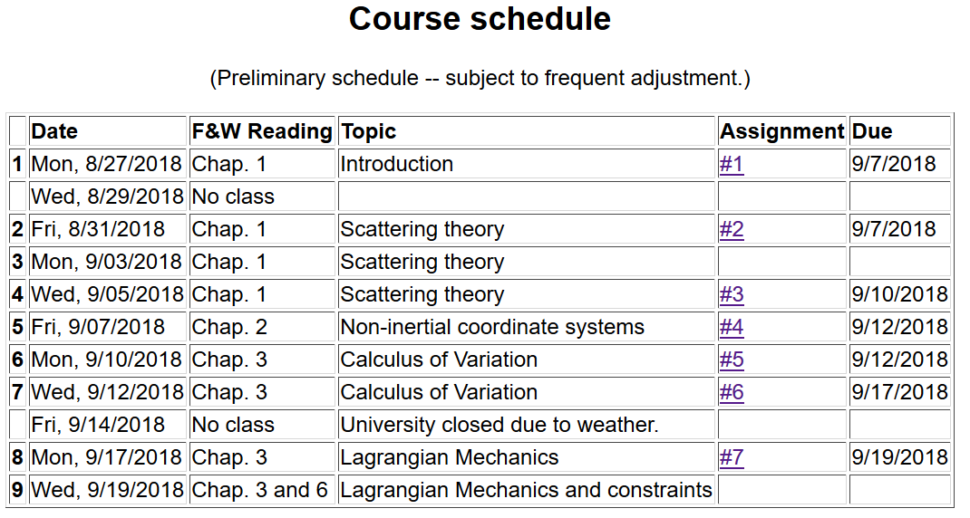

Slide 4
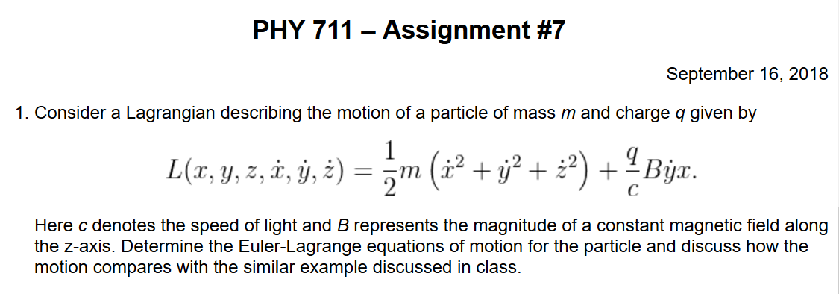

Slide 5
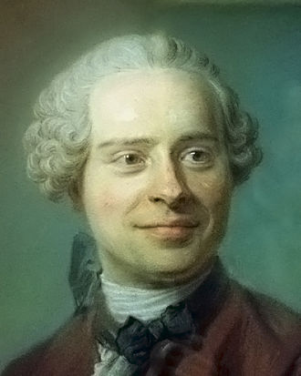
Jean d’Alembert 1717-1783
French mathematician and philosopher

Slide 6
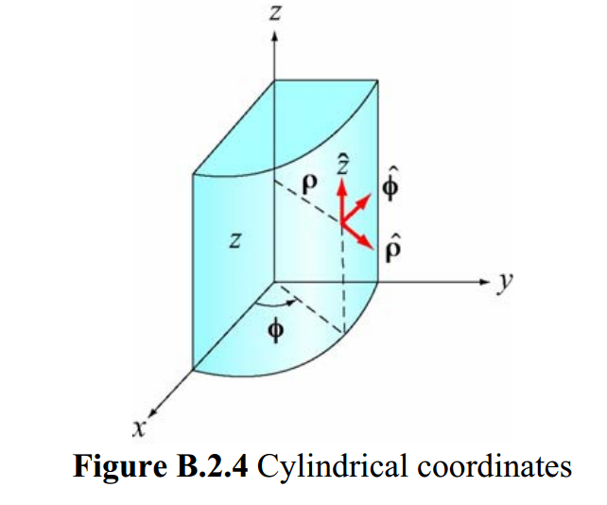
Cylindrical coordinates
(Figure taken from 8.02 handout from MIT.)

Slide 7
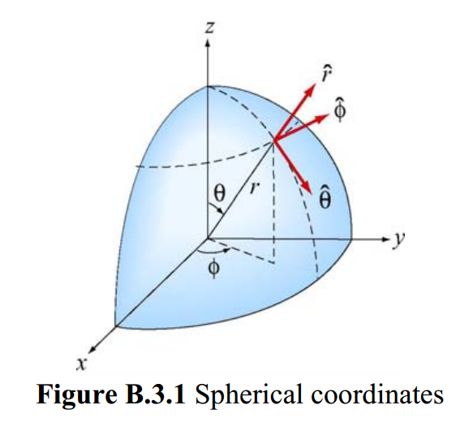
Spherical coordinates
(Figure taken from 8.02 handout from MIT.)

Slide 8
D’Alembert’s principle:

Slide 13
➔Hamilton’s principle

Slide 14
Example:
d
θ

Slide 16
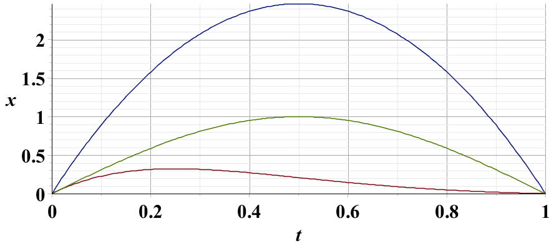
Example – simple harmonic oscillator
x₁
x₂
x₃

Slide 17
Summary –
Hamilton’s principle:

Slide 18
Note: in “proof” of Hamilton’s principle:

Slide 19
Lorentz forces:

Slide 20
Lorentz forces, continued:

Slide 21
Lorentz forces, continued:

Slide 22
Lorentz forces, continued:

Slide 23
Example Lorentz force

Slide 24
Example Lorentz force -- continued

Slide 25
Example Lorentz force -- continued

Slide 26
Example Lorentz force -- continued

Slide 27
Example Lorentz force -- continued

