Slide 1
PHY 711 Classical Mechanics and Mathematical Methods
10-10:50 AM MWF Olin 103
Plan for Lecture 9:
Continue reading Chapter 3 & 6
Summary & review
Lagrange’s equations with constraints

Slide 2
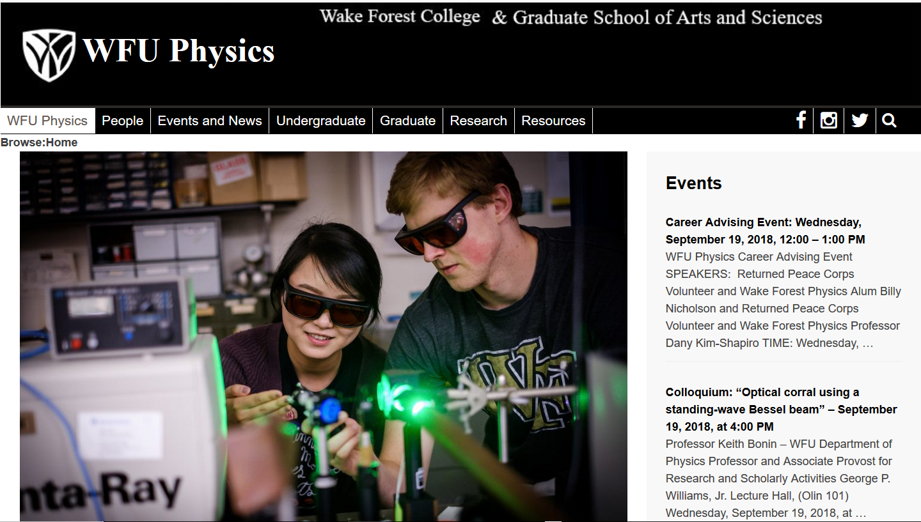

Slide 5
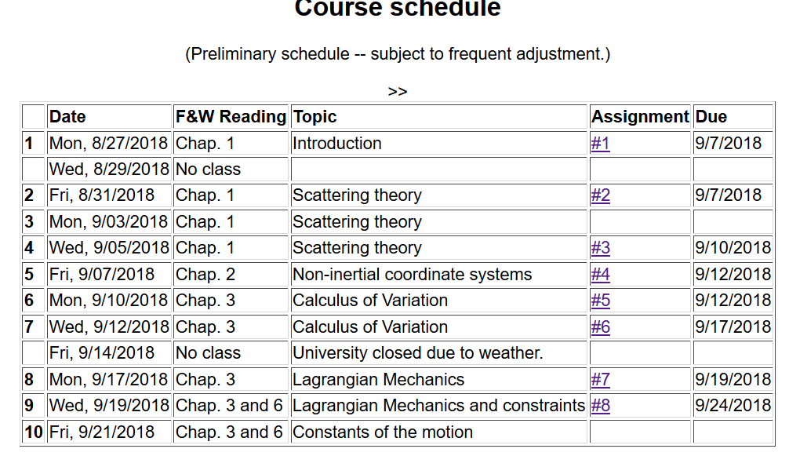

Slide 6
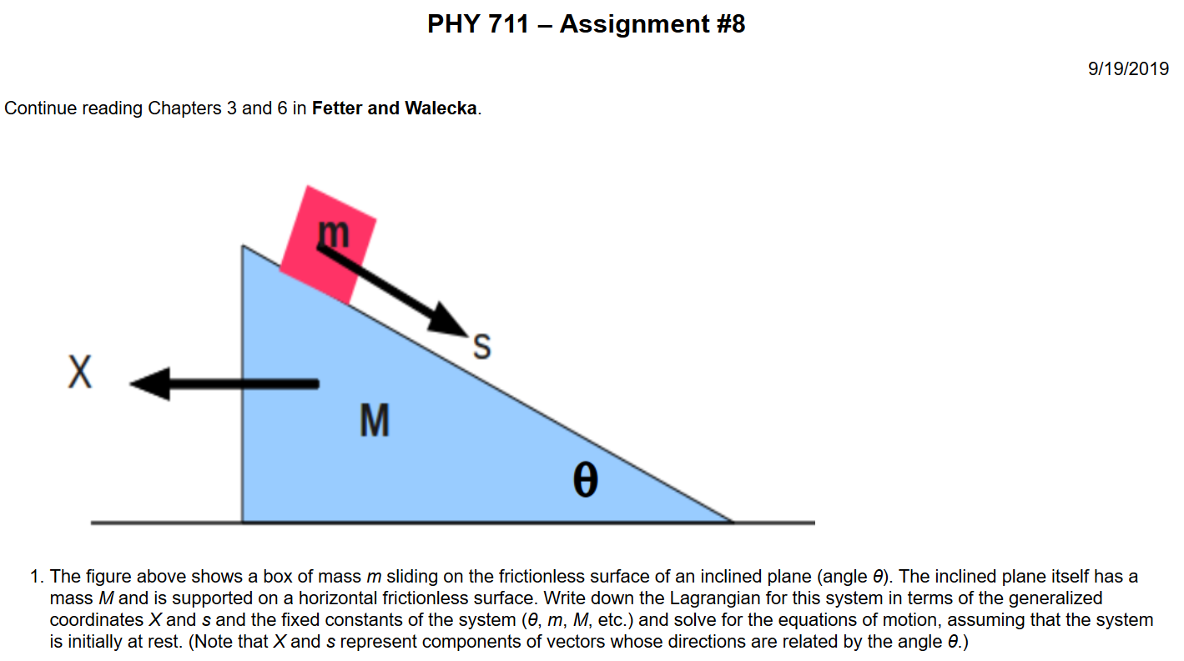

Slide 7
Comments on generalized coordinates:
Here we have assumed that the generalized coordinates
q_{σ} are independent. Now consider the possibility that the coordinates are related through constraint equations of the form:
Lagrange
multipliers

Slide 8
Simple example:
u
θ
y
x
θ

Slide 9
Force of constraint;
normal to incline

Slide 10
Rational for Lagrange multipliers

Slide 11
Euler-Lagrange equations with constraints:
Example:
r
θ
mg

Slide 12
Example continued:

Slide 13
Another example:

Slide 14
Another example:
A particle of mass m starts at rest on top of a smooth fixed hemisphere of radius R. Find the angle at which the particle leaves the hemisphere.
θ
R

Slide 15
Example continued

Slide 16
Example continued

Slide 17
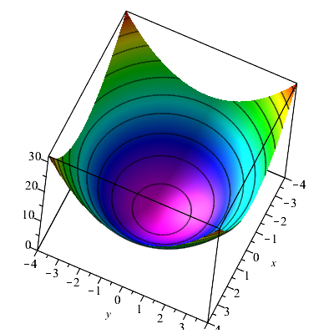
Consider a particle of mass m moving frictionlessly on a parabola z=c(x²+y²) under the influence of gravity. Find the equations of motion, particularly showing stable circular motion.

