Slide 1
PHY 711 Classical Mechanics and Mathematical Methods
10-10:50 AM MWF Olin 103
Plan for Lecture 1:
Welcome & overview
Class structure & announcements
Introduction to algebraic manipulation software – Maple and Mathematica
Start reading Chap. 1 for next time

Slide 2
Comment about Physics Colloquia
http://www.physics.wfu.edu

Slide 3
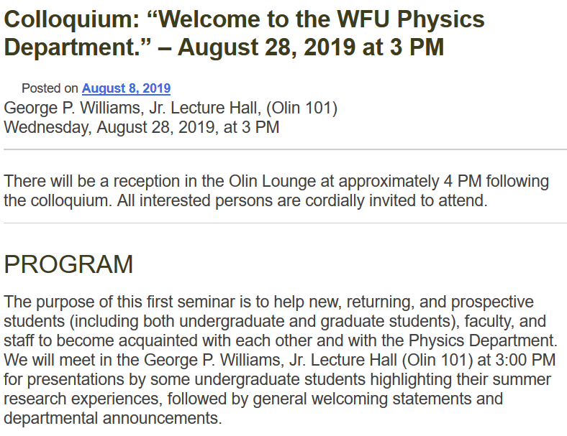

Slide 4
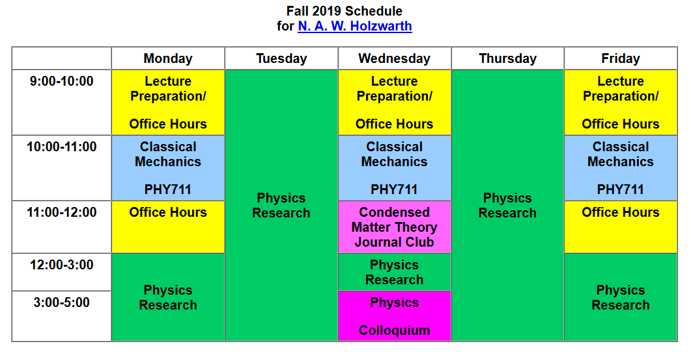
Course schedule and office hours
Please feel free to email me natalie@wfu.edu to set up an appointment outside of “official” office hours.
Office: Olin 300 Office Phone: 336-758-5510

Slide 5
Textbook:

Slide 6
Comment – Classical Mechanics is not Dead!
While the topic of classical mechanics was well established by 1920, it forms the foundation of modern investigations and its extensions can be found in many current research areas.
Examples:
Atomistic simulations of materials – “molecular dynamics”
Scattering theory/experiments
Rocket science
Limiting results of quantum mechanics

Slide 7
Topics
Classical Mechanics
Scattering theory
Accelerated reference frames
Calculus of variation
Lagrangian formalism
Hamiltonian formalism
Oscillations about equilibrium
Wave equations
Rigid rotation; moments of inertia
Physics of fluids
Sound waves in fluids and solids
Surface waves
Heat conduction
Viscous fluids
Elastic continua
Math Methods
Use of Maple and/or Mathematica
Solutions methods for differential equations
Green’s function methods
Special functions
Matrix properties; eigenvalues and eigenvectors
Fourier transforms
Laplace transforms
Contour integration

Slide 8
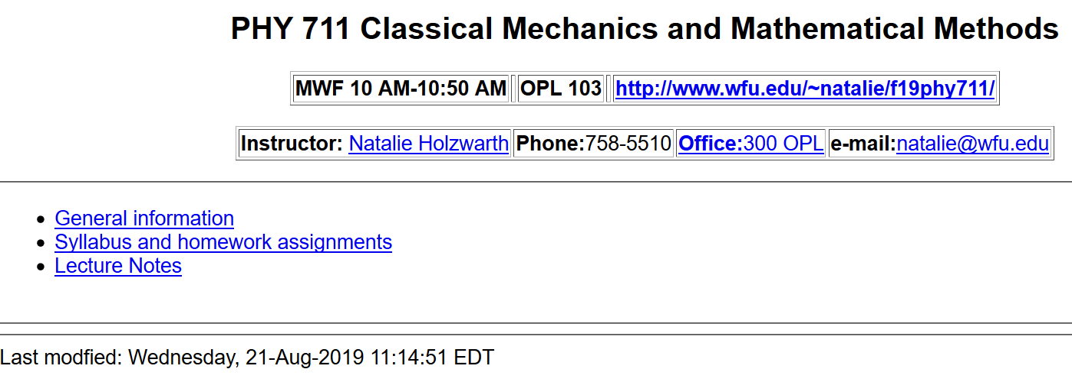
Course webpage https://users.wfu.edu/natalie/f19phy711

Slide 9
Course webpage:
http://www.wfu.edu/~natalie/f19phy711

Slide 10
Course webpage: http://www.wfu.edu/~natalie/f19phy711

Slide 11
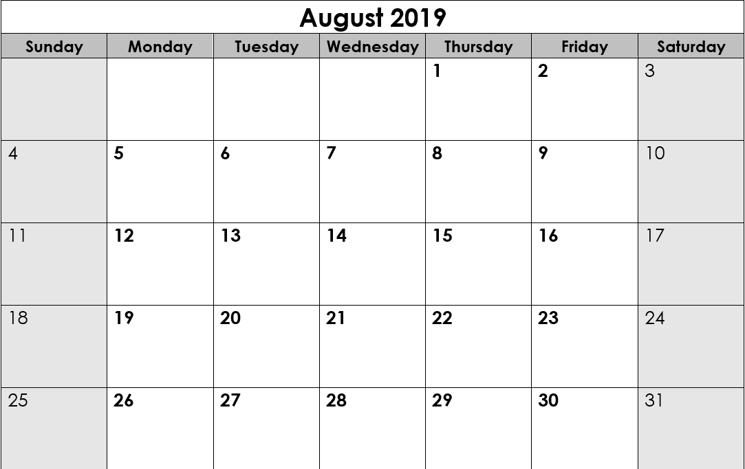
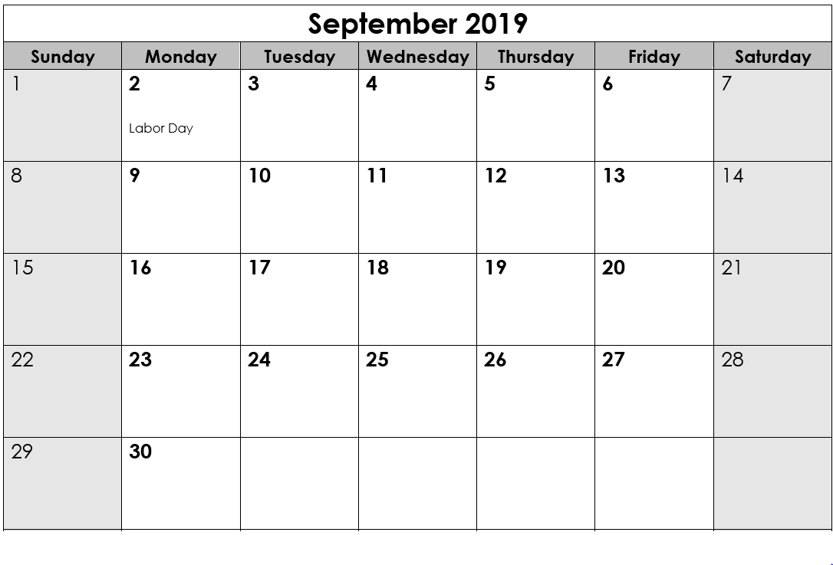
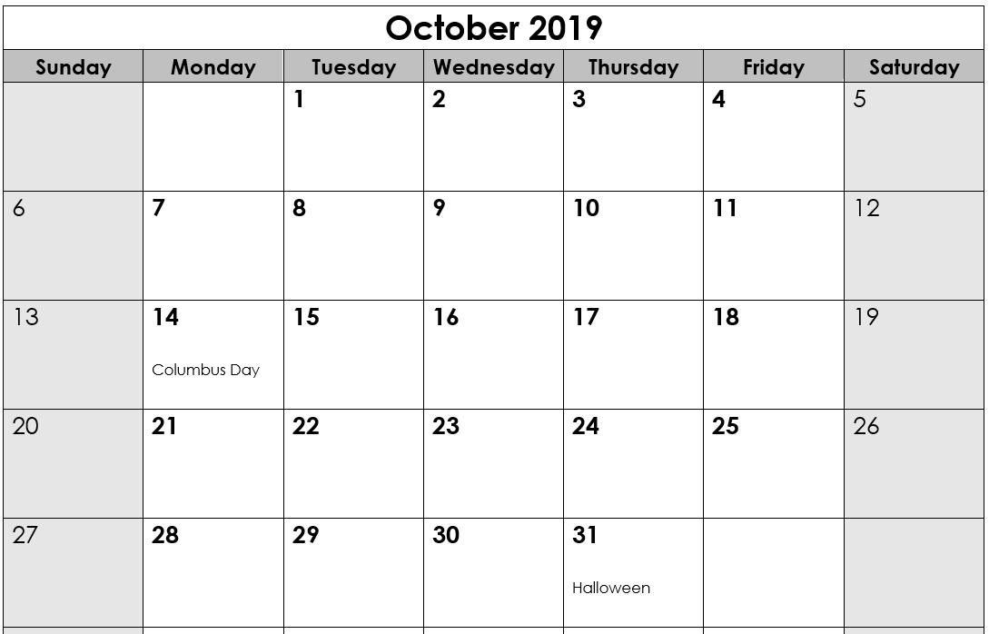
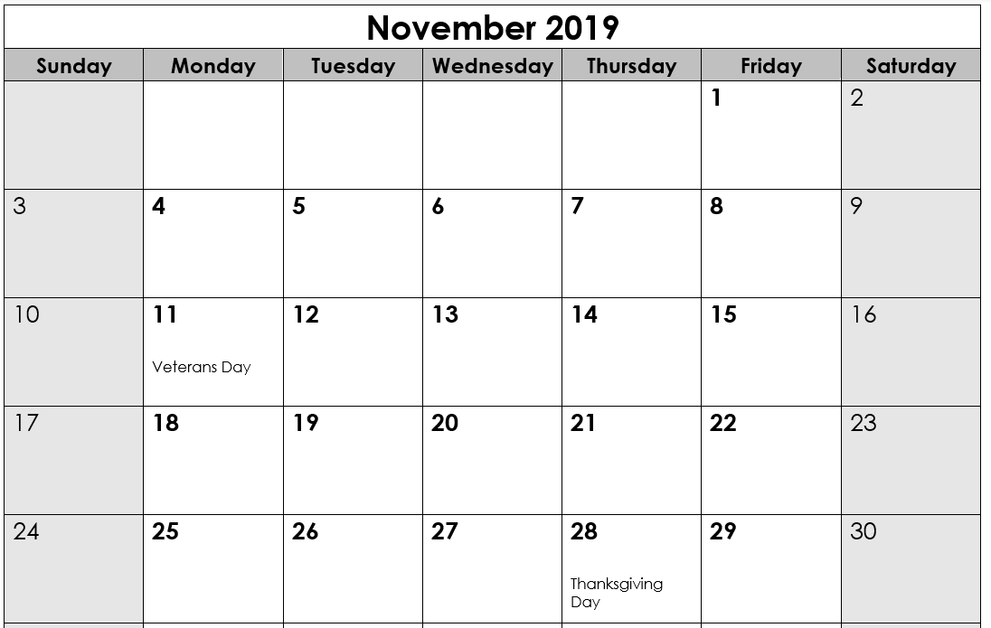
Looking ahead --
Fall break
Take home mid-term

Slide 12
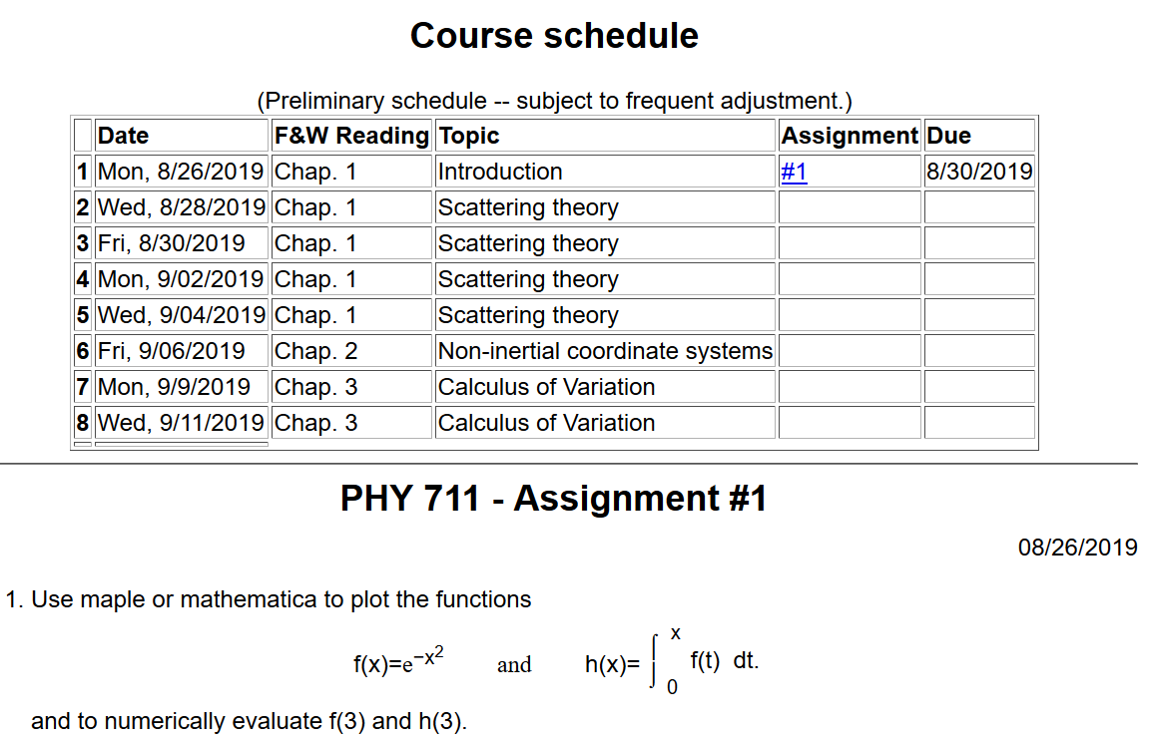
Course webpage: http://www.wfu.edu/~natalie/f19phy711/homework

Slide 13
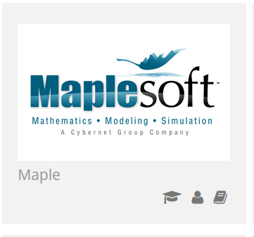
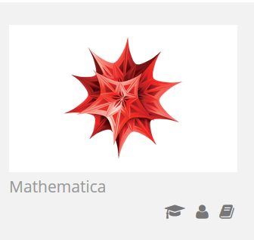
Comment on software useful for this course
https://software.wfu.edu/
Installation straightforward; takes a while ..
Please contact me or yipcw@wfu.edu if you have trouble.

Slide 14
Other possibilities –
http://www.wolframalpha.com/

Slide 16
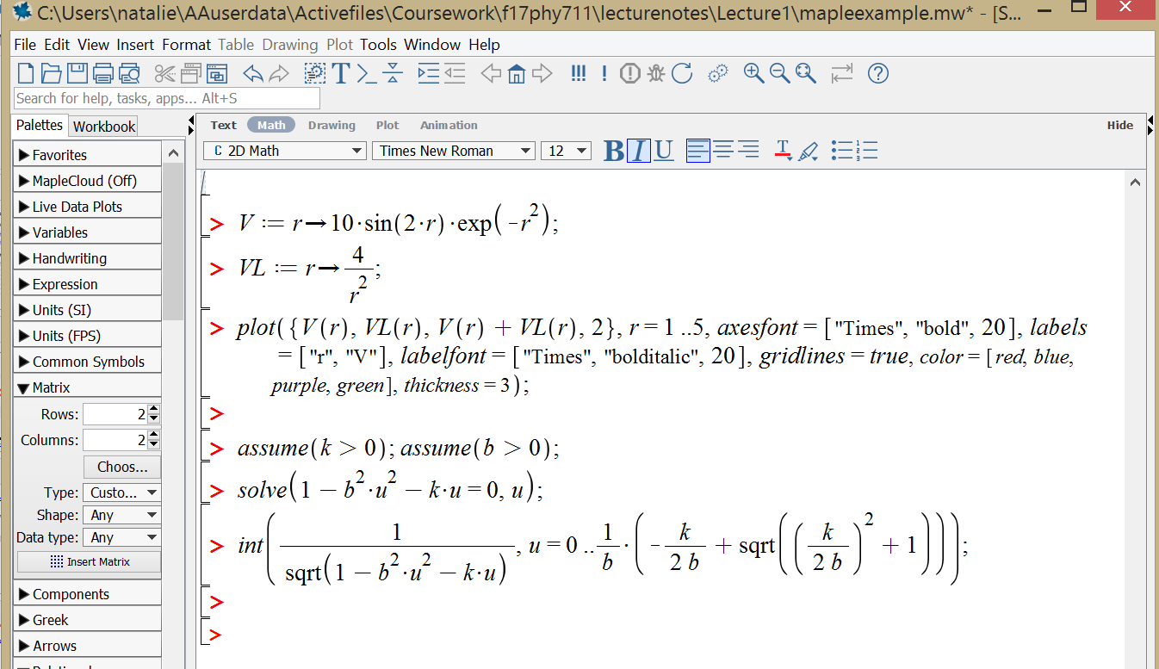
Example Maple file: mapleexample.mw

Slide 17
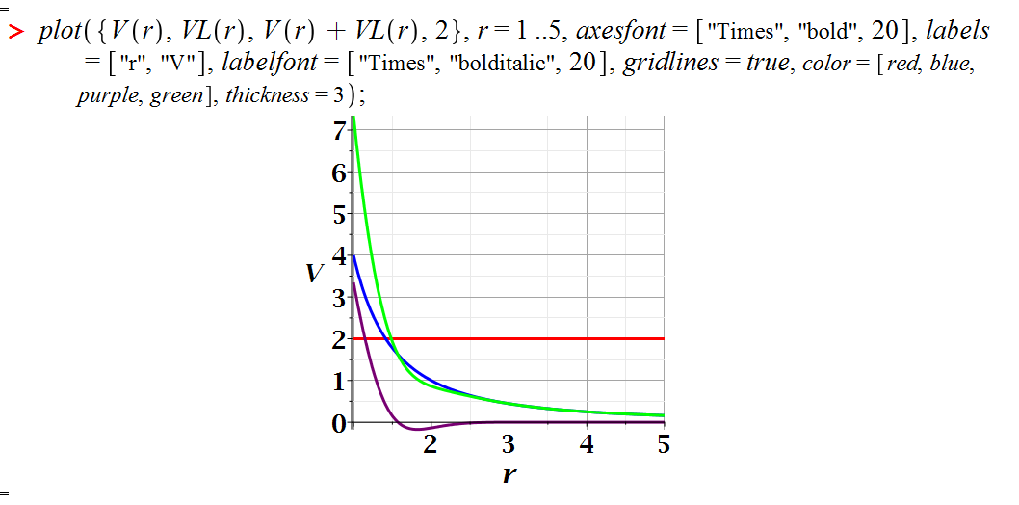
Maple exercise – continued:

Slide 18
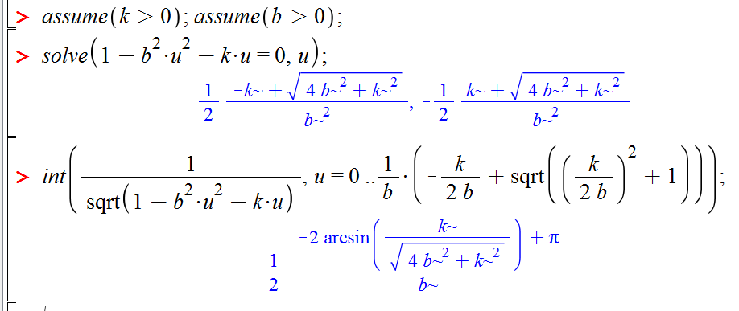
Maple exercise – continued:
Solving an algebraic equation and evaluating an integral:

Slide 19
Brief assessment exercise.

