Slide 1
PHY 711 Classical Mechanics and Mathematical Methods
10-10:50 AM MWF Olin 103
Plan for Lecture 10:
Continue reading Chapter 3 & 6
Constants of the motion
Conserved quantities
Legendre transformations

Slide 2
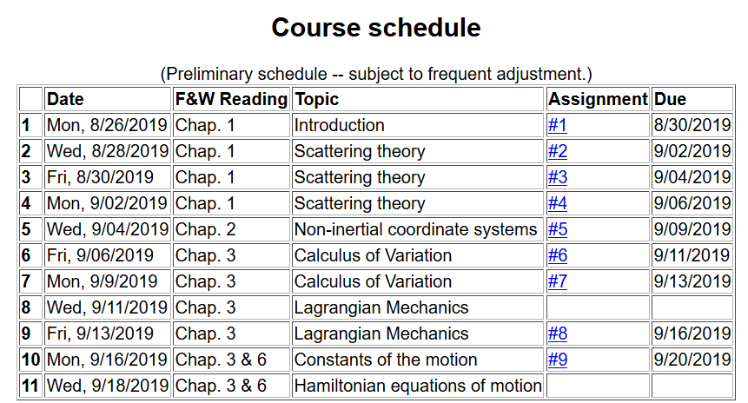

Slide 3
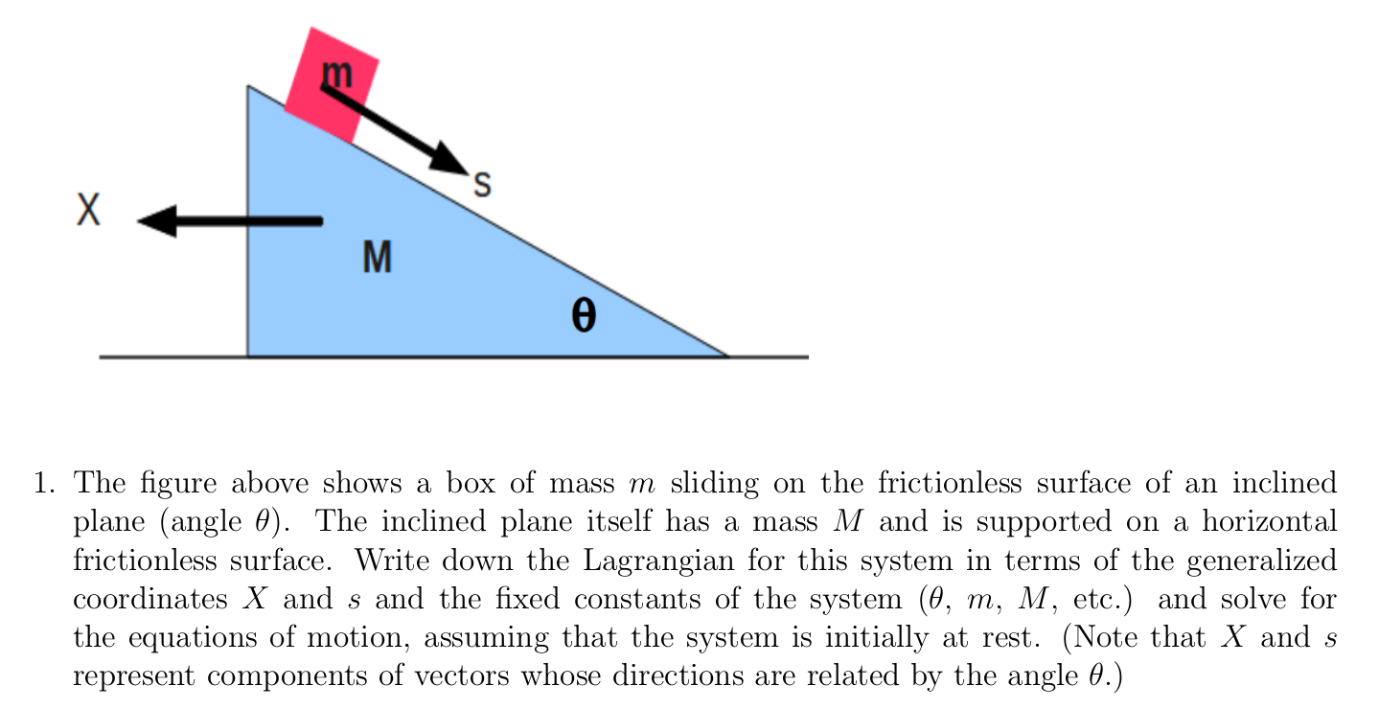
Homework #9

Slide 4
Summary of Lagrangian formalism (without constraints)

Slide 5
Examples of constants of the motion:

Slide 6
Examples of constants of the motion:

Slide 7
Recall alternative form of Euler-Lagrange equations:

Slide 8
Additional constant of the motion:

Slide 9
Additional constant of the motion -- continued:

Slide 10
Other examples

Slide 11
Other examples

Slide 12
Lagrangian picture
Switching variables – Legendre transformation

Slide 13
Mathematical transformations for continuous functions of several variables & Legendre transforms:
Simple change of variables:

Slide 14
Simple change of variables -- continued:

Slide 15
Simple change of variables -- continued:
?
?

Slide 16
Mathematical transformations for continuous functions of several variables & Legendre transforms continued:

Slide 17
For thermodynamic functions:

Slide 19
Lagrangian picture
Switching variables – Legendre transformation

Slide 20
Hamiltonian picture – continued

