Slide 1
PHY 711 Classical Mechanics and Mathematical Methods
10-10:50 AM MWF Olin 103
Plan for Lecture 13:
Finish reading Chapter 6
Virial theorem
Canonical transformations
Hamilton-Jacobi formalism

Slide 2
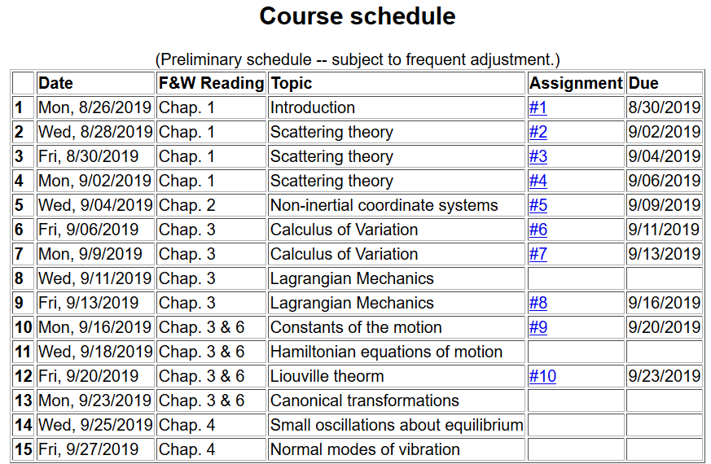

Slide 3
Virial theorem (Rudolf Clausius ~ 1870)
Note that this implies that the motion is bounded

Slide 4
Examples of the Virial Theorem

Slide 5
Examples of the Virial Theorem
centripetal acceleration
gravitational force

Slide 6
Hamiltonian formalism and the canonical equations of motion:

Slide 7
Notion of “Canonical” generalized coordinate transformations

Slide 8
Some details --

Slide 9
Some relations between old and new variables:

Slide 11
Note that it is conceivable that if we were extraordinarily clever, we could find all of the constants of the motion!
Possible solution – Hamilton-Jacobi theory:

Slide 13
0
0
0

Slide 14
0
0
0

Slide 15
Differential equation for S:

Slide 16
Continued:

Slide 17
Continued:

Slide 18
Another example of Hamilton Jacobi equations

Slide 20
Check action:

Slide 21
Recap --
Lagrangian picture
Hamiltonian picture

Slide 23
Recipe for constructing the Hamiltonian and analyzing the equations of motion

