Slide 1
PHY 711 Classical Mechanics and Mathematical Methods
10-10:50 AM MWF Olin 103
Plan for Lecture 14:
    Start reading Chapter 4
      Small oscillations about equilibrium
      Normal modes

Slide 2
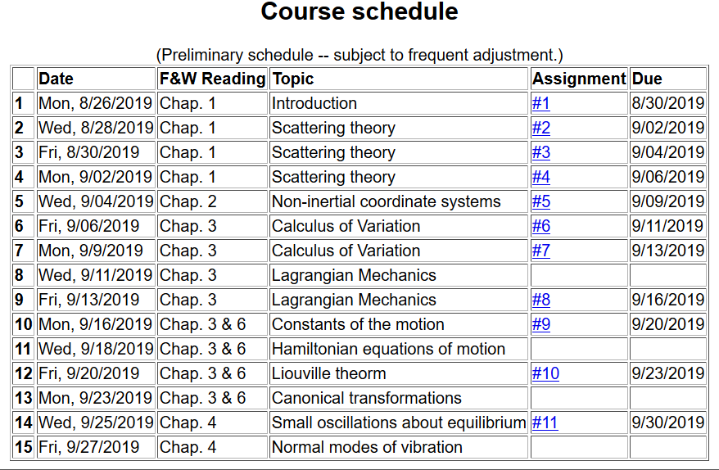

Slide 3
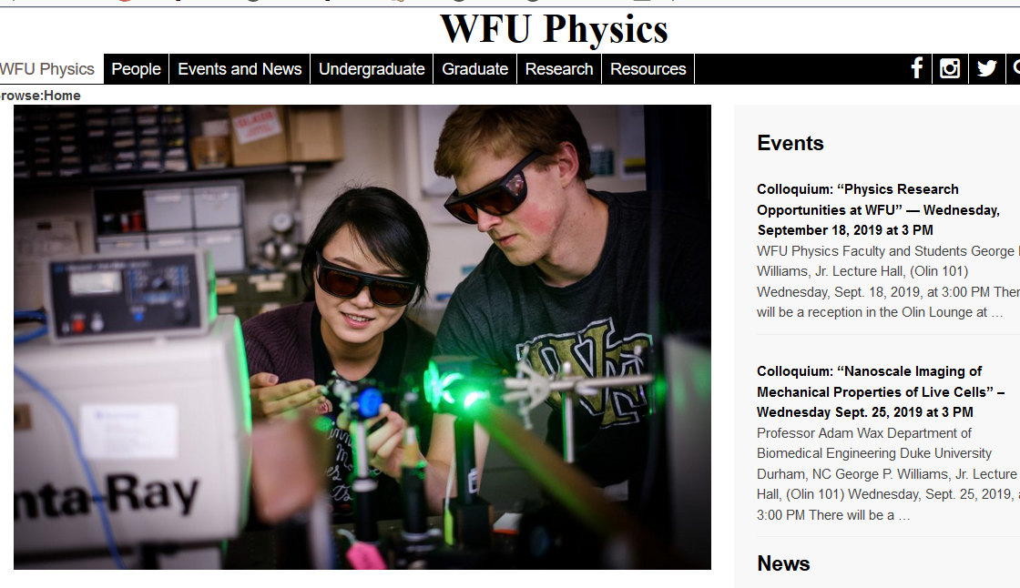

Slide 4
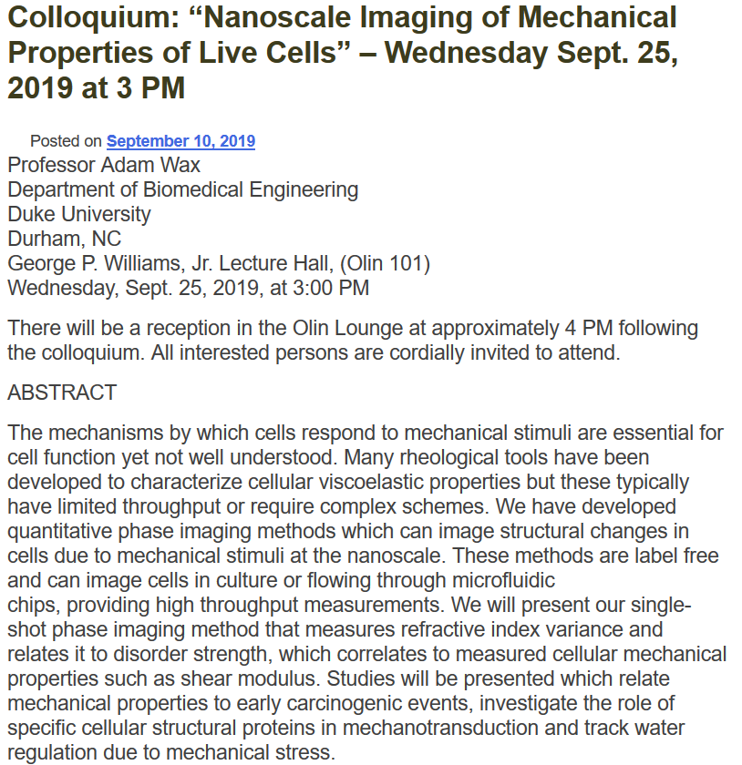

Slide 5
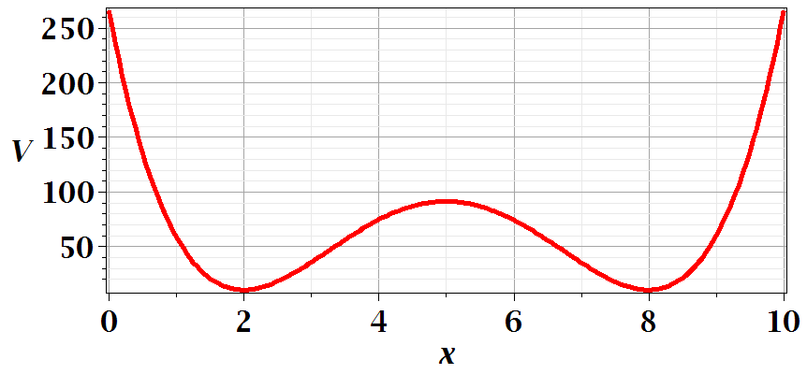
Motivation for studying small oscillations – many interacting systems have stable and meta-stable configurations which are well approximated by:

Slide 7
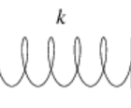
Example – linear molecule
m₁
m₂
m₃

Slide 12
Digression:

Slide 13
Digression on matrices -- continued
Eigenvalues of a matrix are “invariant” under a similarity transformation

Slide 14
Example of transformation:

Slide 17
m₁
m₂
m₃
m₁
m₂
m₃
m₁
m₂
m₃

Slide 19
Additional digression on matrix properties
Singular value decomposition

Slide 20
Singular value decomposition -- continued

Slide 21
Consider an extended system of masses and springs:
m
m
m

Slide 23
Can solve as an eigenvalue problem --

Slide 24
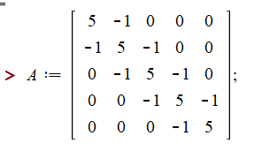
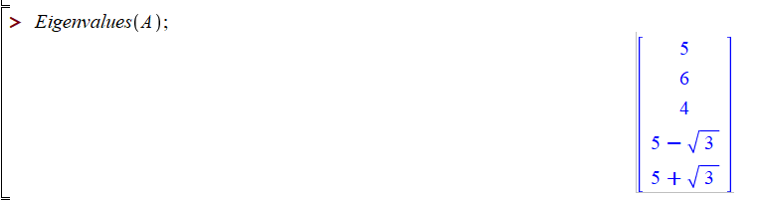

Slide 25
This example also has an algebraic solution --

Slide 28
