Slide 1
PHY 711 Classical Mechanics and Mathematical Methods
10-10:50 AM MWF Olin 103
Plan for Lecture 15:
Continue reading Chapter 4
Normal modes for extended one-dimensional systems
Normal modes for 2 and 3 dimensional systems

Slide 2
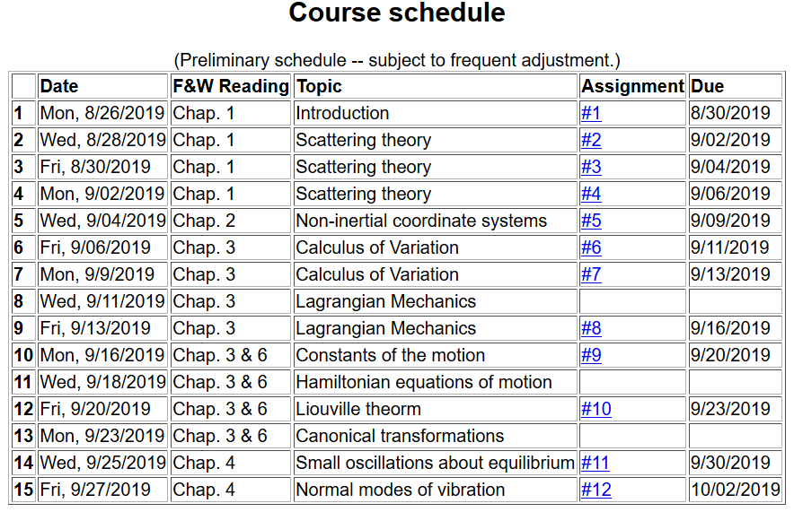

Slide 3
Example – linear molecule
m₁
m₂
m₃

Slide 5
m₁
m₂
m₃
m₁
m₂
m₃
m₁
m₂
m₃

Slide 6
Consider an extended system of masses and springs:
m
m
m

Slide 12
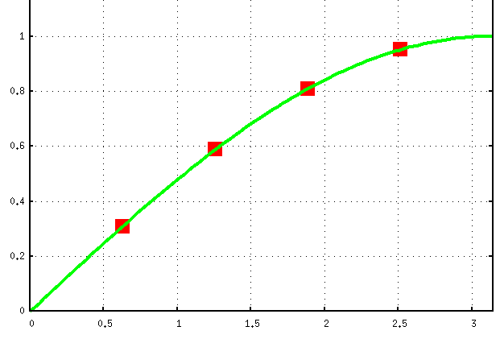
Example for N=4:
Note that solution form remains correct for N→∞

Slide 13
For extended chain without boundaries:
m
m
…
…
m

Slide 14
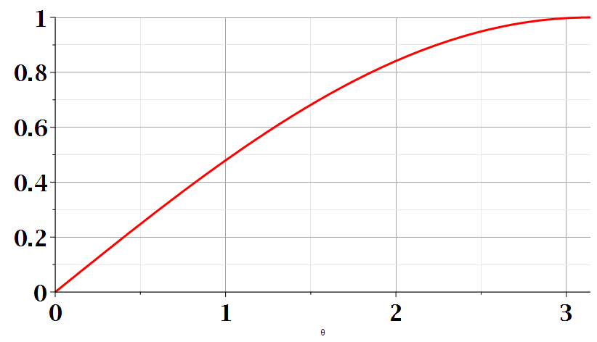

Slide 15
Consider an infinite system of masses and springs now with two kinds of masses:
m
M
m
M
m
m

Slide 17
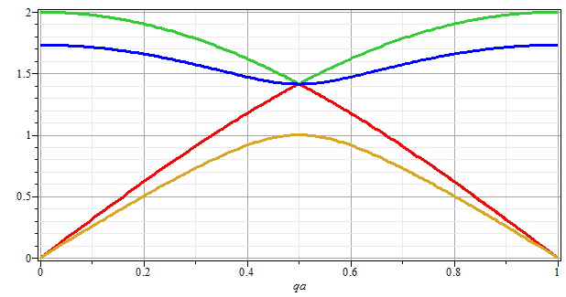
ω
qa/π

Slide 18
Eigenvectors:

Slide 19
Potential in 2 and more dimensions
V(x,y)

Slide 20
Example – normal modes of a system with the symmetry of an equilateral triangle
3
u₃
m
k
k
u₂
1
2
u₁
k
m
m

Slide 21
Example – normal modes of a system with the symmetry of an equilateral triangle -- continued
3
u₃
u₂
1
2
u₁

Slide 22
Example – normal modes of a system with the symmetry of an equilateral triangle -- continued

Slide 23
Example – normal modes of a system with the symmetry of an equilateral triangle -- continued
= ω²

Slide 24
Example – normal modes of a system with the symmetry of an equilateral triangle -- continued
3
u₃
m
k
k
u₂
1
2
u₁
k
m
m

Slide 25
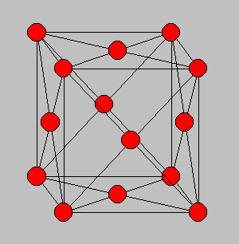
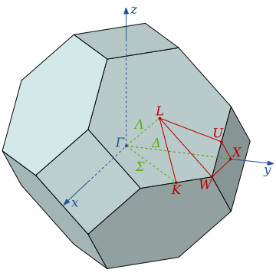
3-dimensional periodic lattices
Example – face-centered-cubic unit cell (Al or Ni)
Diagram of atom positions
Diagram of q-space ν(q)

Slide 26
From: PRB 59 3395 (1999); Mishin et. al. ν(q)

Slide 27
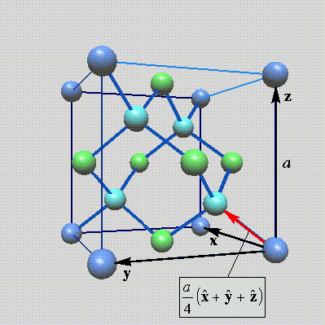
Lattice vibrations for 3-dimensional lattice
Example: diamond lattice
Ref: http://phycomp.technion.ac.il/~nika/diamond_structure.html

Slide 31
B. P. Pandy and B. Dayal, J. Phys. C. Solid State Phys. 6 2943 (1973)

