Slide 1
PHY 711 Classical Mechanics and Mathematical Methods
10-10:50 AM MWF Olin 103
Plan for Lecture 16:
    Start reading Chapter 7
      Comments on linear vs. non-linear equations
      Masses coupled by springs ⬅➔masses coupled by string
      Mechanics one-dimensional continuous system
      The wave equation

Slide 2
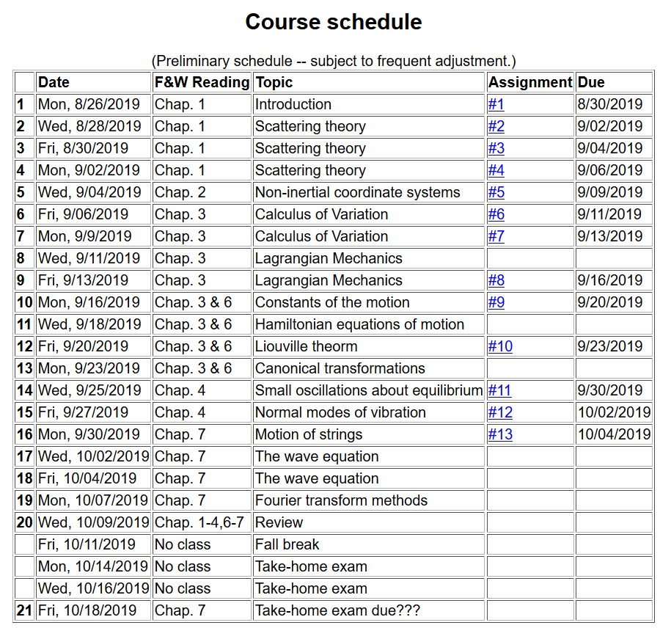

Slide 5
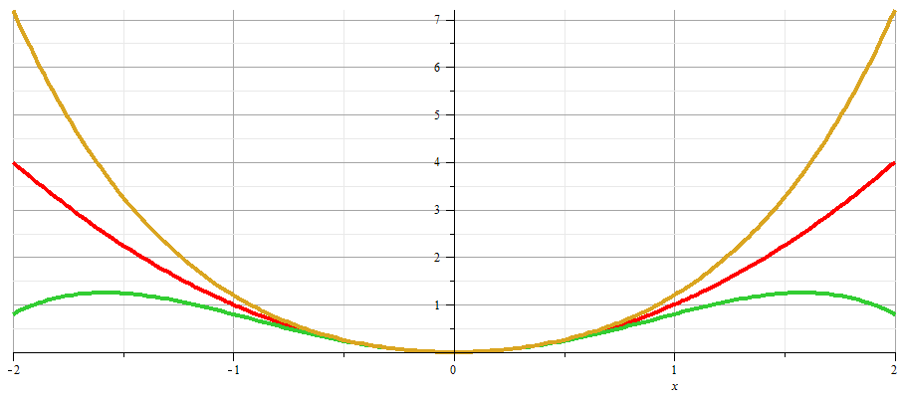
x

Slide 9
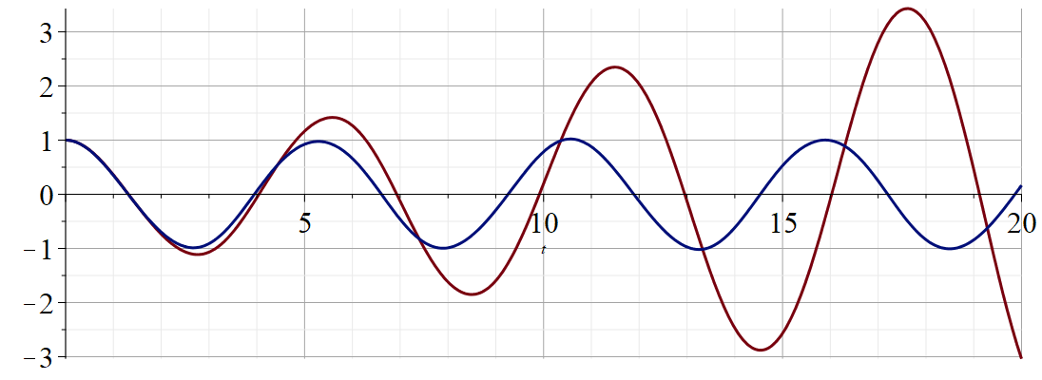
Regrouped expansion
x
t
Original perturbation expansion

Slide 10
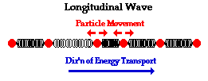
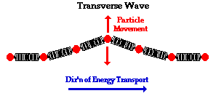
Returning to linear case; continuum limit --
Longitudinal versus transverse vibrations
Images from web page:
http://www.physicsclassroom.com/class/waves/u10l1c.cfm

Slide 11
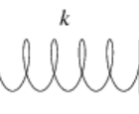
Longitudinal case: a system of masses and springs:
m
m
m

Slide 12
system parameter with units of (velocity)²

Slide 13
Transverse displacement:
τ
μ(x,t)

Slide 19
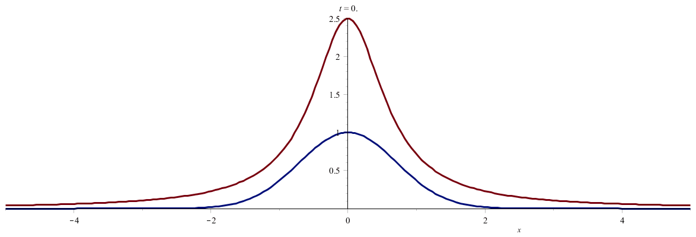

Slide 20
