Slide 1
PHY 711 Classical Mechanics and Mathematical Methods
10-10:50 AM MWF Olin 103
Plan for Lecture 19:
Read Chapter 7 & Appendices A-D
Generalization of the one dimensional wave equation ➔ various mathematical problems and techniques including:
Orthogonal function expansions
Fourier series
Fourier transforms
Fast Fourier transforms

Slide 2
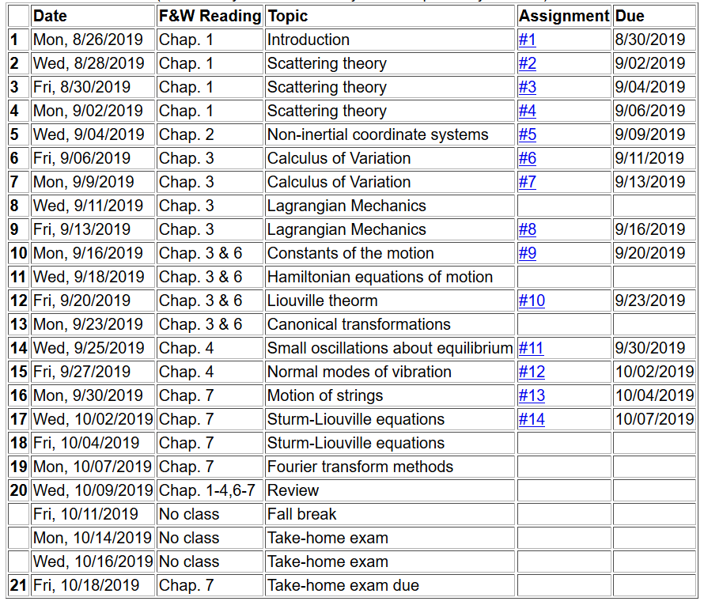

Slide 3
Eigenvalues and eigenfunctions of Sturm-Liouville equations

Slide 5
Example
x

Slide 6
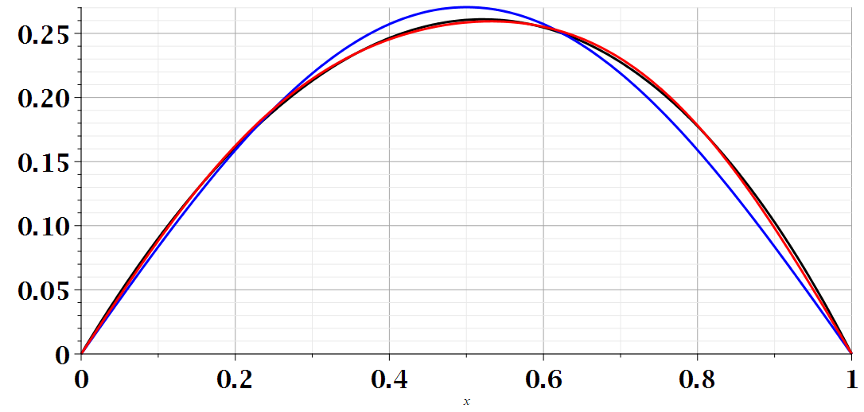
Example
x

Slide 7
Note that this analysis can also apply to time dependent functions. In the remainder of the lecture, we will consider time dependent functions.

Slide 8
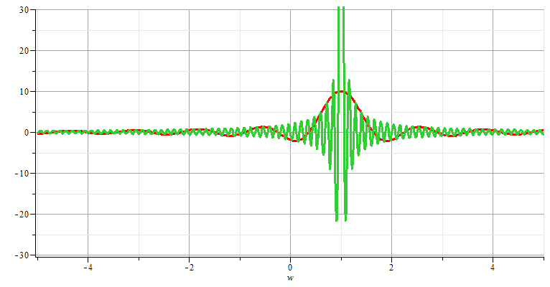
Generalization to infinite range -- Fourier transforms

Slide 9
Note: The location of the 2π factor varies among texts.

Slide 10
Note that for an infinite time range, the Fourier transform is continuous in both time and frequency.

Slide 11
Use of Fourier transforms to solve wave equation

Slide 12
Use of Fourier transforms to solve wave equation -- continued
Note that at this point, we do not know the coefficients A_{n}; however, it clear that the solutions are consistent with D’Alembert’s analysis of the wave equation.

Slide 16
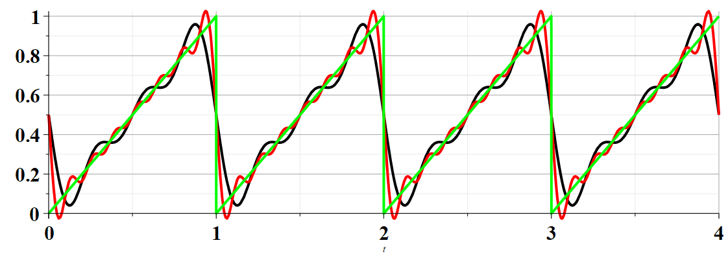
Example:

Slide 17
Summary –
Find discrete frequencies ω for functions f(t) over finite time domain of for functions f(t) which are periodic: f(t)=f(t+nT)
➔Numerically, there is an advantage of tabulating double discrete Fourier transforms (discrete in ω and in t).

Slide 18
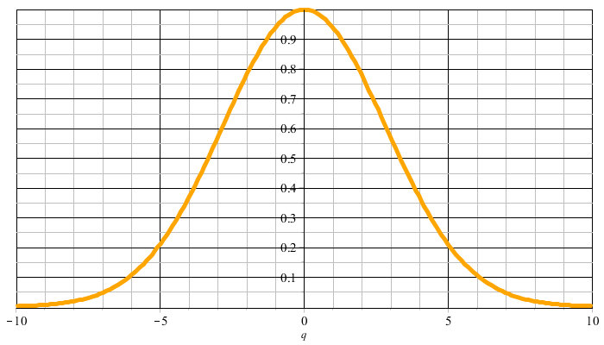
Example:
f(t)
t
F(νΩ)
νΩ

Slide 19
F(νΩ)
νΩ
ν=M
νΩ
ν=-M

Slide 20
Constructed frequency periodic function --

Slide 22
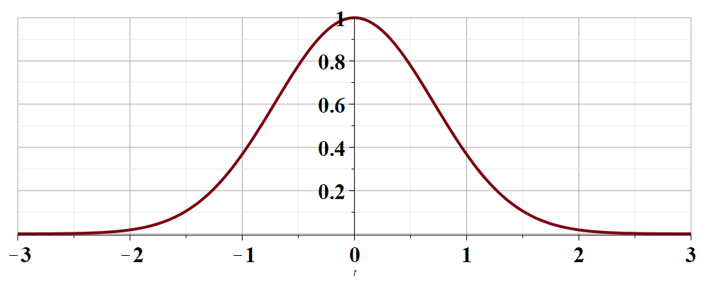
t →

Slide 25
Cooley-Tukey algorithm: J. W. Cooley and J. W. Tukey, “An algorithm for machine calculation of complex Fourier series” Math. Computation 19, 297-301 (1965)

Slide 26
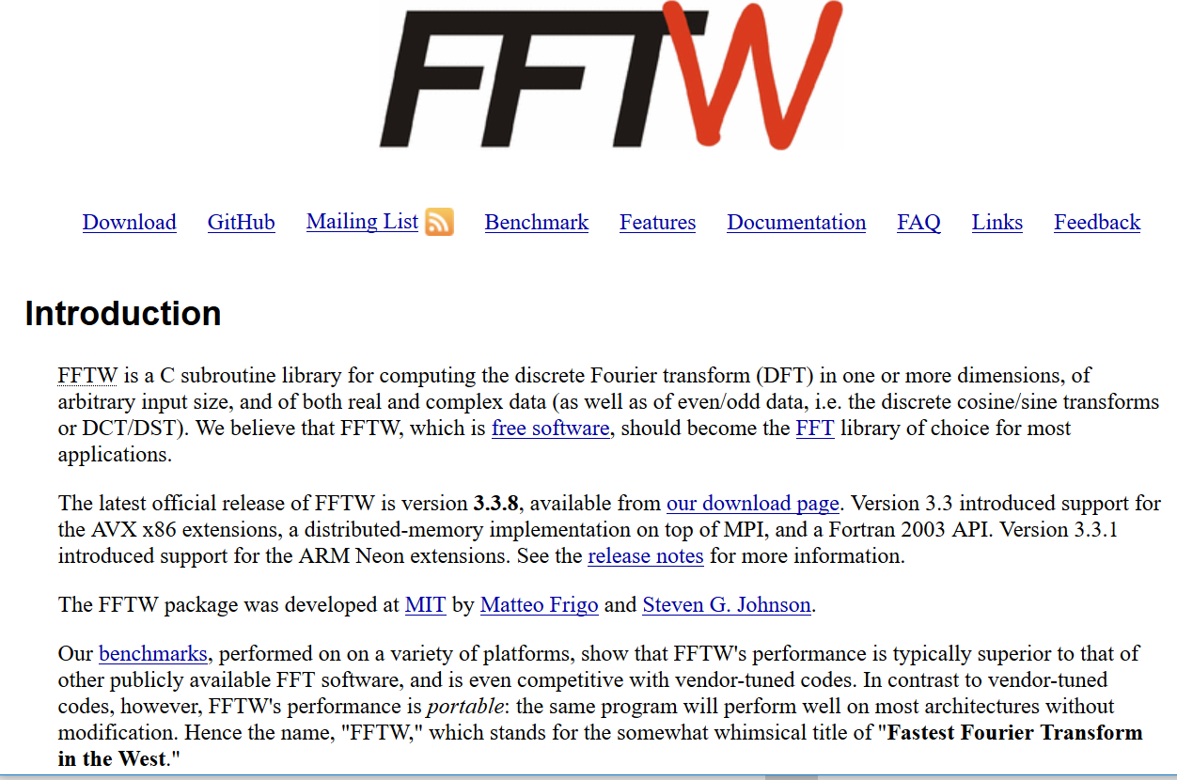
http://www.fftw.org/

