Slide 1
PHY 711 Classical Mechanics and Mathematical Methods
10-10:50 AM MWF Olin 103
Plan for Lecture 2: -- Chap. 1 of FW
Brief comment on quiz
Introduction to scattering theory
Example of scattering of hard spheres
General particle interactions
Laboratory and center of mass reference fame

Slide 2
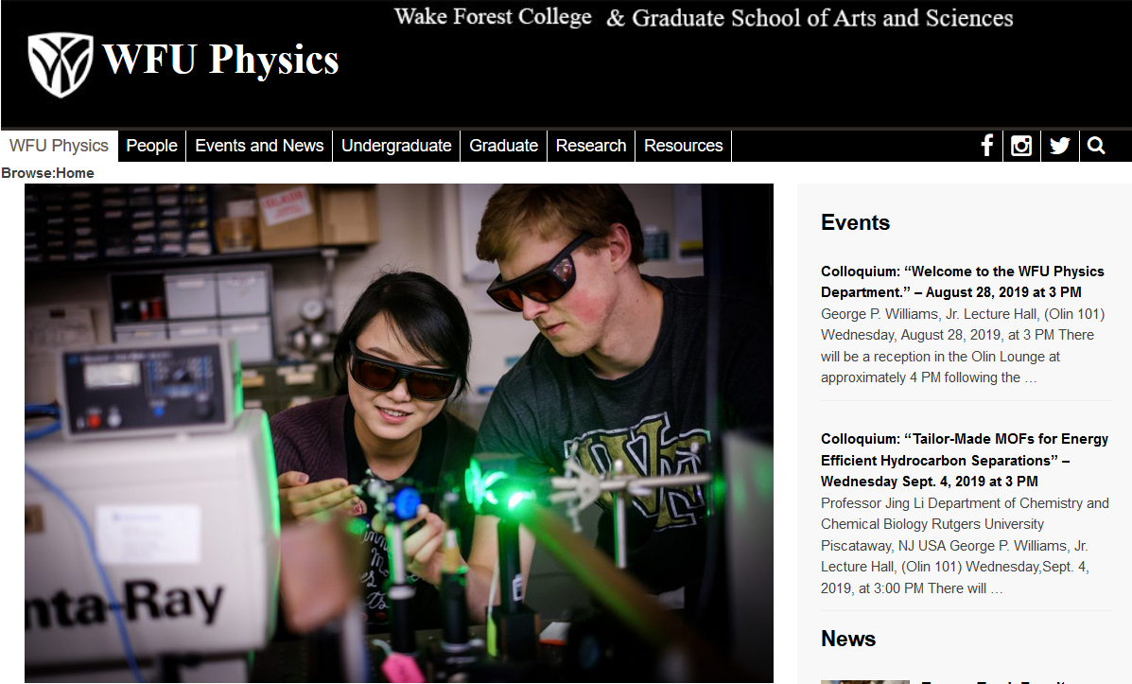
Comment about Physics Colloquia
http://www.physics.wfu.edu

Slide 3
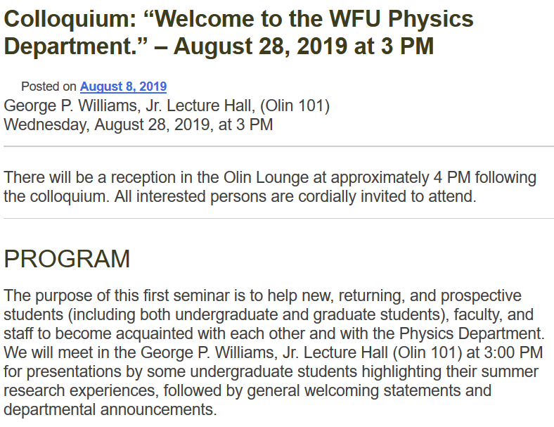

Slide 4
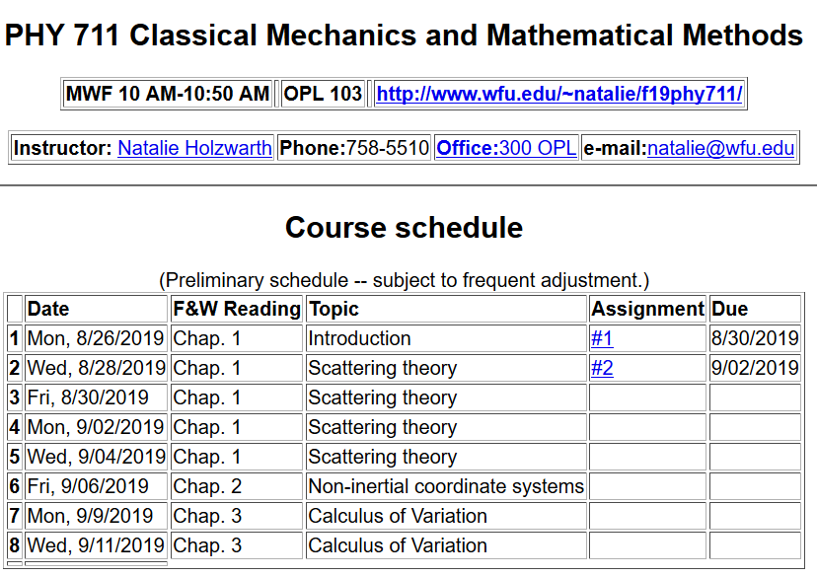

Slide 6
Comment on quiz questions
1.
3.

Slide 7
Scattering theory:
detector

Slide 8
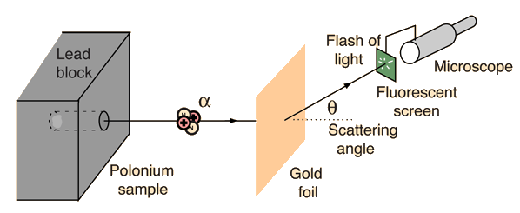
Example: Diagram of Rutherford scattering experiment
http://hyperphysics.phy-astr.gsu.edu/hbase/rutsca.html

Slide 9
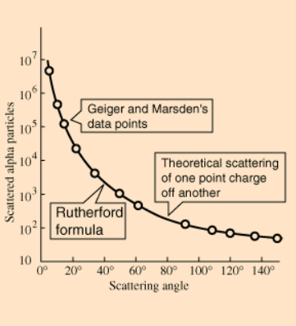
Graph of data from scattering experiment
From website: http://hyperphysics.phy-astr.gsu.edu/hbase/Nuclear/rutsca2.html

Slide 10
Standardization of scattering experiments --
Impact parameter: b
b
Figure from Marion & Thorton, Classical Dynamics

Slide 11
Note: The notion of cross section is common to many areas of physics including classical mechanics, quantum mechanics, optics, etc. Only in the classical mechanics can we calculate it from a knowledge of the particle trajectory as it relates to the scattering geometry.
b
Figure from Marion & Thorton, Classical Dynamics
Note: We are assuming that the process is isotropic in ϕ

Slide 12
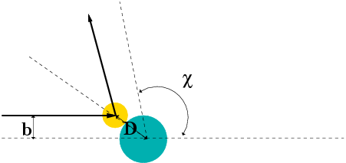
Simple example – collision of hard spheres having mutual radius D; very large target mass
Microscopic view:

Slide 13
Simple example – collision of hard spheres -- continued
Hard sphere:

Slide 14
More details of hard sphere scattering –
Hidden in the analysis are assumptions about the scattering process such as:
No external forces ➔ linear momentum is conserved
No dissipative phenomena ➔ energy is conserved
No torque on the system ➔ angular momentum is conserved
Target particle is much more massive than scattering particle
Other assumptions??

Slide 15
More general treatment of hard sphere scattering
v
mass m
u
α
β
θ
α
mass M
R
V

Slide 16
Continued treatment of hard sphere scattering
v
u
α
β
θ
α
R
V

Slide 17
Continued treatment of hard sphere scattering
v
β
u
α
θ
α
R
V

Slide 18
Continued treatment of hard sphere scattering
v
u
α
β
θ
α
R
V

Slide 19
Relationship of scattering cross-section to particle interactions --
Classical mechanics of a conservative 2-particle system.
1
2

Slide 20
Typical two-particle interactions –

