Slide 1
PHY 711 Classical Mechanics and Mathematical Methods
10-10:50 AM MWF Olin 103
Plan for Lecture 20:
Review Chapters 1-4,6,7
Scattering theory & Rotation reference frames
Calculus of variation
Lagrangian and Hamiltonian formalisms
Normal modes of vibration
The wave equation
Sturm-Liouville equation

Slide 2
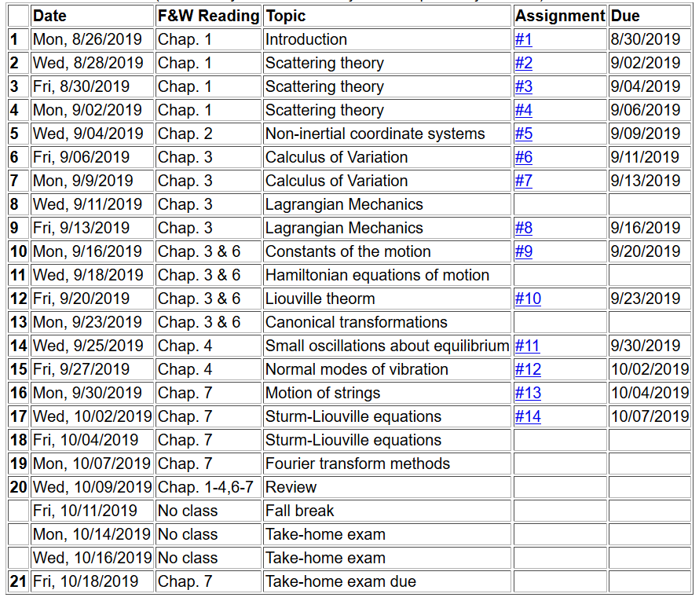

Slide 3
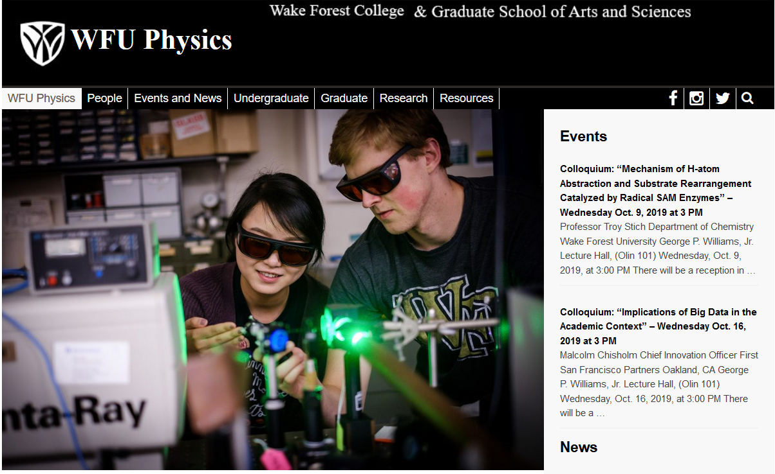

Slide 4
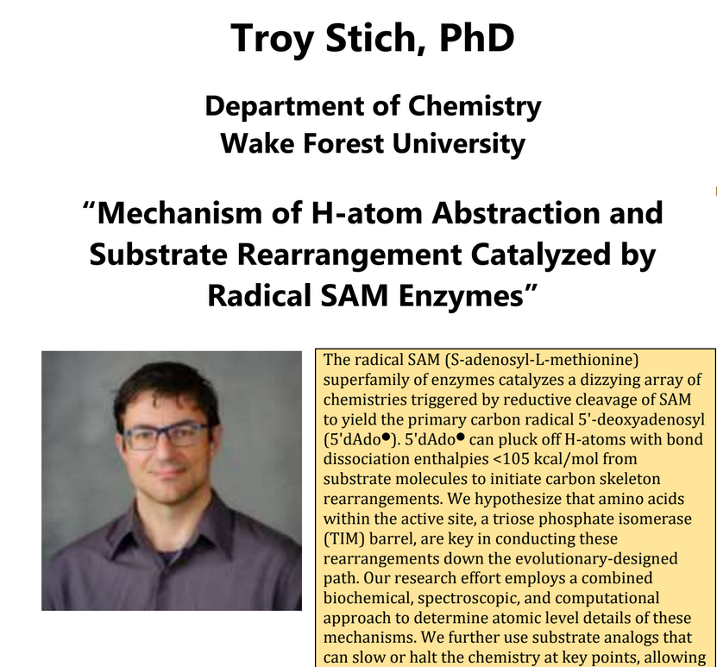
3 PM Olin 101

Slide 5
Scattering theory
detector

Slide 6
b
Figure from Marion & Thorton, Classical Dynamics

Slide 7
Relationship of scattering cross-section to particle interactions --
Classical mechanics of a conservative 2-particle system.
1
2

Slide 8
Relationship between center of mass and laboratory frames of reference

Slide 9
Relationship between center of mass and laboratory frames of reference – continued (elastic scattering)
V_{CM}
V₁
v₁
ψ
θ

Slide 10
Differential cross sections in different reference frames – continued:

Slide 11
Calculation of elastic scattering cross section in the center of mass frame of reference for central potential V(r)
Conserved energy in CM frame
Distance of closest approach

Slide 12
Application of Newton’s laws in a coordinate system which has an angular velocity and linear acceleration
Newton’s laws; Let r denote the position of particle of mass m:
Centrifugal
force
Coriolis
force

Slide 13
Calculus of variation example for a pure integral functions

Slide 14
Alternate Euler-Lagrange equation

Slide 15
Application to particle dynamics

Slide 16
Potential energy
Kinetic energy

Slide 18
Recipe for constructing the Hamiltonian and analyzing the equations of motion

Slide 19
Liouville’s theorem:
Imagine a collection of particles obeying the Canonical equations of motion in phase space.
In statistical mechanics, we need to evaluate the probability of various configurations of particles. The fact that the density of particles in phase space is constant in time, implies that each point in phase space is equally probable and that the time average of the evolution of a system can be determined by an average of the system over phase space volume.

Slide 20
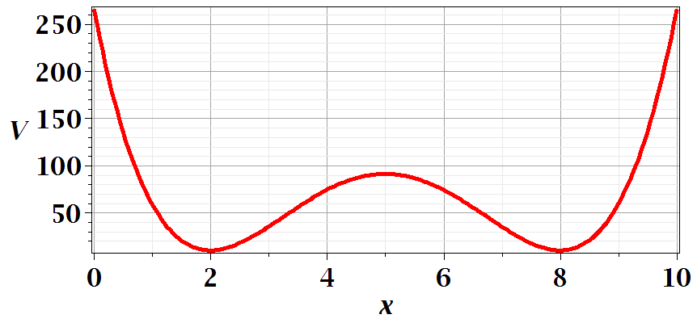
Motivation for studying small oscillations – many interacting systems have stable and meta-stable configurations which are well approximated by:

Slide 21
Example – linear molecule
m₁
m₂
m₃

Slide 23
m₁
m₂
m₃
m₁
m₂
m₃
m₁
m₂
m₃

Slide 25
Digression:

Slide 26
Digression on matrices -- continued
Eigenvalues of a matrix are “invariant” under a similarity transformation

Slide 27
Additional digression on matrix properties
Singular value decomposition

Slide 28
Singular value decomposition -- continued

Slide 29
Longitudinal case: a system of masses and springs:
m
m
m

Slide 30
system parameter with units of (velocity)²

Slide 33
